Slide 1
The 24 CFR Part 58 environmental review process, including new CoC program environmental review requirements
Instructor: David Nuccio, WI and MN FEO
(414) 935-6690
david.a.nuccio@hud.gov

Slide 2
What is an Environmental Review (ER)?
A Due Diligence process of your project, site and the surrounding environment to analyze and/or mitigate any impacts to your property, the environment, and for the well-being of occupants
Requires documentation from verifiable and traceable sources of information for compliance with the related Federal laws and authorities under § 58.5 and § 58.6, and NEPA where applicable
Encourages public participation and proper notification
Requires that an Environmental Review Record (ERR) be created to capture the entire ER process, including HUD’s RROF requirements
Notes:
An ERR (Env Review Record) is a record of your entire ER process which includes but is not limited too: all applicable ER checklists or forms which includes a clear project description, delineation of all activities involved, and verifiable source documentation for compliance with all applicable laws under Sections 58.5 and 58.6, and your entire RROF process.
Your ERR can be part of your project file or made separate

Slide 3
HUD’s Environmental Regulations
24 CFR Part 58: Environmental Review requirements written for Units of General Local Government (“Responsible Entities”/PJ’s”)
24 CFR Part 55: Regulations that pertain to the protection of floodplains and wetlands
24 CFR Part 51: Regulations that pertain to Noise abatement and control, Explosive and Flammable ASTs, and Airport/Airfield Runway Clear Zones
24 CFR Part 35: The LSHR (Lead based paint)
24 CFR Part 50: Environmental Review requirements written for HUD staff primarily pertaining to activities not delineated under § 58.1
Notes:
Descending order

Slide 4
The various types of Environmental Reviews

Slide 5
Exempt level activities (do not require an ER or RROF)
As listed under § 58.34 (a)
Environmental, planning & design costs
Information and financial services
Administrative and mgmt activities
Public services (w/no physical impacts)
Inspections
Purchase of tools and insurance
Technical assistance and training
Payment of principal and interest
Temporary assistance for disaster or imminent threats
5
Notes:
But still document via HUD’s Exemption forms found on HUD’s Resource Exchange website accordingly

Slide 6
CENST (~ Exempt) level activities (also, do not require an ER or RROF)
As listed under § 58.35 (b):
Tenant-based rental assistance (TBRA)
Supportive Services (healthcare, housing placement)
Operating costs (utilities, supplies)
Managing a HMIS
Economic development costs (non-construction)
Pre-development costs
Maintenance
Supplemental Assistance
6
Notes:
Obligate, commit or expend funds w/out any further review or approval from HUD
TBRA projects where the program participant independently selected the location of their unit
Supportive services ONLY
Operating costs that are not used as a reserve for replacement costs ONLY
HMIS (Homeless Mgmt Info System) costs, not including leasing office space, ONLY

Slide 7
CEST Activities (do require an ER, and RROF unless project converts to Exempt)
Common CEST activities under § 58.35 (a):
Minor rehabilitation, improvements or repairs to SF/MF structures
New construction, reconstruction and demo pertaining to < 4 units
Acquisition and disposition of property
Leasing, SBRA and PBRA
CEST activities will require application of either HUD’s “Statutory Checklist” or the “Limited Scope Review” (LSR) ER form
7
Notes:
CEST= Exemptions and Categorically Excluded Not Subject to

Slide 8
Conversion to Exempt Flowchart
No circumstances that require compliance with § 58.5 laws and authorities
No circumstances that require compliance with § 58.6 other requirements
Project converts to Exempt
CEST Activities ONLY
8
Notes:
For CEST projects only, if you find that there were no circumstances that require compliance with any of the related Federal laws and authorities under 58.5 and 58.6, you are permitted by HUD to convert the project to Exempt. When a project converts to Exempt, this in turn exempts you from the NOI-RROF/FONSI public notification and RROF certification process. Simply record your determination on your ER form or checklist and place in your ERR, you can then obligate and expend funds accordingly.

Slide 9
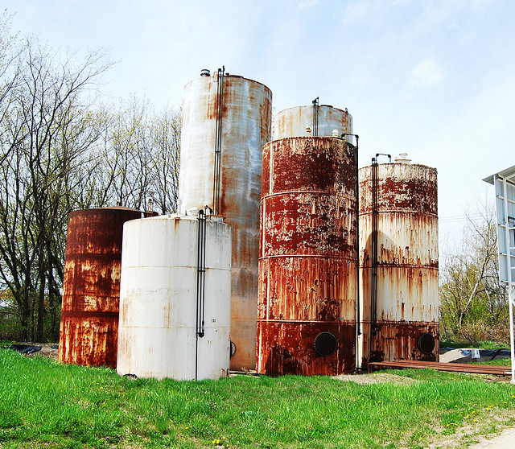
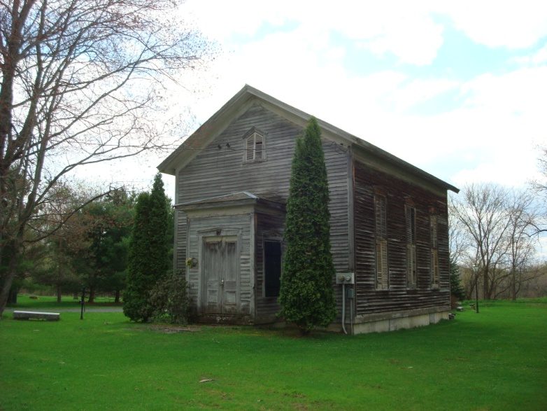
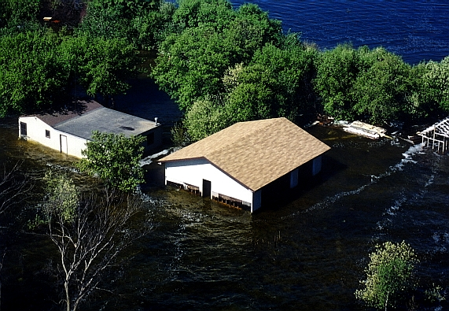
Apply HUD’s Statutory Checklist for CEST activities that addresses the following laws under § 58.5 and § 58.6:
Air quality
Coastal Zones
Toxics/site contamination
Endangered Species
Environmental Justice
Explosive and Flammable Hazards
Farmlands
Floodplains
Historic Preservation
Noise
Sole Source Aquifers
Wetlands
Wild and Scenic Rivers
National Flood Insurance requirements
Coastal Barriers
9
Notes:
Apply to all CEST activities as listed under Section 58.35 (a) with exception to Leasing and S/PBRA activities under the Continuum of Care (CoC) program
Find the Stat Checklist on HUD Exchange website

Slide 10
The LSR form addresses only the following laws under § 58.5 and § 58.6 for specific CEST activities:
Coastal Barriers
Toxics/Site Contamination
Floodplains
Flood Insurance
Notes:
Limited Scope Review

Slide 11
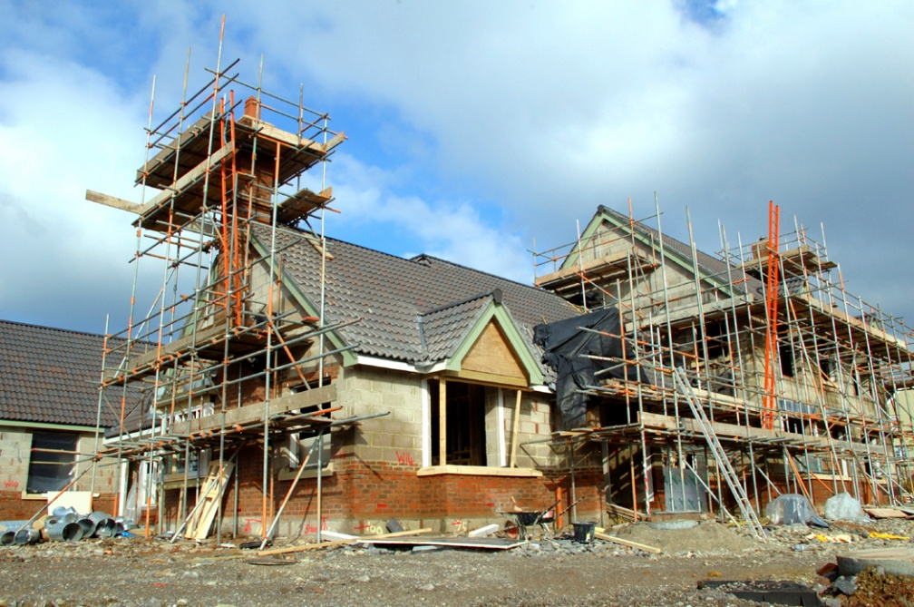
Environmental Assessment (EA) level activities (does require an ER)
The ER process for larger scale projects per § 58.36:
Major rehabilitation of SF or MF units (exceeding § 58.35 (a) threshold levels)
New construction, reconstruction, or demolition > 4 units
When there is a change in land use
Apply the EA Worksheet:
Consists of a Part A (§ 58.5 laws and authorities and § 58.6 Other requirements) and a Part B (NEPA requirements)
Part A and B must be supported by verifiable and traceable source documentation
11

Slide 12
The ER process for CoC projects

Slide 13
Who performs the ER for CoC programs under the HEARTH Act?
Responsible Entities (RE):
Note: Recipients (non-governmental organizations) receiving CoC funds directly from HUD must request that the RE perform the ER
HUD staff:
When a RE refuses to perform the ER for a Recipient with legitimate reasoning as deemed acceptable by HUD
Notes:
When a RE objects to performing the ER for a Recipient, this will need to be backed up by legitimate reasoning or hardship subject to review and approval by HUD per the guidelines under § 58.11. If the Part 58 ER turns into a Part 50, HUD will perform the review with assistance from the Recipient (a certifiable private N/P organization or HA)

Slide 14
The Part 58 ER process for CoC projects
Apply the applicable ER documentation form for all Non-Exempt CoC activities:
Limited Scope Review (LSR) form = for low impacting CEST activities pertaining ONLY to Leasing, SBRA and PBRA under § 58.35 (a)
Statutory Checklist (SC) = for higher impacting CEST activities such as minor rehabilitation of SF or MF units, new construction/demolition/ reconstruction under 4 units, and acquisition also under § 58.35 (a)
Environmental Assessment (EA) Worksheet = for EA level activities pertaining major rehabilitation of SF or MF units, new construction, demolition and reconstruction > 4 units per § 58.36
Notes:
Stat Checklist - may or may not include Leasing and S/PBRA activities
EA – may include Leasing, S/PBRA and other CEST activities for the project as a whole
SBRA- Sponsor Based Rental Assistance
PBRA- Project Based Rental Assistance

Slide 15
CoC projects can convert to Exempt
§ 58.34 (a) (12): CEST projects will convert to exempt if there are no circumstances which require compliance with any of the laws and authorities as cited under § 58.5
Projects that convert to exempt do not require public notification or submission of the 7015.15 RROF form
Still complete your “Limited Scope Review” (LSR) form for Leasing or S/PBRA activities ONLY
Notes:
Most Leasing and S/PBRA projects will convert to exempt. Help calm you down. CEST=CE

Slide 16
Leasing, SBRA and PBRA takeaways
All new and renewal CoC projects require an ER
HUD strongly encourages that the RE complete the ER
N/P recipients shall work with State and/or Local governmental entities to coordinate the ER process
Recipients shall complete the LSR checklist for HUD clearance for projects that convert to Part 50
CoC ERs are good for 5 years
Leasing and S/PBRA activities require “Limited Scope Reviews”, with minimal analysis
Recipients must not enter into a lease agreement or expend funds until the ER is complete and a ROF is issued or if the project turns Exempt under § 58.34 (a) (12)
Do Not utilize the new HEROS on-line system

Slide 17
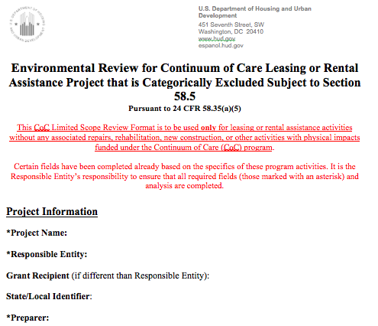
LSR form for Part 58 projects

Slide 18
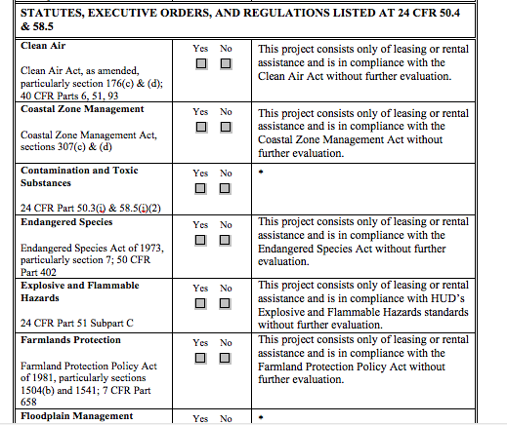
LSR form already completed for you, with exception to four areas!!!

Slide 19
When CoC projects under Part 58 convert to Part 50
When a RE objects to performing the ER for a Recipient, this will need to be backed up by legitimate reasoning or hardship subject to review and approval by HUD per § 58.11
Notes:
Under FAQ’s under HUD Exchange CoC section: HUD’s answer “under very limited circumstances”

Slide 20
§ 58.11
Legal capacity and performance.(a) A responsible entity which believes that it does not have the legal capacity to carry out the environmental responsibilities required by this part must contact the appropriate local HUD Office or the State for further instructions. Determinations of legal capacity will be made on a case-by-case basis.
(b) If a public housing, special project, HOPWA, Supportive Housing, Shelter Plus Care, or Self-Help Homeownership Opportunity recipient that is not a responsible entity objects to the non-recipient responsible entity conducting the environmental review on the basis of performance, timing, or compatibility of objectives, HUD will review the facts to determine who will perform the environmental review.
(c) At any time, HUD may reject the use of a responsible entity to conduct the environmental review in a particular case on the basis of performance, timing or compatibility of objectives, or in accordance with § 58.77(d)(1).
(d) If a responsible entity, other than a recipient, objects to performing an environmental review, or if HUD determines that the responsible entity should not perform the environmental review, HUD may designate another responsible entity to conduct the review in accordance with this part or may itself conduct the environmental review in accordance with the provisions of 24 CFR part 50.
[61 FR 19122, Apr. 30, 1996, as amended at 68 FR 56129, Sept. 29, 2003]

Slide 21
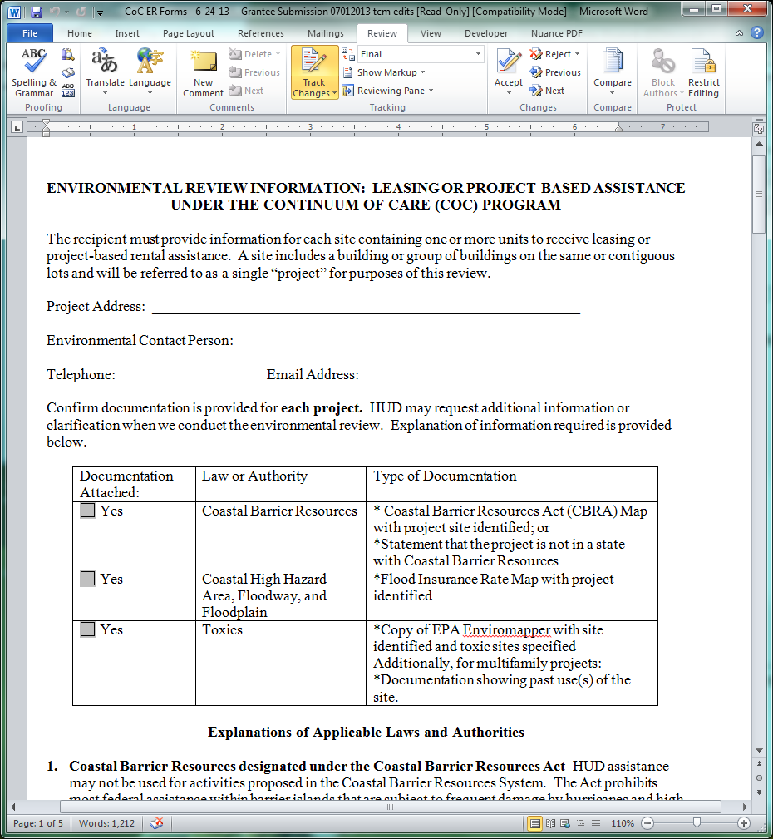
LSR form for Part 50 projects

Slide 22
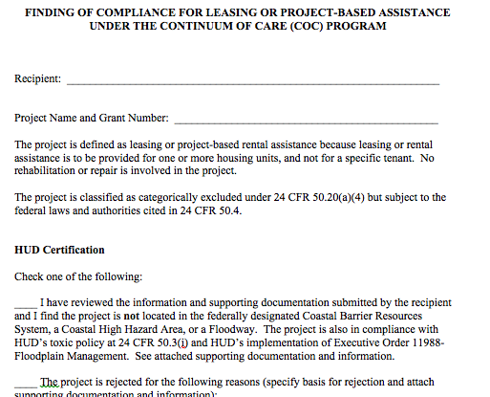
HUD Part 50 Certification form

Slide 23
Mapping Tools
Coastal Barrier Resources: www.fws.gov/cbra/CBRS-Mapper.html
Floodplains: https://msc.fema.gov/
Contamination:
NEPAssist: nepassisttool.epa.gov/nepassist/entry.aspx
Envirofacts: http://www.epa.gov/enviro/index.html
Notes:
HUD accepts these mapping methods as verifiable sources of documentation. Also, Google Earth or Google maps to identify material threats.

Slide 24
Links to the LSR forms and ALL other ER checklists and forms are found at:
LSR form under Part 58:
LSR form and instructions: https://www.onecpd.info/resource/3800/limited-scope-environmental-review-coc/
LSR form under Part 50:
Recipient completes form and submits to HUD for clearance: https://www.onecpd.info/faqs/file/?faqsaction=faqs.viewfaqdoc&id=295
HUD Clearance/Certification form: https://www.onecpd.info/faqs/file/?faqsaction=faqs.viewfaqdoc&id=293
All other forms and checklists found at: https://www.hudexchange.info/environmental-review/
The Exempt/CENST forms: https://www.onecpd.info/resource/3141/part-58-environmental-review-exempt-or-censt-format/
The CEST Statutory Checklist: https://www.onecpd.info/resource/3139/part-58-environmental-review-cest-format/
EA Worksheet: https://www.onecpd.info/resource/3140/part-58-environmental-assessment-form/

Slide 25
Applicable Laws under § 58.5 pertaining ONLY to Leasing and S/PBRA activities
Coastal Barriers
Toxics/Site Contamination
Floodplains
Flood Insurance

Slide 26
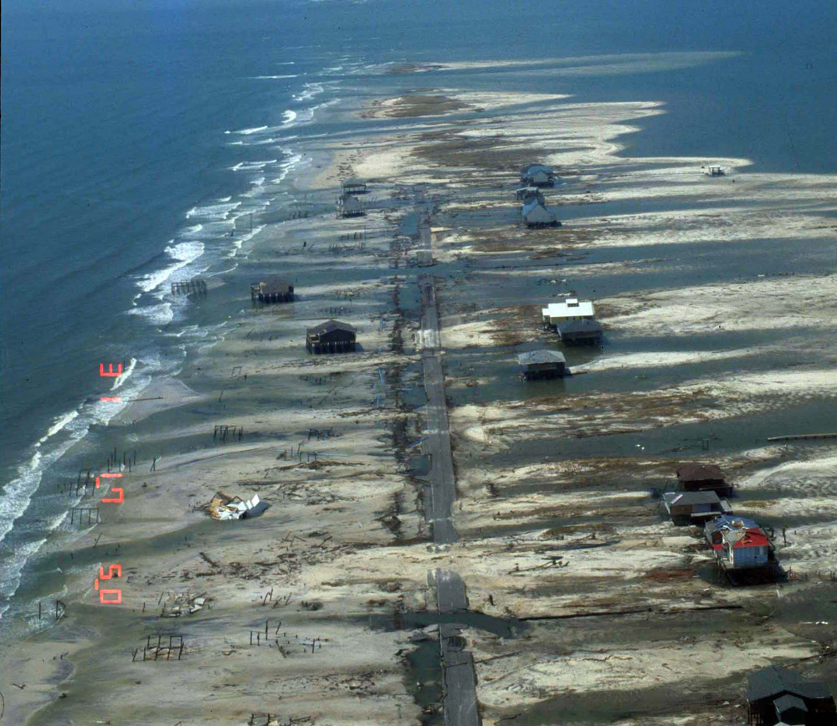
Coastal Barriers
Long and narrow islands or land that abut the ocean, bay or estuaries as the first line of defense from storms and storm surges
HUD will reject any project located within a Coastal Barrier as identified by the FWS via CBRS map

Slide 27
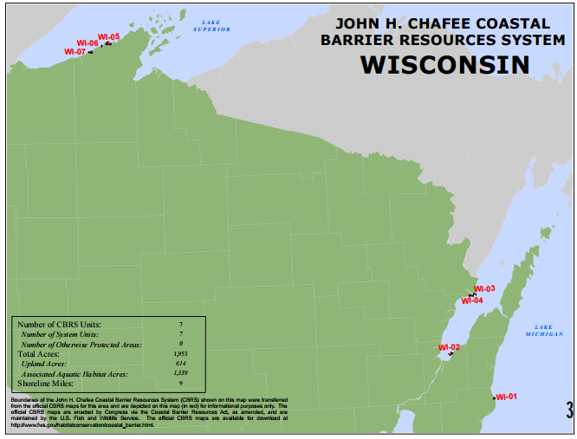
Notes:
Wisconsin
Number of CBRS units 7
Total Acres 1,953
Shore line Miles 9
Michigan
Units 46
Shore Line Miles 61
New Jersey
Units 21
Shore Line Miles 44

Slide 28
Toxics/Site Contamination
HUD funded project sites must be free of:
Soil, surface and groundwater contamination (chemicals, heavy metals, gases, or petroleum products) for compliance with § 58.5 (i) (2)

Slide 29
§ 58.5 (i) (2) is HUD’s toxics/site contamination regulation
It is HUD policy that “all” properties that are being proposed for use in HUD programs be free of hazardous materials, contamination, toxic chemicals and gases, and radioactive substances, where a hazard could affect the health and safety of occupants or conflict with the intended utilization of property

Slide 30
How to Document
In order to comply with § 58.5 (i) (2): HUD’s toxics/site contamination regulation

Slide 31
Compliance Documentation Tools (apply as your transaction screening process for Toxics)
Generate a base map * | Evaluate previous land uses: municipal property cards, street directories, aerials, SanBorn and zoning maps, etc.. | Other evidence of contamination: Interview municipal representatives
Other evidence of contamination: Interview property mgr or owner | Other evidence of contamination: Perform a Site Walk, record field observations and take photographs (next slide) | Research on-line data-bases and mapping systems to help identify HW sites
Consult w/ pertinent parties | Receive site clearance letters (NFA/RAO, “No Adverse Affect” etc.) | Supplement your ER with pertinent ESA Studies *
Notes:
Generate a Base/site map – Google earth/maps also to help identify ASTs.
Evaluate municipal historical land use records (paper chase) and “other evidence of contamination” such as: property cards, street directories, SanBorn and Zoning maps. Interview local officials, boards, representatives and prop mgrs. Perform a site walk and record field observations or suspicious conditions.
Research “on-site or in the general proximity to municipal dumps/junk yards, landfills, industrial and HW sites” (NPL/Superfund, CERCLIS, kcsl, Brownfields, RCRA, etc.). Research adjoining sites for SF properties projects and 3000’ radius search for MF properties
Hire a EP to perform a Phase I ESA when there is evidence or the likelihood of site contamination pertaining to your transaction screening process for toxics.
At a minimum perform site walk and data base search of HW sites, u have been designated by HUD to perform the ER responsibilities.

Slide 32
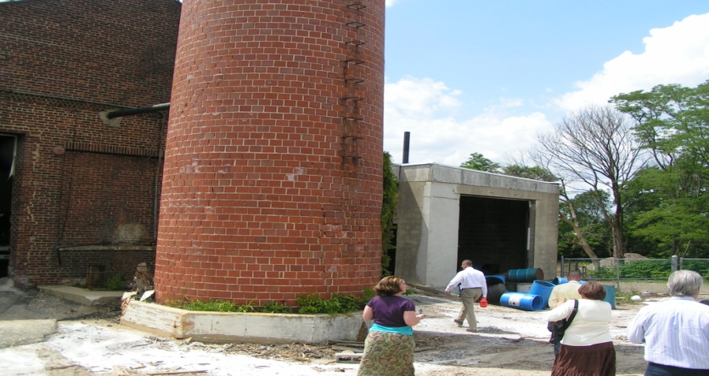
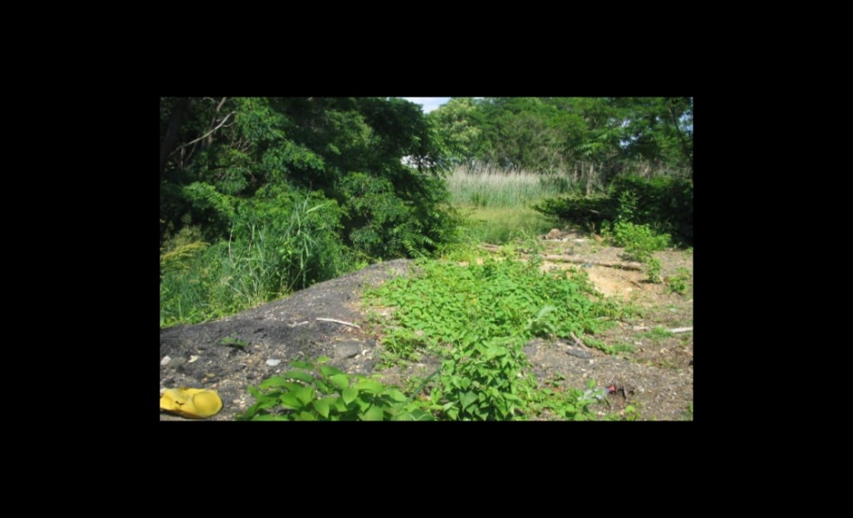
Site Reconnaissance
Your project site and adjoining properties are visually inspected for hazardous conditions, such as:
Noxious odors
Vent or fill pipes (USTs)
Pits, ponds, lagoons, pools of liquid
Surface water discoloration
Mounds of dirt or rubble, dumped material, solid waste, garbage, etc.
Distressed vegetation
Stains and corrosion
Septic systems
Groundwater monitoring or injection wells
Proximity to sensitive receptors – wetlands & critical habitats
Note any “limitations” or obstacles in trying to effectively identify RECs
Structures: Indicators of a past uses (next slide)
Corroded ASTs, drums, containers (next slide)
Notes:
Apply as a tool when screening for toxics
l) and m) following slides

Slide 33
Don’t ask for extra oil on your pizza!
Structure indicating that the previous use was likely a gas station
Gas stations are notorious for polluting groundwater. Would be outlined as a REC in a Phase I report as performed by a ASTM certified EP

Slide 34
Understanding Material Threats
A Material Threat is a deplorable object that has likely released a HS or fuel oil into the ground
Material threats discovered during a site walk should be noted on your ER form or checklist
A Material Threat is analogous with “obvious threat” and “smoking gun“ concept
A Material Threat is a hazardous condition that would be delineated as a REC in a Phase I
Notes:
A standalone UST that demonstrates good structural integrity, should not be noted as a suspicious condition as an indicator of site contamination. If it is rusted, punctured, shows soil staining, or in decrepit form, then it should be noted as a suspicious condition warranting further analysis or may prompt a Phase I ESA.

Slide 35
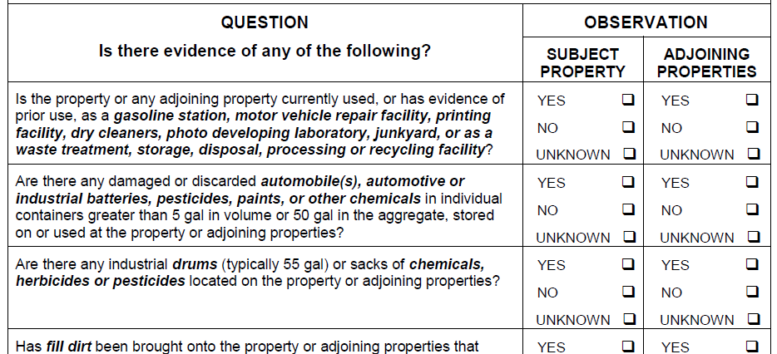
The Site Reconnaissance checklist
Notes:
As a handout

Slide 36
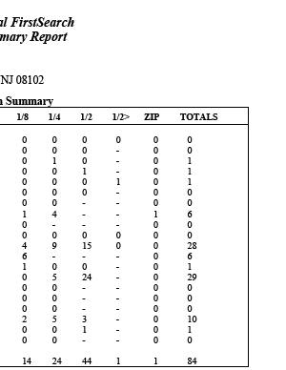
Scrutinize State and Federal data-bases for HW sites
Notes:
Consultants use – EDR
HUD uses - TOXMAP, EPA data-bases, NEPAssist, NJ State Geo-Web, Enviromapper, etc.

Slide 37
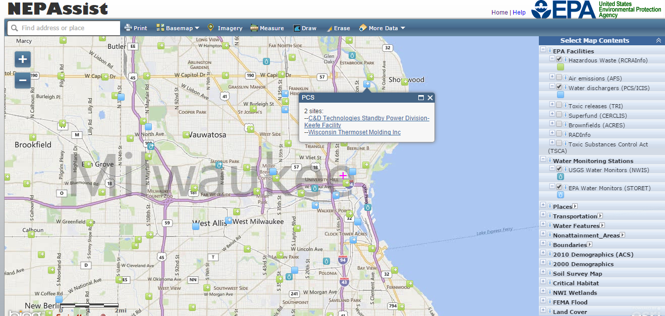
Perform a search of HW sites for your project site and neighboring properties via NEPAssist or other on-line mapping systems
Notes:
Abutting for SF properties
3000’ radius for MF properties
On this site there is a measuring tool in the top center of the page

Slide 38
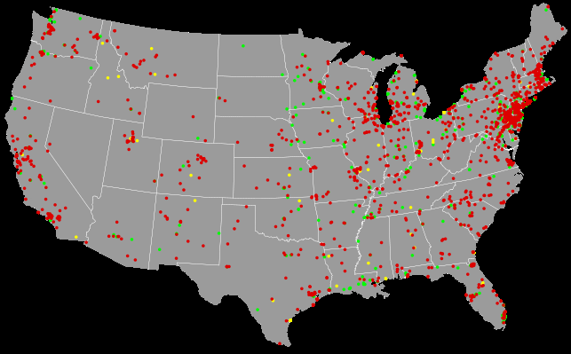
2014 Superfund sites
Notes:
Superfund sites are delineated accordingly: As proposed, final or delisted stage.
Yellow = Proposed (Analysis stage: not yet under Superfund program, still on NPL)
Red = Final (Remediation stage: funded via Superfund Trust-fund)
Green = Delisted (Closed out: removed from the Superfund program)
Superfund sites on the NPL get funded through the HW Trust Fund program accordingly:
Petroleum refineries taxed 30% - Exxon, Mobil, BP!
Corporations manufacturing, disposing or handling chemicals 45%
Industrial facilities taxed 15%
Cost recoveries from suing/fining RP’s 10%

Slide 39
The Fundamentals of a Phase I

Slide 40
What is a Phase I Report?
An investigative, non-intrusive study of your subject property and nearby properties to determine the presence or likely presence of toxics or hazardous materials
A Phase I can satisfy § 58.5 (i) (2) requirements and replace the screening process for toxic properties
What does a Phase I investigate?
The condition of your site and adjoining properties
Serious conditions are recorded as a REC Finding
Notes:
A REC: Site conditions indicating that the release of a “HS or PP” has occurred and the site is likely contaminated.
A Phase I is limited in scope: not address wetlands, VOCs (ASTM amending), asbestos, Pb, mold, radon, endangered species, floodplains, etc.

Slide 41
Likely Phase I Exemptions
When acquiring residential property, unless otherwise advised during your transaction screening process for toxics
When rehabilitating SF or MF structures, unless otherwise advised during your transaction screening process for toxic properties
For all Exempt level and CENST activities

Slide 42
Toxic black mold is addressed under HUD’s Sec 8 Voucher program, OHHLHC policies and indirectly under § 58.5 (i) (2)
Notes:
Section 8 vouchers: HUD funded dwelling units must be “free of pollutants in the air at levels that threaten the health of the occupants” and 24 CFR 5.703(f) that “our dwelling units and common areas must have proper ventilation and be free of mold”
Basics: Toxic Black Mold (Stacebotrys chartarum) or mildew (common names) is a fungus/fungi of ~ 200 species, the most common is: microscopic airborne mold spores or microbial toxins that latch on to dead organic matter (wallboard, sheetrock, wood, paper, carpet, food) for food and when the spores die they create a “moldy” smell. Need H2O as the fuel.
Health Problems: acute respiratory problems and even death in infants have been reported
Preventive measures: moisture control – ventilate, reduce indoor humidity, de-humidify, exhaust fan, clean. More frequent along coastal areas.
Mold assessment survey steps: visually inspect (perform a reasonable persons perspective assessment), formally test (swab for type, or sample air for volume), review lab results, remediate (clean/replace), monitor air as in O&M plan.
Pertinent activity: Assess prior to Rehab

Slide 43
Radon
Notes:
Radon is a generic term for several radioactive metallic elements found in rock or soil such as Radium, Uranium and Thorium or radionuclide deposits that when decay produce a colorless, odorless (i.e.- CO), carcinogenic, radioactive toxic gas – called Radon gas.
Health impacts:
Linked to respiratory and lung cancer.
2nd leading cause of lung cancer (cigs 1st), in the US. EPA estimates - 20,000 deaths a year.
A silent deadly gas - can’t see or smell.

Slide 44
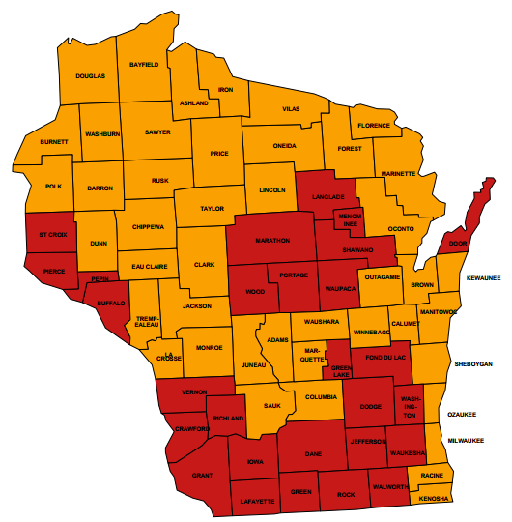
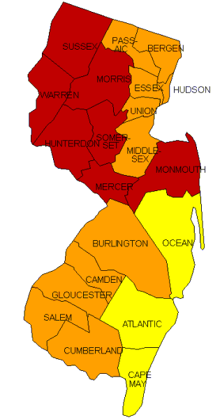
EPA Map of Radon Zones for WI
Notes:
Red = Radon Zone 1 = high risk area of the state for radioactive gases
Orange = Zone 2 = moderate risk area
Yellow = Zone 3 = low risk area
A Radon test per ASTM 1465-08 should be performed by a license Radon professional or purchase a radon test kit for projects that fall w/in the high to moderate potential radon gas risk zones complimenting HUD’s “2013 Housing Radon Policy” and satisfying §58.5 (i) (2) regulation, which states that “HUD programs shall be free of radioactive substances that could effect the health and safety of occupants or interfere with the intended use of property.”
Assessment: Defer to your EPA generated Radon map for NJ (next slide) as a first step to determine if a test needs to be performed.
Mitigation measures: Test results above the 4 pCi/L threshold level will require mitigation measures such as; sealing/caulking cracks, installing a soil depressurization/ventilation system in the basement, or choose an alternative site.

Slide 45
24 CFR Part 55: Floodplain Management
Basic definitions and policies:
100 year floodplains or SFHAs are land masses as identified on a FIRM by FEMA where there is a 1% chance or greater of flooding in any given year
HUD discourages the development of projects in a floodplain that puts occupants and HUD funded properties at risk
HUD will reject any project located in Floodway or Coastal High Hazard Area
5 or more housing units: Analyze project to determine if there are alternatives to locating project in the floodplain using an 8 Step evaluation process * per § 55.20
Where a community is participating in the National Flood Insurance Program, National Flood Insurance must be obtained and maintained by the HUD client for acquisition, new construction and rehabilitation activities if the property is within a 100 year floodplain per § 58.6 (a)
Notes:
8-step summary: Consists of identifying impacts, evaluating all practicable alternatives, and mitigating accordingly. Publish an early impact to floodplain notice (15 day comment period) and a final notice (7 days) when all practicable alternatives to not developing in the floodplain have been exhausted

Slide 46
How to identify a floodplain
Defer to a FEMA FIRM or DFIRM Firmette map, or other sources such as: NEPAssist or NWI inventory maps
Sample floodplain notices are found on HUD Exchange, under “Manage a Program” then “Environmental Review”
46

Slide 47
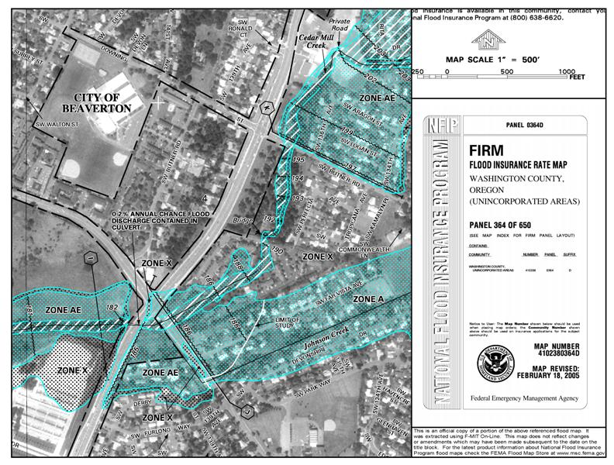
Example of a DFIRM

Slide 48
The “HUD Exchange” website
Notes:
Demonstrate - Search box terms that work for “HUD Exchange” that can Google:
- Coc limited scope
- CoC limited scope review
FAQ’s:
1. “Manage a program”
2. “Environmental Review”
2. Select “CoC Limited Scope Review” (bottom right under Suggested Formats)
3. Click Limited Scope Environmental Review Instructions-- CoC
4. Limited Scope Environmental Review Format-- CoC

Slide 49
Contacts
Questions?

