Slide 1
Balance of State CoC FY17 COC Competition
RobyN Thibado, BOS Board President
Carrie Poser, COC Director
August 2017

Slide 2
Presentation Overview
Overview and Deadlines
Collaborative Application
Questions
Data
Project Application Ranking
Questions

Slide 3
What is the FY2017 COC Program Competition?
The Notice of Funding Availability (NOFA) for the Fiscal Year (FY) 2017 Continuum of Care Program Competition, FR-6100-N-25 was released on July 14, 2017.
Approximately $2 billion is available nationwide.
https://www.hudexchange.info/resources/documents/FY-2017-CoC-Program-Competition-NOFA.pdf

Slide 4
What is the purpose of the COC Program?
The COC Program (24 CFR part 578) is designed:
To promote a community-wide commitment to the goal of ending homelessness;
To provide funding for efforts by nonprofit providers, states, and local governments to quickly re-house homeless indivdiuals, families, persons fleeing domestic violence, and youth while minimizing the trauma nad dislocation caused by homelessness;
To promote access to and effective utilitization of mainstream programs; and
To optimize self-sufficiency among those experiencing homelessness.

Slide 5
HUD’s Homeless Policy and Program Priorities
Ending homelessness for all persons
COCs should:
Identify, engage, and effectively serve all persons experiencing homelessness
Measure their performance based on local data that takes into account the challenges faced by all subpopulations (e.g. veterans, youth, families, chronic)
Have a comprehensive outreach strategy to identify and continuously engage all unsheltered persons
Determine characteristics of those with the highest needs and longest experiencing of homelessness to develop housing and services tailored to those needs
Use the reallocation process to create new projects that improve their overall performance and better respond to their needs
Creating a systemic response to homelessness
CoCs should:
Use system performance measures such as average length of homeless episodes, rates of return, and rates of exit to permanent housing destinations to determine how effectively they are serving people experiencing homelessness
Use coordinated entry to promote client choice, coordinated housing and mainstream services to ensure people experiencing homelessness receive assistance quickly, and make homeless assistance open, inclusive, and transparent.

Slide 6
HUD’s Homeless Policy and Program Priorities
Strategically allocating and using resources
COCs should:
Use cost, performance, and outcome data to improve how resources are utilized to end homelessness
Review project quality, performance, and cost effectiveness
Maximize the use of mainstream and other community-based resources when serving people experiencing homelessness
Review all projects eligible for FY17 to determine their effectiveness in serving people as well as their cost effectiveness
Using a Housing First approach
COCs should:
Help individuals and families move quickly into permanent housing
Measure and help projects reduce the length of time people experience homelessness
Engage landlords and property owners, remove barriers to entry, and adopt client-centered service methods

Slide 7
COC Program Implementation
The FY2016 Appropriations Act established certain requirements for the FY2016 Competition and that HUD will continue to require in the FY2017 COC Competition:
COCs cannot receive grants for new projects, other than through reallocation, unless the COC competitively ranks projects based on how they improve system performance;
HUD is increasing the share of the COC score that is based on performance criteria; and
HUD will prioritize funding for COCs that have demonstrated the ability to reallocate resources to higher performing projects

Slide 8
New Project Opportunities
The following types of projects may be created using funds that the COC has made available through reallocation:
Permanent Supportive Housing – 100% dedicated to chronic homelessness
Rapid Rehousing – Serving individuals and families, including unaccompanied youth
Expansion projects - to expand eligible renewal permanent housing projects that will increase the number of units in the project or allow the recipient to serve additional persons.
Supportive Services Only – To develop or operate a coordinated assessment system
The following types of projects may be created through the permanent housing bonus (up to 6% of the COC’s FPRN):
Permanent Supportive Housing – 100% dedicated to chronic homelessness
Rapid Rehousing – Serving individuals and families, including unaccompanied youth
Expansion projects - to expand eligible renewal permanent housing projects that will increase the number of units in the project or allow the recipient to serve additional persons.
For the FY17 Competition, the BOS permanent housing bonus is: $551,342.

Slide 9
COC Competition Components
The COC Consolidated Application is made up of 3 parts:
FY 2017 COC Application
The Collaborative Applicant must provide information about the COC planning body, governance structure, overall performance, and the strategic planning process. This part of the application is scored and will determine the order in which COCs are funded.
FY 2017 Project Application
Project applications must be completed for COC planning, new, and renewal application requests.
New project applications apply for funds (through reallocation or the permanent housing bonus) and renewal projects must provide a description of the proposed project including the population/sub-population they will serve, the type of housing and services that will be provided, and the budget activities that are being requested.
COC planning must provide a description of the activities that will be carried out with grant funds for COC planning costs.
FY 2017 COC Priority Listing
The listing must include the reallocation forms for COCs to indicate which projects will be reallocated, 4 separate listing forms (new, renewal, and COC planning), and the HUD-2991 form.
The listing forms rank project applications in order of priority and identify any project applications rejected by the COC.
The Collaborative Applicant will be required to certify that there is a demonstrated need for all ranked permanent housing (RRH and PSH) renewal projects on the Renewal Priority listing.

Slide 10
Ranking on the Priority Listing
HUD requires the use of Tier 1 and Tier 2 funding process.
Tier 1 is equal to the greater of the combined amount of ARA (annual renewal award) for all permanent housing and HMIS projects eligible for renewal up to $1,000,000 or 94% of the ARD (annual renewal demand).
In the Balance of State, our ARD is = $8,521,969 the Tier 1 limit is = $8,010,651
Tier 2 is the difference between Tier 1 and the COC’s ARD plus any amount available for the permanent housing bonus.
In the Balance of State, the Tier 2 amount is = $8,521,969 – $8,010,651 + $551,342 = $1,062,660
If a project straddles the Tier 1 and Tier 2 funding line, HUD will conditionally select the project up to the amount of funding that falls within Tier 1. Then, using the Tier 2 scoring process, HUD will fund the Tier 2 portion of the project.
If HUD does not fund the Tier 2 portion of the project, HUD may award the project at the reduced amount, provided the project is still feasible with the reduced funding.

Slide 11
Tier 2 Scoring
HUD will evaluate and rank all Tier 2 projects nationally.
Tier 2 conditional awards will be based on funding availability, starting with the highest ranked Tier 2 project in the country and work their way down the list.
The point values are different than the FY16 COC Competition process.
Element | Points
COC Score | 50 points
COC Project Ranking | 40 points
Commitment to Policy Priorities | 10 points
Total | 100 points

Slide 12
COC Score (up to 50 points)
Up to 50 points will be awarded to a project application (new or renewal) in direct proportion to the score received by the CoC Application in the national competition.
The CoC Application must receive all 200 CoC Application points available to receive the full 50 points for the CoC Application score.
200 points on the CA | Then all project applications will receive 50 points
150 points on the CA | Then all project applications will receive 37.5 points
100 points on the CA | Then all project applications will receive 25 points
50 points on the CA | Then all project applications will receive 12.5 points
Examples - if the CoC Application (CA) receives:
To calculate the math: Take the number of points received on the CA and divide them by the total points possible (200).
Then multiple that number by the total points possible in the Tier 2 COC Score (50).
150 divided by 200 = .75 multiply by 50 = 37.5 points

Slide 13
COC Project Ranking (up to 40 points)
Up to 40 points will be awarded to a project application (new or renewal) based on a mathematical calculation related to where the project was placed (or ranked) on Tier 2.
Point value will be 40 times the quantity (1-x) where the x is the ratio of the cumulative funding requests for all projects or portions of projects ranked higher by the COC in Tier 2 plus one half of the funding of the project of interest to the total amount of funding available in Tier 2.
Example:
If a COC is eligible to apply for projects totaling $500,000 in Tier 2 and applies for 5 projects ranked in Tier 2 of $100,000 each: the highest ranked project would receive 36 points, the next ranked would receive 28, the next ranked would receive 20 points, the next ranked would receive 12 points, and the last will receive 4 points.
40 x (1 – cum. Funding + ½ divided by total)
Total available in Tier 2 = 500,000
Tier 2 project #1 – asked for 100,000 40 x (1 – 0+50,000 divided by 500,000) = 40 x .9 = 36 points
Tier 2 project #2 – asked for 100,000 40 x (1 – 100,000+50,000 divided by 500,000) = 40 x .7 = 28 points
Tier 2 project #3 – asked for 100,000 40 x (1 – 200,000+50,000 divided by 500,000) = 40 x .5 = 20 points
Tier 2 project #4 – asked for 100,000 40 x (1 – 300,000+50,000 divided by 500,000) = 40x .3 = 12 points
Tier 2 project #5 – asked for 100,000 40x (1 – 400,000+50,000 divided by 500,000) = 40 x .1 = 4 points

Slide 14
Commitment to Housing First (up to 10 points)
Up to 10 points will be awarded for how the project application commits to applying the Housing First model – including but not limited to low barrier entry, prioritizing rapid placement and stabilization in permanent housing, no service participation requirements or preconditions to entry.
These points are awarded as follows:
Project Type | Points | Commitment
Permanent Supportive Housing | Up to 10 points | How well the project application demonstrates commitment to applying the Housing First model
Rapid-Rehousing | Up to 10 points | How well the project application demonstrates commitment to applying the Housing First model
Transitional Housing | Up to 10 points | How well the project application demonstrates that it is low-barrier, prioritizes rapid placement and stabilization in permanent housing and does not have service participation requirements or preconditions to entry
Safe Haven | Up to 10 points | How well the project application demonstrates that it is low-barrier, prioritizes rapid placement and stabilization in permanent housing and does not have service participation requirements or preconditions to entry
HMIS | 10 points | Automatically

Slide 15
Timeline
Board Review of Requests for Reconsideration and Decision Friday, August 11
Letter of Interest (SSO-CE) deadline Monday, August 14
New Project Application deadline Friday, August 18
Board Review of New Projects and Decision Friday, August 25
All Renewal and New Project Applications submitted in e-snaps Monday, August 28
Local Coalition Request of Information TBD
Final Project Ranking and notification to Projects Wednesday, September 13
Entire COC Consolidated Application deadline Thursday, September 28

Slide 16
Collaborative Application

Slide 17
Topic | Points | Percentage of Total
COC coordination and engagement | 43 | 21.5%
Project ranking, review, & capacity | 29 | 14.5%
HMIS | 13 | 6.5%
Point-in-Time | 6 | 3.0%
System Performance | 49 | 24.5%
Performance & strategic planning | 60 | 30.0%

Slide 18
Overview
The Consolidated Applications will be assed on a 200-point scale and contains 6 parts.
Note: HUD defines subpopulations as: families, youth, veterans, persons fleeing domestic violence, persons who are unsheltered, and chronically homeless individuals and families.
Part 1: COC Coordination and Engagement (43 points):
Demonstrate coordination with other systems of care, including sources of funding other than the COC Program; inclusive and outcome-oriented community process, including an organization structure(s) and decision-making process for developing and implementing a COC strategy that is inclusive of representatives from both the private and public sectors, has a fair and impartial project review and selection process; and has created, maintained, and built up a community-wide inventory of housing for people experiencing homelessness.

Slide 19
Part 2: Project Ranking, Review, and Capacity (29 points):
Clearly demonstrate the existence of a coordinated, inclusive, and outcome-oriented community process for the solicitation, objective review, ranking, and selection of project applications, and a process by which renewal projects are reviewed for performance and compliance with 24 CFR part 578.
Part 3: HMIS (13 points):
Clearly demonstrate the existence of a functioning HMIS that facilitates the collection of information on homelessness using residential and other homeless services and stores that data in an electronic format.
Part 4: Point-in-Time (6 points):
Points related to the collection, use, and submission of data from the last PIT count (2017). HUD will compare 2017 PIT count data to 2016 PIT count data.

Slide 20
Part 5: System Performance (49 points):
Points based on COC system-wide performance related to reducing homelessness within the COC’s defined geographic area.
Part 6: Performance and Strategic Planning (60 points):
Points based on the COC’s plan for and progress towards reducing homelessness within its geographic area and decreasing the number of recurrences of homelessness.
Chronic Homelessness
Veteran Homelessness
Youth Homelessness
Households with Children Homelessness

Slide 21
Challenging Questions
Addressing the Needs of LGBT Individuals (2 points) Maximum points will be awarded to CoCs that demonstrate:
(1) LGBT serving organizations or advocacy groups are included in the COC Membership;
(2) COCs regularly conduct training to providers about how to effectively implement the Equal Access to Housing in HUD Programs Regardless of Sexual Orientation or Gender Identity, including the Equal Access in Accordance with an Individual’s Gender Identity in Community Planning and Development Programs; and
(3) have implemented a COC-wide anti-discrimination policy.
Public Housing Agencies (5 points)
Maximum points will be awarded to COCs that demonstrate the PHA(s) in their geographic area:
(1) have established an admission preferences for households experiencing homelessness; and
(2) that at least 20% of new admissions were homeless at admission.

Slide 22
Street Outreach (3 points) Maximum points will be awarded to COCs that demonstrate that the COC’s street outreach:
(1) Covers 100% of the COC’s geographic area;
(2) Is conducted on a regular basis; and
(3) Is tailored to reach those that are least likely to request assistance.
Mainstream Benefits & Other Assistance (2 points) Maximum points will be awarded to CoCs that demonstrate:
(1) systematically keeping program staff up-to-date regarding mainstream resources available for homeless program participants (e.g. Food Stamps, SSI, TANF, substance abuse programs);
(2) collaboration with healthcare organizations to assist homeless program participants with enrolling in health insurance; and
(3) provide assistance with effective utilization of Medicaid and other benefits.

Slide 23
Severity of Needs and Performance (4 points)
Maximum points to COCs that describe the specific needs and vulnerabilities the COC considers in their project ranking and selection process and how the COC takes them into account.
Needs and vulnerabilities include:
Low or no income
Current or past substance abuse
A history of victimization (e.g. domestic violence, sexual assault, childhood abuse)
Criminal histories
Chronic homelessness

Slide 24
Reallocated Projects (4 points)
Maximum points will be awarded to COCs that:
(a) demonstrate the COC actively encourages new and existing providers to apply for new projects through reallocation; or
(b) demonstrate the COC has cumulatively reallocated at least 20% of the COC’s ARD between FY2013 and FY2017 COC Program Competitions.
CoC Process of Reallocation attachment = how the reallocation process is communicated through the COC & encourages new and existing providers to apply for new projects using reallocation process.
If the COC chooses to use this second option, HUD will confirm this information by reviewing each year’s ARD & the % of the ARD submitted under the reallocation process.

Slide 25
Bed Coverage (6 points)
To CoCs that recorded 85% or higher for the bed coverage rate in the CoC’s geographic area.
Beds funded by victim service providers must not be included in this calculation.
Funding for the project does not impact or alter the score.
Project Type | HMIS Bed Coverage Rate (2017) | HMIS Bed Coverage Rate (2016)
Emergency Shelter beds | 85.72% | 77.94%
Safe Haven Beds | 100% | 100%
Transitional Housing beds | 86.69% | 85.43%
Rapid Re-Housing beds | 100% | 100%
Permanent Supportive Housing beds | 78.94% | 59.72%
Other Permanent Housing beds | 33.82% | 48.28%

Slide 26
Conducting an Effective Youth Count (3 points)
Maximum points to COCs that demonstrate that during the planning process for the Point-in-Time count they:
engaged stakeholders that serve homeless youth;
involved homeless youth; and
worked with stakeholders to select locations where homeless youth are most likely to be identified.

Slide 27
Reducing the Number of Homeless Individuals and Families (10 points)
Must demonstrate an overall reduction of at least 5% in the number of individuals and families who experience homelessness. The information provided for both sheltered and unsheltered homeless based on the criteria below will be verified against the information submitted to the HDX. To receive maximum points:
(a) the CoC will receive up to 2 points for demonstrating a decrease in the number of sheltered homeless individuals and families since the 2017 PIT compared to the 2016 PIT count as recorded in HDX; (-2.82%)
(b) the CoC will receive up to 5 points for demonstrating a decrease in the number of unsheltered homeless individuals and families in the 2017 PIT count compared to the previous PIT count as recorded in HDX. (+ 3.79%)
(c) the CoC will receive up to 3 points for demonstrating a decreased in the combined number of sheltered and unsheltered homeless individuals and families in the 2017 PIT count compared to the previous PIT count as recorded in HDX. (- 3.08%)

Slide 28
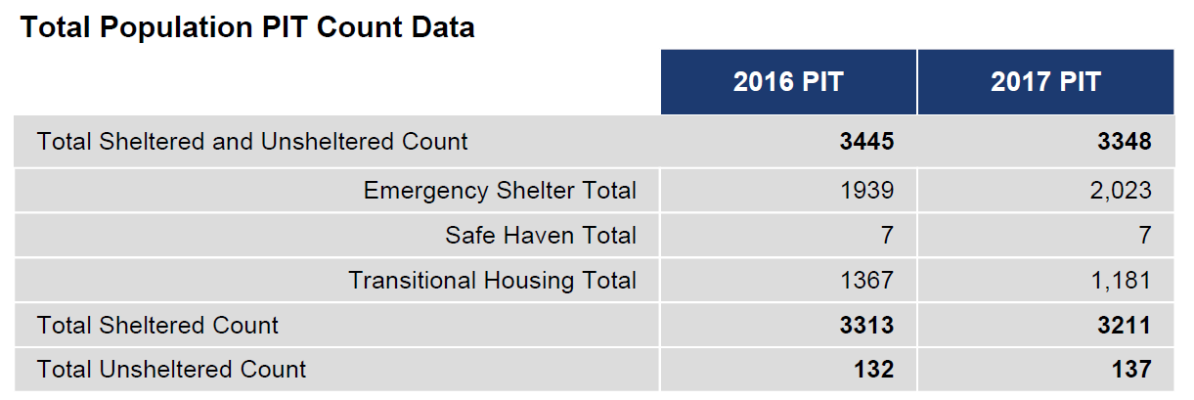

Slide 29
Reduction in the Number of First Time Homeless (3 points)
Maximum points will be awarded to CoCs that:
(1) demonstrate a reduction in the number of first-time homeless as reported in HDX;
(2) that identify the process by which risk factors are identified in its community for becoming homeless for the first time;
(3) clearly describe the strategies in place to address individuals and families at risk of becoming homeless; and
(4) identify the organization or position that is responsible for overseeing the COCs strategy to reduce or end the number of people experiencing homelessness for the first time.

Slide 30
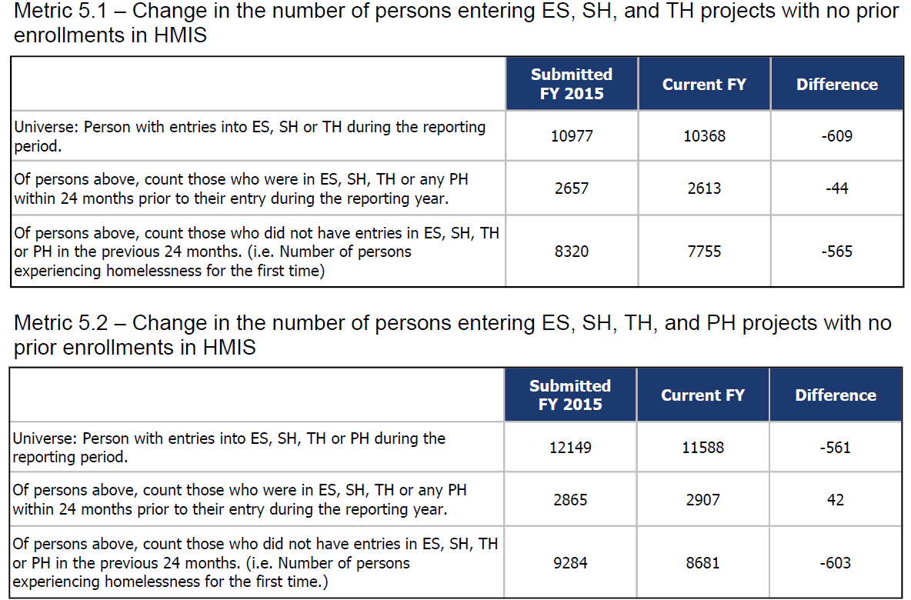

Slide 31
Length of Time Homeless (11 points)
Maximum points will be awarded to CoCs that:
(1) demonstrate a reduction in the length of time individuals and families remain homeless in the COC’s geographic area as reported in HDX;
(2) describe the COC’s efforts to reduce the length of time individuals and families remain homeless;
(3) describe how the COC identifies and houses individuals and families with the longest length of time homeless; and
(4) identify the organization or position that is responsible for overseeing the COC’s strategy to reduce the length of time individuals and families remain homeless.

Slide 32
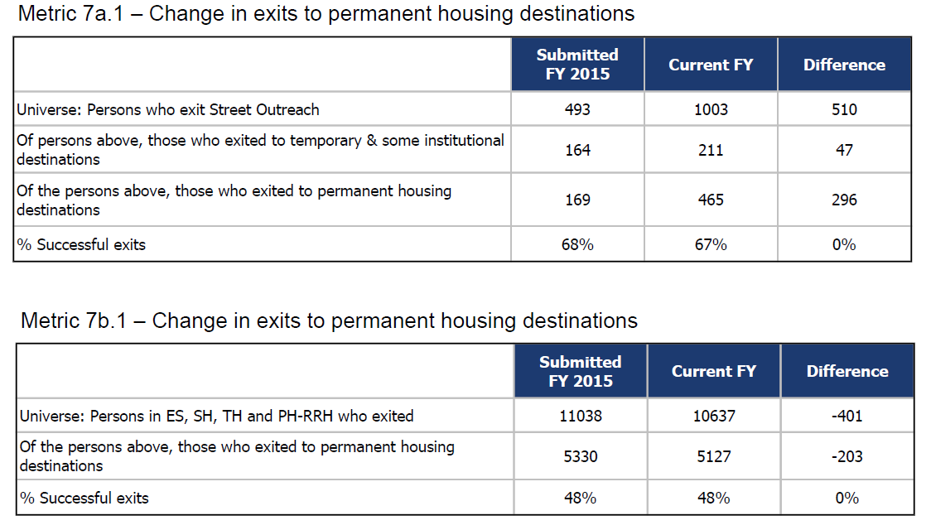
Successful Permanent Housing Placement or Retention (9 points)
To receive maximum points, a CoC must demonstrate:
(1) an increased rate at which persons exit to permanent housing destinations (and retain permanent housing if they are currently in a permanent housing project) as reported in HDX; and
(2) describe steps the COC is taking to improve permanent housing placement and retention.

Slide 33
Returns to Homelessness (6 points)
To receive maximum points, a CoC must demonstrate:
(1) a reduction in the rate at which persons that exited permanent housing destinations experienced additional spells of homelessness as reported in HDX;
(2) describe the strategies that have been implemented to identify individuals and families who return to homelessness;
(3) describe the strategies that will reduce returns to homelessness; and
(4) identify the organization or position that is responsible for overseeing the COC’s strategy to reduce returns to homeliness.

Slide 34
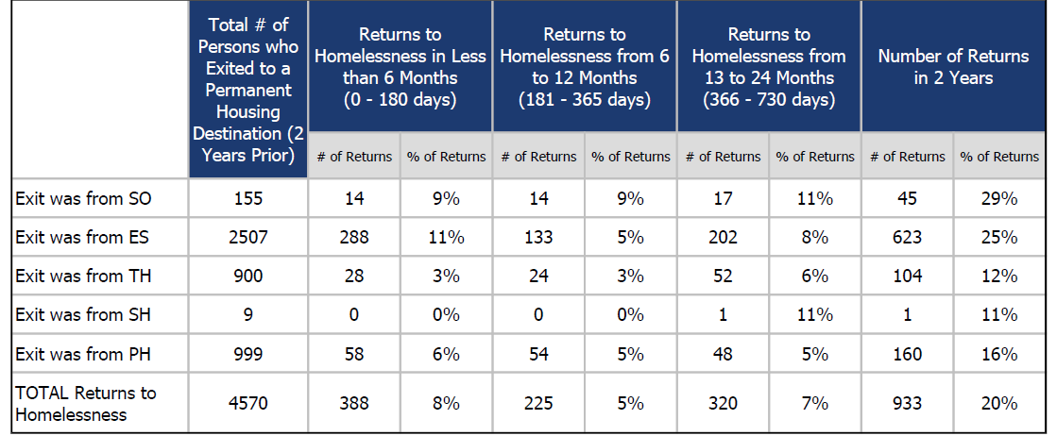

Slide 35
Jobs and Income Growth (4 points)
To receive maximum points, a CoC must demonstrate:
(1) an increase in income from employment and non-employment cash sources for persons served in COC program-funded projects as reported in HDX;
(2) describe the strategies that have been implemented to access employment and mainstream benefits;
(3) describe how COC program-funded projects have been assisted to implement the strategies;
(4) describe how the COC is working with mainstream employment organizations to help individuals and families experiencing homeliness increase their cash income; and
(5) identify the organization or position that is responsible for overseeing the COC’s strategy to increase jobs and income growth from employment and non-employment cash sources, including mainstream employment organizations.

Slide 36
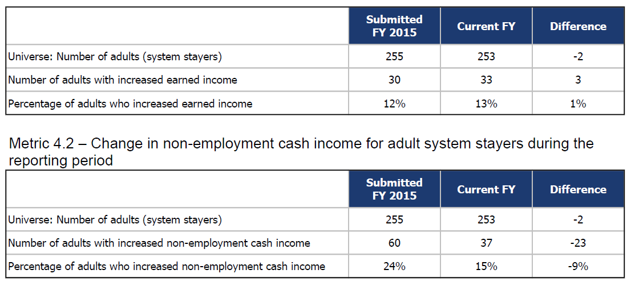

Slide 37
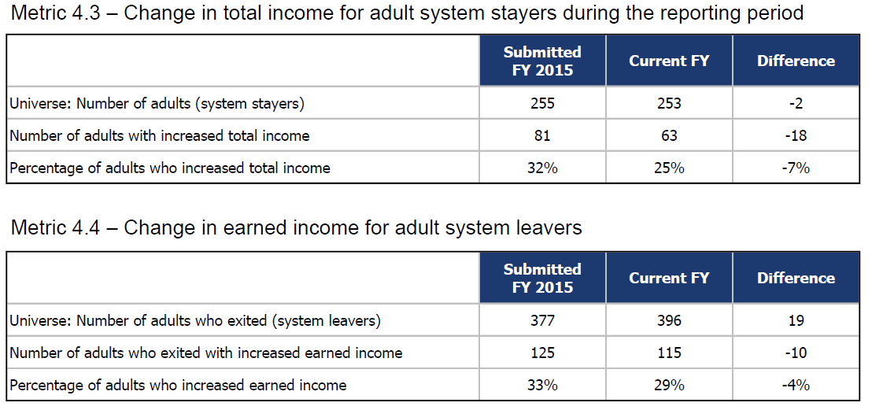

Slide 39
Ending Chronic Homelessness (15 points)
HUD will award:
(1) 2 points will be awarded to CoCs that have adopted the order of priority described in Notice CPD 16-11: Prioritizing Persons Experiencing Chronic Homelessness and other Vulnerable Homeless Persons in Permanent Supportive Housing.
(2) Up to 5 points to CoCs that increase the total number of PSH beds (from any funding source) dedicated to chronic homelessness. Maximum points will be awarded to CoCs that demonstrate an increase in dedicated PSH beds reported on the HIC from 2016 to 2017.
+ 57.95%

Slide 40
Ending Chronic Homelessness (15 points)
HUD will award:
(3) Up to 6 points where at least 90% of PSH requested in the FY2017 COC Program Competition are either beds dedicated to CH individuals or families or are in projects classified as Dedicated PLUS.
(4) Up to 2 points to CoCs for reducing the number of chronically homeless individuals and families in the CoC, as reported by the CoC in the 2017 PIT count compared to the 2016 PIT count. Maximum points to CoCs that are able to demonstrate a decrease in both the total number of chronically homeless individuals and families as well as a decrease in the total unsheltered chronic homeless population. CoCs must explain any increase or no change to the number of CH homeless individuals and families in the CoC.
+ 24.06%
+ 25.00%
+ 17.39%

Slide 41
Ending Homelessness Among Households with Children (15 points)
(1) Up to 2 points to CoCs that prioritize households with children based on need, including factors such as: history of or vulnerability to victimization (e.g. domestic violence, sexual assault, childhood abuse), number of previous homeless episodes, unsheltered homeless, criminal history, bad credit or rental history.
(2) Up to 3 points to CoCs based on the local plan to rapidly re-house households with children within 30 days of those families becoming homeless. Maximum points awarded to COCs that:
(a) describe an effective strategy to quickly rehouse families; and
(b) identify the organization or position that is responsible for implementing the strategy.
(3) Up to 4 points to CoCs for increasing rapid rehousing units for households with children experiencing homelessness. Maximum points will be awarded to COCs that increase rapid rehousing units by at least 5%.
+ 78.82%

Slide 42
(4) Up to 2 points to CoCs for ensuring emergency shelters, transitional housing, and permanent housing–permanent supportive housing and rapid re-housing–projects within the CoC do not deny admission to or separate family members when they enter shelter or housing.
(5) Up to 3 points to CoCs that demonstrate the total number of homeless households with children and youth, has decreased as reported in the 2017 PIT count compared to 2016.
(6) Up to 1 point to COCs that demonstrate unaccompanied youth and families with children experiencing homelessness are informed of and receive access to education services through programs such as Public Pre-K, head start, child care, and home visiting. Maximum points will be awarded to COCs that demonstrate there are written agreements in place between the COC or its HUD-funded projects and educational supports and services, including those for children 0-5.

Slide 43
Ending Youth Homelessness (15 points)
(1) Up to 2 points to CoCs that prioritize unaccompanied youth based on need, including factors such as: history of or vulnerability to victimization (e.g. domestic violence, sexual assault, childhood abuse), number of previous homeless episodes, unsheltered homeless, criminal history, bad credit or rental history.
(2) Up to 5 points to CoCs for strategies that address the unique circumstances and needs of unaccompanied homeless youth.
Maximum points will be awarded to COCs that demonstrate they are addressing:
(a) unsheltered homelessness;
(b) trafficking; and
(c) other forms of exploitation experienced by unaccompanied youth experiencing homelessness.

Slide 44
(3) Up to 7 points to CoCs that demonstrate the strategies used by the COC, including additional funding secured, to increase the availability of housing and services for youth experiencing homelessness, especially those experiencing unsheltered homelessness.
Maximum points will be awarded to COCs that provide evidence that the strategies implemented are effective at ending youth homelessness and include the measure that is being used to determine the effectiveness of the strategies.
(4) Up to 1 point to COCs that demonstrate how the COC collaborates with youth education providers, McKinney-Vento local educational authorities, and school districts.
Maximum points will be awarded to COCs that demonstrate:
(a) formal partnerships with these entities; and
(b) that policies and procedures have been adopted to inform individuals and families who become homeless of their eligibility for educational services.

Slide 45
Ending Veteran Homelessness (15 points)
(a) Up to 8 points to CoCs that demonstrate a decrease in the total number of homeless veterans in the CoC, as reported in the 2017 PIT count compared to 2016.
(b) Up to 4 points to CoCs that demonstrate a 75% reduction in the total number of homeless veterans and unsheltered homeless veterans as reported in the 2015 PIT count, compared to 2010 (or 2009 if an unsheltered count was not conducted in 2010).
(c) Up to 3 points to CoCs that demonstrate they identify, assesses, and refers homeless veterans who are eligible for Veterans Affairs services and housing to appropriate resources such as HUD-VASH, SSVF, and GPD.

Slide 46
Project Application Ranking

Slide 47
Board Scoring Tool
The Board Scoring Tool was approved by the BOS Board of Directors on April 25, 2017.
Board Scoring Tool and Threshold webinar occurred on May 16, 2017.
The NOFA was released by HUD on July 14, 2017.
The initial Board Scoring Tool results were posted on the BOS website on July 26, 2017.
Projects below the threshold were required to submit their plan by August 4, 2017.
Options included: relinquish funds, voluntarily reallocate, or request reconsideration.
An updated Board Scoring Tool results were posted on the BOS website on August 7, 2017.
There will continue to be some movement on the ranking as new projects, final voluntary reallocations, and involuntary reallocation decisions are made by the Board. A final Board coring Tool results should be posted on the BOS website prior to August 28, 2017.

Slide 48
Points on the Board Scoring Tool
Section | Description | Points | Process | Percentage
Part 1 | Timely Submission: APR, QAPR, PIT participation, Submitting Board requested information for the Competition and Project Application | 0 pts. | COC Compliance | Penalty Only
Part 2 | Program: Effective Use of Federal Funds, Unit Utilization, Data Completeness, LOCCS draw, program prioritization | 30 pts. | From e-snaps or SAGE APR and HMIS Entry/Exit or APR From report requested from HUD regarding quarterly drawdown and expenditures | 28% of total
Part 3 | HUD Performance Measures: Housing Stability, Increase Earned Income, Increase Non-Earned Income, Mainstream Benefits | 32 pts. | From e-snaps or SAGE APR and HMIS Entry/Exit or APR | 30% of total
Part 4 | Population (%): Chronic Homeless, Adult with Disabilities, Street/Shelter | 15 pts.* | From e-snaps or SAGE APR and HMIS Entry/Exit or APR | 14% of total
Part 5 | Risk Adjustment: High Risk Pool Score | 20 pts. | HMIS Generated Report | 19% of total
Part 6 | Reoccurrence | 10 pts. | HMIS Generated Report | 9% of total
Part 7 | Point-in-Time Requirement: Participation and Data Submission | 0 pts. | Post-PIT Survey | Penalty Only

Slide 49
Risk Adjustment Score
This score is calculated by ranking all projects from highest rank score to lowest rank score. The projects are not separated by type. The report is generated by ICA out of HMIS.
For example: if the highest score is 65 points – then 65 is set at 100%. And the remaining scores are calculated as a percentage of the highest score.
Five risk factors were selected for the model based on research, supported by Wisconsin outcomes, and sufficiently documented in HMIS. These include:
Chronic Homelessness
Coming from the streets (or a place not meant for human habitation)
AODA
Mental Health Problem
No Income in past 30 days (upon program entry)

Slide 50
Reoccurrence
Reoccurrence is calculated with two different HMIS-based reports.
The 0555 report calculates any exit from a CoC-funded housing program and subsequent entry into an Emergency Shelter/motel voucher program that uses HMIS within 2 years of an exit.
The SPM (system performance measure) report calculates any successful exit from a CoC-funded housing program and subsequent entry into an Emergency Shelter/motel voucher program that uses HMIS within 2 years of an exit.
Reoccurrence scores are not:
impacted by coordinated entry prioritization lists;
entry into a domestic violence shelter;
movement across state lines; or
Entry into another housing program.

Slide 51
Questions?

Slide 52
Resources and References
CoC Interim Rule: 24 CFR Part 578
https://www.hudexchange.info/resources/documents/CoCProgramInterimRule_FormattedVersion.pdf
Notice of Funding Availability (NOFA) for the Fiscal Year (FY) 2017 Continuum of Care Program Competition, FR-6100-N-25
https://www.hudexchange.info/resources/documents/FY-2017-CoC-Program-Competition-NOFA.pdf
HUD: COC Program Competition: e-snaps Resources
https://www.hudexchange.info/programs/e-snaps/guides/coc-program-competition-resources/#general-resources
NAEH: Webinar – FY2017 Continuum of Care NOFA: What’s Inside?
https://endhomelessness.org/event/webinar-fy-2017-continuum-care-nofa-whats-inside/
NAEH: Ending Homelessness Today – Blog (May 8, 2017)
https://endhomelessness.org/what-can-cocs-do-right-now-to-prepare-for-the-continuum-of-care-program-nofa/
USICH: FY2017 HUD COC Program Competition: Strategies for Success (August 3, 2017)
https://www.usich.gov/tools-for-action/webinar-fy-2017-hud-coc-program-competition-strategies-for-success

Slide 53
Resources and References
Equal Access to Housing in HUD Programs Regardless of Sexual Orientation or Gender Identity, 24 CFR part 5
https://www.hudexchange.info/resources/documents/Equal-Access-Final-Rule-2016.pdf
Equal Acces to Housing Final Rule (September 2016)
https://www.hudexchange.info/resource/1991/equal-access-to-housing-final-rule/
HUD SNAPS in Focus: Improving our Crisis Response System (July 24, 2017)
https://www.hudexchange.info/news/snaps-in-focus-improving-our-crisis-response-system/
HUD SNAPS in Focus: Addressing the Needs of Human Trafficking Victims (August 29, 2016)
https://www.hudexchange.info/news/snaps-in-focus-addressing-the-needs-of-human-trafficking-victims/
HUD SNAPS in Focus: Addressing the Needs of Persons Fleeing Domestic Violence (July 25, 2016)
https://www.hudexchange.info/news/snaps-in-focus-addressing-the-needs-of-persons-fleeing-domestic-violence/
WI Balance of State COC – FY2017 COC Competition
http://www.wiboscoc.org/2017-hud-coc-competition.html

