Slide 1
Dairyland COC Spotlight
Landlord Liaison

Slide 2
Dairyland COC is comprised of the following:
Emergency shelters for families and individuals
ETH Rapid Re-Housing
COC Rapid Re-Housing
Permanent Supportive Housing
All of the programs are case management driven

Slide 3
Why a Landlord Liaison?
Case managers are overloaded. How can we help them?
Approached the local landlord association
Have several landlords we have a history of working with, but wanted to expand that list
2016-17 ETH Grant application was released with a new competitive section based on Continuum Performance
The agencies providing the ETH RRH funds applied!

Slide 4
What is our Landlord Liaison?
We created a shared position between the 3 agencies receiving ETH RRH dollars
All partners were involved in the hiring process
Western Dairyland (ETH lead agency) houses and staffs the employee

Slide 5
Benefits to having a Landlord Liaison
Frees up the time of our case managers so they can focus on other things
Landlords have a specific person they know will assist them with any issues/concerns, establishing trust with them, and ensuring the tenants’ long-term success
The Landlord Liaison acts as the main contact between the landlord, the client and the case manager
Landlords contact our LL when they have openings
The LL establishes a relationship with each landlord, thereby learning their processes and personalities. This allows for placing a prospective tenant in an equation for success

Slide 6
Results
In a Service Point ART shelter night report, the average length of shelter stay for the period of time from 1/1/16 to 11/1/16:
In the same report, the average length of shelter stay for the period of time from 11/1/16-2/1/17:

Slide 7
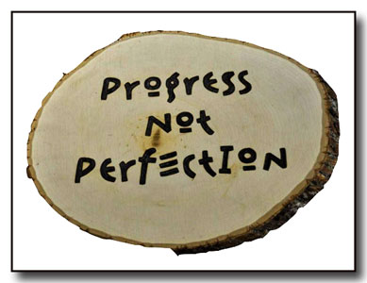
Progress
Households Housed (Nov. 1, 2016-Feb. 1, 2017)
20 total
Catholic Charities
3 households
Family Promise of the Chippewa Valley
10 households
Western Dairyland
7 households

Slide 8
Expanding the role of the Landlord Liaison
Initially, the position focused solely on finding housing for ETH RRH households
Western Dairyland has supplemented some funding to expand services to both CoC RRH and PSH
United Way
CSBG

Slide 9
Process
Receive referral
Obtain all necessary background information utilizing the Intake Form
Run CCAP on all adults, looking specifically for anything of concern to landlords, and discuss with the prospective tenant
Perform housing search taking all information obtained into consideration
Schedule, transport, and attend showings with the prospective tenant(s)
Schedule and perform HQS inspection
Schedule and attend lease signing, obtaining all necessary paperwork and submitting to the case manager upon completion
Two-week follow-up with the landlord and forward information to the case manager
Monthly follow-up thereafter, forwarding information to the case manager

Slide 10
Landlord Feedback
#1
Nice!
#2

Slide 11
Next steps…
Partnering with UWEC homelessness class to do a landlord satisfaction survey
Continue to look at data to see how effective the position is
Look into offering a rental course to our clients (similar to a Rent Smart curriculum)
Look for funding to continue the position☺
Continue to improve processes and adapt as needs and feedback dictate

Slide 12
Contact Information
Jenny Chaput, Landlord Liaison
Western Dairyland
715-836-7511, ext. 1150
jennifer.chaput@wdeoc.org
Jeanne Semb, Housing Services Coordinator
Western Dairyland
715-836-7611, ext. 1141
jeanne.semb@wdeoc.org
Kelly Christianson, Executive Director
Family Promise of the Chippewa Valley
715-834-4357
ecihn@sbcglobal.net
Mary Jacobson, Assistant Executive Director
Catholic Charities
608-519-8022
MJacobson@cclse.org

