Slide 1

Pathways
Housing First!
Ending Homelessness Transforming Systems and Changing Lives
Sam Tsemberis, PhD
CEO Pathways National
Madison, WI, November 12, 2015

Slide 2
Today’s Agenda
9:00- 4:00 Housing First Workshop
Morning Break
10:20-10:40
Lunch 12:00- 1:00 Lunch
Afternoon Break
2:15-2:35

Slide 3
CHAPTER I
Policy and Economic Factors
That Created and Contribute to Homelessness in the U.S.
  Federal government discontinues and remains disengaged from building affordable housing
  Rising rents and Flat line benefits
  Lack of support services for people with disabilities who are currently housed
Notes:
Key Messages:
Relevant policy issue federally, provincially and municipally
Currently managing it ineffectively in large part – substantial direct and indirect investments being made with limited outcomes
Social innovation that offers real, measurable on the ground outcomes
Additional information:
a study in British Columbia found that health, criminal justice and social service costs are 33% higher for people who are homeless than for people with housing (bullet 2)
the majority of participants (70%) have been successfully housed in their first apartment (bullet 3 – At Home)

Slide 4
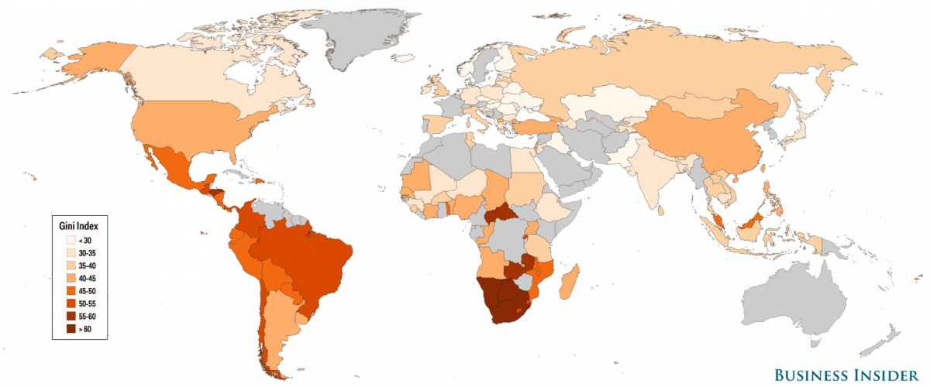
Gini Coefficient – income distribution and Social and Human Services
  Paul Toro: there is a correlation between GINI and social services

Slide 5
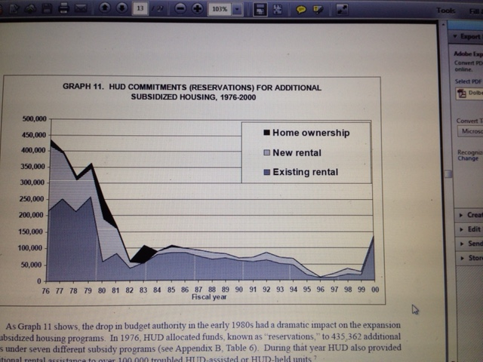
HUD COMMITMENTS FOR ADDITIONAL SUSIDIZED HOUSING 1976-2000

Slide 6
People on Fixed Income/SSI/ are Priced Out* (tacinc.org)
The national average rent for a studio/efficiency unit in 2014 was $674, equal to 90% of monthly SSI.
In eight states and in the District of Columbia, areas with the highest housing costs in the nation, the average studio/efficiency rent exceeded 100% of the income of an SSI recipient

Slide 7
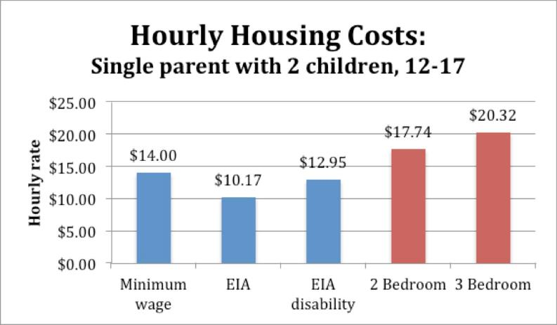
The poor (homeless) are priced out of the real estate market

Slide 8
Homelessness:
Policy response
Homelessness/poverty is caused by long term structural problems but policies have focused on emergency and short term responses
Most policies and legislation concerning the homeless is about emergency shelter, cold weather laws and control of public behavior (e.g., mayors ‘state of emergency on homelessness’; police ‘do not give them money)
Notes:
Key Messages:
Relevant policy issue federally, provincially and municipally
Currently managing it ineffectively in large part – substantial direct and indirect investments being made with limited outcomes
Social innovation that offers real, measurable on the ground outcomes
Additional information:
a study in British Columbia found that health, criminal justice and social service costs are 33% higher for people who are homeless than for people with housing (bullet 2)
the majority of participants (70%) have been successfully housed in their first apartment (bullet 3 – At Home)

Slide 9
Homeless Service System:
Response to clinical conditions
Typical services include:
  Street outreach, Emergency Health Care, Soup kitchens and other ‘emergency’ programs
  Shelters, cold weather shelters, drop-in centers and other temporary places
  Emergency and Transitional housing programs
  To solve chronic homelessness we need long term strategies that are all about permanent housing and (for some) we need to provide supports and sustain them
Notes:
Key Messages:
Relevant policy issue federally, provincially and municipally
Currently managing it ineffectively in large part – substantial direct and indirect investments being made with limited outcomes
Social innovation that offers real, measurable on the ground outcomes
Additional information:
a study in British Columbia found that health, criminal justice and social service costs are 33% higher for people who are homeless than for people with housing (bullet 2)
the majority of participants (70%) have been successfully housed in their first apartment (bullet 3 – At Home)

Slide 10
Do Homeless Service Systems Meet the Needs of People Who Are Homeless?
      It is humbling to realize that historically as social services providers we actually provided very little of what people who are homeless really want
      safe decent affordable place to live
      A decent job
      A loving relationship
Notes:
Key Messages:
Relevant policy issue federally, provincially and municipally
Currently managing it ineffectively in large part – substantial direct and indirect investments being made with limited outcomes
Social innovation that offers real, measurable on the ground outcomes
Additional information:
a study in British Columbia found that health, criminal justice and social service costs are 33% higher for people who are homeless than for people with housing (bullet 2)
the majority of participants (70%) have been successfully housed in their first apartment (bullet 3 – At Home)

Slide 11
Traditional Services Approach
Linear Residential Continuum of Care
Permanent housing
Emergency/
Transitional housing
Level of independence
Drop-In/
Shelter
Homeless
Based on traditional and unwarranted treatment assumptions PLUS
negative attributions toward the poor
Notes:
11
Much time effort sand money spent trying to cure addiction and mental illness for clients wo are unable. Unwilling or uninterested - priorities discrepancy misattributed as lack of motovation

Slide 12
Trajectories for those who remain chronically homeless
Homeless services
???
10% of the population use 50% of system resources
Jail
Emergency
Rooms
Hospital/
Detox
Streets
Shelters
Institutional Circuit
Notes:
12
Talk through the institutional circuit…the rise of the idea of chronic homelessness and information management, etc. Discuss how the assumptions of the traditional approach doesn’t hold up; that people can’t overcome chronic conditions first (by their very nature and definition this is a flawed idea). Talk about the trauma that people experience, and their inability to care for themselves, loss of relationships, often within the context of depleted social networks…cumulative disadvantage…which will be important later in how we work with people.

Slide 13
Who is served by Housing First programs?
Chronic & Episodically Homeless
10% of the population use 50% of system resources
10-15% episodically
80% transitionally homeless
5-10% chronically
Notes:
640 from

Slide 14
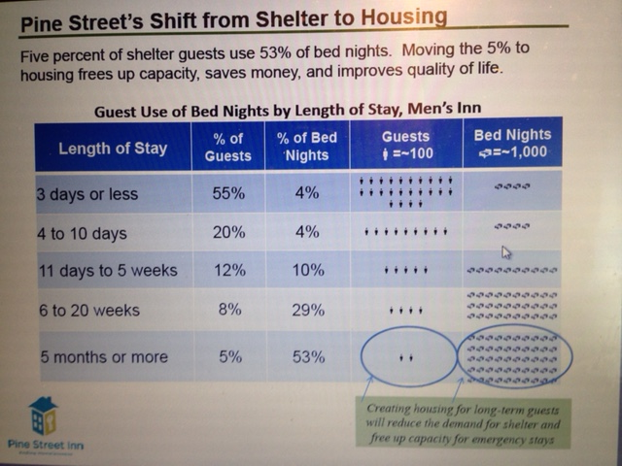
Pine Street Inn, Boston
– Lydia Downey from Managing to Ending homelessness

Slide 15

Shelter utilization and capacity ‘let’s do the math’
Shelter of 100 beds = 36,500 bed nights
Average stay per guest:
10 people staying 10 nights = 100 bed nights
10 people staying 180 nights = 1,800 bed nights
Annual Service Capacity
10 nights per guest = 3,650 guests/year
180 nights per guest= 203 guests/year

Slide 16
Why focus on the chronically homeless?
Existing systems repeatedly fail to engage/serve this group
Small % overwhelms systems (10% 50%)
Well known to the community
Consensus among multiple stakeholders
Opportunity to improve the overall system

Slide 17
2 genealogies driving programs for the homeless
Provider/gov’t/advocate driven system –
Develop a plan to end homelessness; focus is all homeless population
Plans assessment and referrals and system strategies
Program is consumer driven or client directed
Focus on individual who happens to be homeless
Plan is person centered, individualized
The program is evidence based

Slide 18
Q&A
CHAPTER II
THE PATHWAYS
HOUSING FIRST PROGRAM
HOUSING COMPONENT

Slide 19
Housing First:
Immediate Access
Appropriate Supports
No Treatment Prerequisites
Offers Housing as Basic Human Right
A Paradigm Shift in
Housing and Services

Slide 20
Pathways’
Housing First Model
Permanent supportive housing
Transitional housing
Ongoing, flexible support
Harm Reduction
Emergency Shelter Placement
Homeless
Notes:
20

Slide 21
5 Dimensions of the Pathways’ Housing First Program
Consumer Choice
Services Match Client Needs
Separation of Housing and Services
Recovery Oriented Services
Program structure
Notes:
21

Slide 22

Choice in Housing
(Practical financial limits)
Choice in availability
TENANTS RIGHTS/STANDARD LEASE
Match client choice and availability
Program Agreement (home visit a must)
Affordable & decent
Integrated into the community
Permanent

Slide 23
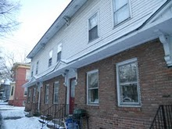
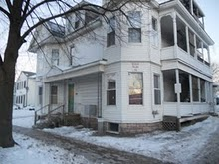
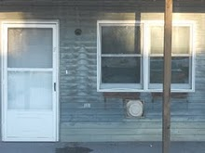
200 Tenants, 200 Apartments, 2 Counties, 6 Cities, 95 Landlords:
Housing Retention Rate 90.5% (12 mo)
Pathways Vermont,
Housing First Rural Programs

Slide 24
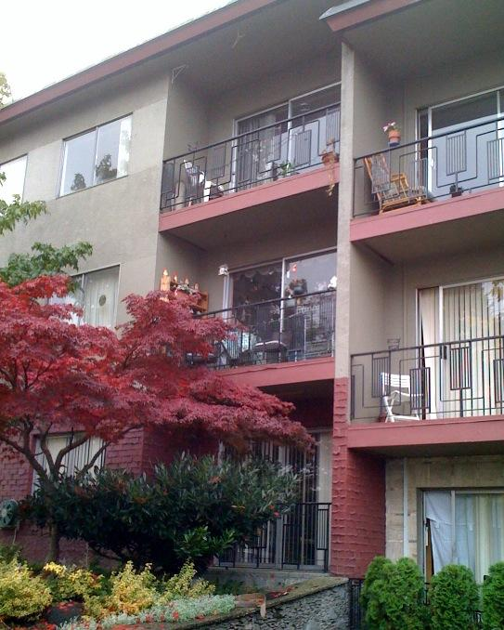
Rental Housing
Community Landlords as Partners
Guaranteed rent
Support for tenancy
No vacancy loss
Program responsible for damages
Recognition for help in solving problems
All have common goal: safe, decent, well-managed housing

Slide 25
Single Site Approach to Housing First
Single Site Harm Reduction Proram
Some programs concentrate special needs populations and have services on site (integration is a challenge)

Slide 26
Housing First; Providing Housing
HOUSING FIRST provides immediate access to housing
Programs find ways to engage private market or landlords or social housing
Rent or rent supplements are essential
Best practice target: provide access between 2-4 weeks from date of admission

Slide 27
Q&A
CHAPTER III
THE PATHWAYS
HOUSING FIRST PROGRAM
SERVICES, TREATMENT, AND SUPPORT

Slide 28

After housing…
Health &Wellness/Weight Loss/Exercise
Finances/Budgeting/
Money Management
Alcohol/Drug -- Use Abuse
Mental Health Issues
JOB, JOB, JOB
eviction

Slide 29
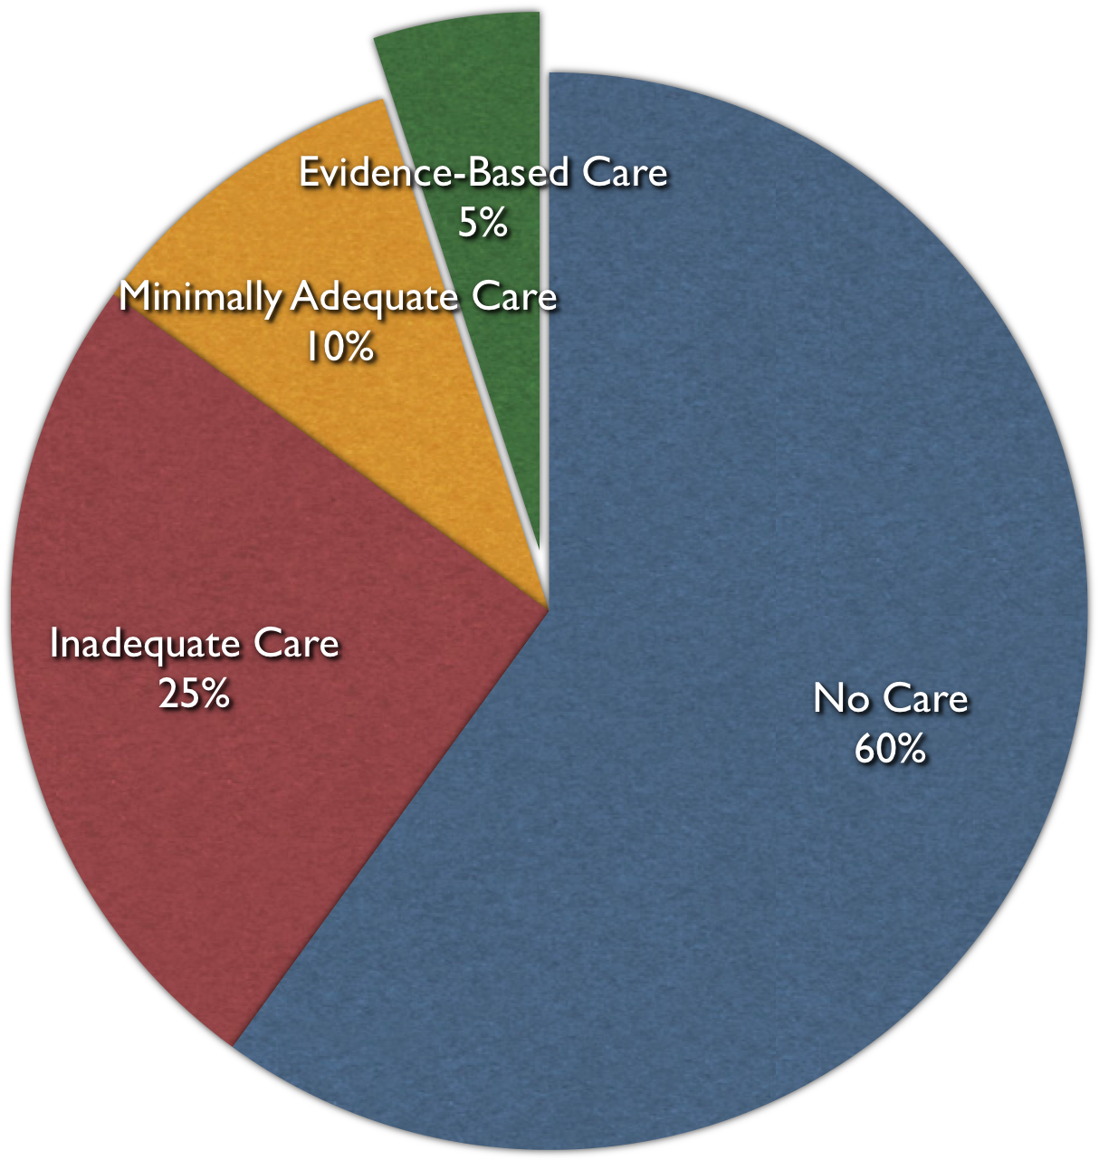
Why do so many
avoid mental health services?
(Labelling, stigma,
discrimination, isolation, fear, etc.

Slide 30

1b. Choice and SERVICES
“NO WRONG DOOR”
Friends & Family
Spiritual
Education
Documents/
Legal
EMPLOY
MENT
CLIENT
HEALTH
SOCIAL
SUPPPORT
Arts /
Creativity
Addiction
Tx
Mental
Health
SELF-DETERMINATION
IS THE FOUNDATION OF
PROGRAM PHILOSOPHY
HOUSING
Notes:
Discuss service choices

Slide 31
2. MATCHING SERVICE NEEDS
Community based, responsive, and flexible
High Need
ACT - a multidisciplinary team and provides support and services directly
Caseload 1 to 10
Work as Team
Services provided in the participant’s home or community (group meetings offered at offices or other community settings)
Off site and on-call services 7-24
Moderate Need
ICM - case management team provides support and brokers services
Case loads of 1 to 15/20
FACT Team provides blended model
All teams use a recovery orientation
Notes:
31
Discuss the historical piece and how in this intervention we are doing a blend of services …. Case mangement plus, ACT lite, many sites are augmenting services

Slide 32
Limits to Choice:
SERVICES
Home visits are mandatory and frequency may be increased to meet new circumstances
Planning for crises (WRAP plan) anticipates problems and provides a mutually agreed upon blueprint for response
(e.g., medical, emotional, relapse, may include additional support, or hospitalization)

Slide 33
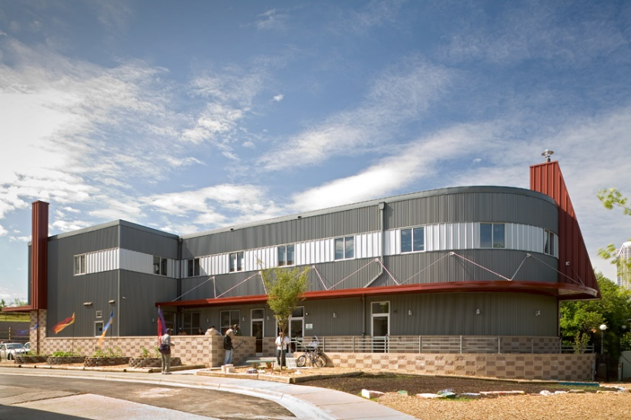
3. Separation of Housing and Services
Separated spatially,
conceptually,
and operationally

Slide 34
PRINCIPLE 3: HOUSING and SERVICES ARE SEAPARATE DOMAINS
Housing Domain
Services Domain
Clinical services and case management Benefits/entitlements/case management
Recovery goals; family reconnection, social, educational, employment
Apartment selection, set up
Agree to terms of standard lease
Lease signing, security, furnishing
Rent payments and managing the apartment and the tenancy
Treatment goals: mental and physical health; addiction

Slide 35
Another Dimension of the Paradigm Shift is the Treatment Philosophy
4. Recovery Oriented Services

Slide 36



Changing Thinking That We Have Been Locked Into
Jail Lock up
Psych Hospital Ward Key
Own Keys to Own Apt.

Slide 37
Treatment Philosophy
What Are Recovery Focused Services?
What is a welcoming culture?
What is trauma informed and trauma competent?
Why use Harm Reduction?

Slide 38

Housing First Requires Change
Change in view of those served
Change in goals of the system
Change in power relationships
Change in locus of care
Change in treatment culture
Change in funding patterns

Slide 39

Recovery Orientation
- Staff and Agency orientation
- Inter-personal
(you are an active agent in the treatment and outcome)

Slide 40
Overview: Six Core Principles of the Strengths Approach
People with psychiatric disabilities have a continuing capacity to learn, grow and change
The focus is on the individual’s strengths rather than on their psychopathology
The consumer directs the process (shifts power dynamic and motivation*)
The helping relationship is primary and essential
Assertive outreach is the preferred way of serving people
The community is rich with resources; natural occurring community resources are preferable to formal program resources
Notes:
This overview should be stated without elaboration, each is discussed in great detail later

Slide 41
How SBA Differs (cont.)
From what’s wrong to what’s strong
  Rather than focus on what is “wrong” (symptoms, substance use concerns, skill and resource deficits) focus foremost on what is “right” with people (their goals, what they want, what they can already do well or well enough)
Personalized rather than categorical recovery supports
  Rather than categorizing people by diagnosis, level of functioning, degree of vulnerability, or stage of change and providing a standardized service package for a category of people, SBA tailors services and supports to the individual to build personal pathways to recovery

Slide 42
Relationship Building: Engage in Hope-Instilling Practice
Express and model respect, treat the person with dignity
Continuously promote personal choice in small and large ways
Expand the resources base. Open new horizons by describing possibilities and exposing people to opportunities and recovery role models
Focus on the potential for a “real life” in the community, rather than the formal services
Be purveyors of Hope: Rachel Remen, book Kitchen Table Wisdom

Slide 43

Life’s domains develop at different pace
  Living situation
  Employment
  Intimate Relationship
  Health/Wellness
  Social supports
  Leisure/recreation
  Education
  Spirituality

Slide 44
World Health Organization (WHO)
Studies on Outcomes for Severe Mental Illness
Outcomes at two years and five years, the patients in the developing countries had a “considerably better course and outcome.”
Report concludes “being in a developed country was a strong predictor of not attaining a complete remission.”
They also found that “an exceptionally good social outcome characterized the patients” in developing countries.
Source: Jablensky, A. “Schizophrenia, manifestations, incidence and course in different cultures.” Psychological Medicine 20, monograph
(1992):1-95.

Slide 45
WHO Studies (continued)
Medication usage (Robert Whitaker:
Mad in America, 2002.)
16% of patients in the developing countries were regularly maintained on antipsychotics
61% of the patients in wealthier countries.
15-year to 20-year follow-up:
53% of schizophrenia patients had favorable outcomes, were “never psychotic” after first 2 years, and of those 73% were employed.
Source: Harrison et al., in Schizophrenia Bulletin June 2001.

Slide 46
Q & A
CHAPTER IV
harm reduction, home visits
and trauma informed agency

Slide 47


    Harm Reduction and
    Housing First
Harm Reduction in Everyday Life

Slide 48

Harm Reductions
A perspective on treatment that includes a set of practical strategies to reduce the negative consequences of drug use (food, relationships, finances), that incorporates a spectrum of strategies from safer use to abstinence.
-The Harm Reduction Coalition

Slide 49
Harm Reduction and Housing First
Harm Reduction is not limited to working with addiction
Seek to reduce the risks associated with any harmful behaviors (safe injection, psychiatric symptoms, eviction, explotation, etc.)
HR allows for consumer directed services
Allows for honest discourse
HR involves tolerance of risk by staff and agency
Notes:
Harm reduction is another part of the Housing First service philosophy. The Harm Reduction Coalition defines harm reduction as: A perspective and a set of practical strategies to reduce the negative consequences of drug use (food, relationships, finances), incorporating a spectrum of strategies from safer use to abstinence. Exampes of harm reduction include: - Condom use
- Change patterns of use (amount, timing, location)
- Superficial cutting vs. jabbing knife into leg
- Needle exchange
- Methadone (substitution therapy)

Slide 50
The statistics on harm reduction

Slide 51

Narrative Therapy
Language does not simply reflect reality it constructs reality
e.g., addicts vs people who use substances
Naming the problem and locating the problem outside the person allows us to unite with the person against the problem*
Michael White and
David Epston
At Home/Chez Soi: Brian Williams and Barbara Baumgarten (2013)

Slide 52
Principles of Harm Reduction,
Attitudes and Values
Accepts, for better and for worse, licit & illicit drug use is part of society
Drug Use= continuum of behaviors
Successful Interventions = Improve quality of life
Non-judgmental, non-coercive provision of services & resources
Affirms drug users as primary agents of reducing harms
Minimize harmful effects rather than ignore or condemn them

Slide 53
Principles of Harm Reduction - Intervention
Person
Context
Drug
Meet people where they are
Understanding why they use
Understand under which conditions are they more prone to use
Relapse plans = expected part of recovery
  Strengths based- gains rather than losses approach - noting time reduction or abstinence is maintained
**
** targeted behavior

Slide 54
Strategies/Interventions include:
Controlled Use
Goal is to reduce the harm by reducing consumption or by controlling episodes/situation of use
Application
Applied in self-help support groups (Moderation Management; www.moderation.org)
Some dual disorder programs
Some harm reduction/needle exchange programs
Some housing programs

Slide 55


Substitution Therapy
Goal is to replace one drug with a high associated risk with another drug of a lower risk
Application
Methadone maintenance
Nicotine replacement strategies
Physician-prescribed drugs

Slide 56


Examples of Reducing Risks
  Using a screen or rubber tubing for
  crack use
  Getting off the bus two stops earlier
  and walking
  Switching timing
  Paying rent before buying substances
  Buying a pint or 6 pack instead of a
  quart
  Buy loosie instead of a pack

Slide 57

Harm Reduction and Housing First
“Attitude is not everything, it is nearly everything” –Bert Pepper, MD
Harm reduction is:
An integral part of Housing First
Rooted in unconditional positive regard for the individual

Slide 58
Harm Reduction and Liability in Housing First Programs
Requires AGENCY to assume some Responsibility and Liability
Requires CLIENTS to assume greater responsibility and liability
Client's choices are discussed in terms of consequences
Responsibilities as tenant, neighbor, community member
For landlords' concerns - liability
For other tenants - safety
For tenant's lease
Examining the consequences of use and relapse
For tenant's behavior - risk

Slide 59
Decisional Balance: Having open and honest conversation
What are the costs and benefits of
changing vs. not changing behavior?
Option | Benefits | Costs
Making Change (reducing alcohol) | Family would trust me again More money Better health | Won’t have a way to relax Lose my friends Life will be boring
Not Changing | Helps me relax I Feel like I fit in Love the buzz I get | Less money Cannot see my kids Legal problems

Slide 60

Home Visits: Up Close and Personal
Home visit provides opportunity for observation of entire life space
Observe and possibility to intervene in areas of health, mental health, self care, hygiene, social life, nutrition, community participation and more
What is the most respectful, empowering, and effective way to address the issues we observe? (stage of change is issue specific not person specific**)

Slide 61
Trauma-Informed
System
Enduring and meaningful change occurs when the people who make up the system share a philosophy about trauma, services, the helping relationship, and trauma clients.
How we understand trauma will determine to how we envision the overall approach to the work we do.

Slide 62
In a trauma-informed system
trauma is viewed not as a single discrete event but rather as a defining and organizing experience that forms the core of an individual’s identity.

Slide 63
In a trauma-informed approach the focus is on understanding the whole individual and appreciating the context in which that person is living their life.
Rather than asking: “How do I understand this problem or this symptom?”
We ask instead: “How do I understand this person?”

Slide 64
This approach
shifts the focus onto the individual
and away from some limited aspect of his/her functioning
It gives the message that his/her life is understandable, and her behaviors make sense when they are understood as part of a whole picture.

Slide 65
Housing First and Harm Reduction
    Meet people where they are…
    but don’t leave them there.

Slide 66
Q&A
Home Visit Video
(12 min)

Slide 67


Recovery and Peer Support
What helps?
What hinders?
No substitute for peer support
We need to expand definition of ‘services’
Notes:
Summarize and emphasize the idea of where the locus of control is.. That is now with the client.. Give a hint about why MI works well with this perspective

Slide 68
Graduation and Recovery:
Social Networks, Life Not Defined by Illness, Community Integration
Social, Friends, and Family
+Positive reconnections
Team Supports Wellness
Self Management
Teaching rather than doing
+New social possibilities
- Discontinuity with street friends
- Additional responsibilities and stress
+New roles and responsibilities for consumers and staff

Slide 69

Social Inclusion and
Community Integration

Slide 70
Promoting Social Inclusion
Term ‘Social Inclusion’ originated in Europe
Society and its institutions actively promote opportunities for the participation of excluded persons including persons with psychiatric disabilities, in mainstream social, economic, educational, recreational, and cultural resources.
Full recovery can only occur when people with mental illnesses have the means and access to full-fledged membership in their communities (Thompson and Rowe, Psych Services, August 2010).

Slide 71
Rain City YouTube Video: Choice
HOUSING FIRST
AND SYSTEMS CHANGE

Slide 72
System Change Question
Can we simply introduce a new program into an existing system and keep everything else the same?

Slide 73
HUD Continuum of Care Encouraging Housing First
Extent to which PSH programs within a Community implement a Housing First approach
Prioritization of chronic homelessness
Housing offered without preconditions
Rapid placement (and stabilization)
in permanent housing with supports

Slide 74
Programs
Stages of Change
Pre-
contemplation
Contemplation
Preparation
Action
Maintenance
Relapse

Slide 75
Current System
shelter
Housing
St support
Centralized
Assessment and
Centralized Entry
Housing
Mod
support
Housing
High
support
street

Slide 76
Steps needed to Introduce System Change Intervention
Target Population: Community sets priority among homeless population
Collaboration: Partnership among agencies (identification, data sharing, resource sharing, etc.)
Operations: Design or re-design system so there is a clear map for all providers and participants
Measure: Set specific targets and timelines and trach outcomes as a community (transparency)
Leadership/Collaboration model

Slide 77
Program Building Blocks
Outreach
Housing First ICM
Coordinated Entry
Permanent Supportive Housing
Other Support Services
Transitional Housing
Emergency Shelter
Affordable Housing

Slide 78
Chapter V
Program Fidelity

Slide 79
Pathways Housing First Program
What is Program Fidelity?
How do you Measure it?
Why does it matter?
https://samhsa.gov/nationalregistry

Slide 80
Why Fidelity?

Slide 81
Components of Program Fidelity
Assess the extent to which components of the program model are being implemented
  Structural features:
  what does the housing look like?
  What services are provided?
  Philosophy, values: participant choice? Harm reduction?

Slide 82

Fidelity Site Visit
Multiple Sources of Data
Before visit: collect basic info
  What types of housing do participants live in
  How long did it take to get into housing
  What percentage of participants have been discharged
Team meeting observation
Individual interviews with staff
  All frontline providers; Each discipline
  Team Leader
  Program Director, Administrators
Focus group with program participants
Chart review (random selection)
Optional: home visits

Slide 83
Why Fidelity?
Housing First is not Housing Only
Housing First is not “Housing is the first thing after they…”
Choice is not laissez-faire
Assertive engagement is not coercion
Peer Specialists are not junior case managers
Understand current practice & make improvements
Maximize outcomes

Slide 84
Pathways Housing First Fidelity Dimensions
5 Domains:
1) Housing Choice & Structure
2) Separation of Housing & Treatment
3) Service Philosophy
4) Service Array (Match Needs)
5) Program Structure

Slide 85
Sample Items
Rights of Tenancy, affordability, integration
No housing readiness requirements
No treatment contingencies: Can keep housing as long as participant follows a standard lease
Extent of implementation of harm reduction
Availability of services for assistance with psychiatric, substance abuse, employment/educational, and social integration needs

Slide 86


Question #1
True or False?
Housing First means that the first thing you do is place the client into an apartment of their own right away. thus cannot be fairly assessed using the fidelity scale.
Notes:
F it is a client driven program so you help the client go where he or she wants to go, usually an apartment of their own.

Slide 87
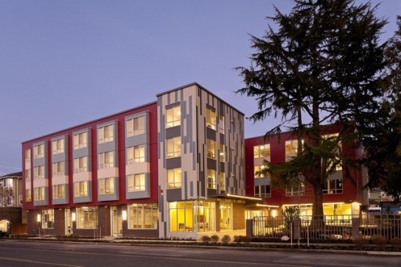
Question #2
True or False?
Congregate living (single site) or group home programs are not compatible with the Housing First scattered site apartment model and cannot considered as Housing First (or assessed using the HF fidelity scale).ist scattered site model and thus cannot be fairly assessed using the fidelity scale.
Notes:
(False:Paula can speak to the use of the scale with some modifications with the Bosman)

Slide 88

Question #3
A, B, C or D?
HF programs use both ICM and ACT teams to provide support and treatment services. In what ways do they operate differently?
Service Philosophy
The services they can offer a consumer
Only one can use a team approach
None of the above scattered site model and thus cannot be fairly assessed using the fidelity scale.
Notes:
Brian can speak to the advantages re having a multi-disciplinary team that can delivery services rather than having to access system resources. Might also note that some fidelity items were reworded in the revision of the scale developed to accommodate our Canadian project.

Slide 89
Question #4
True or False?
If you cannot promise direct access to housing at first engagement, it is not housing first. and thus cannot be fairly assessed using the fidelity scale.
Notes:
T. The program must have either it's own units or rent subsidies to allow the program Participants to start the housing search right away.

Slide 90

Question #5
True or False?
Incorporating peer specialists, people with lived experience, into your program is helpful and recommended for Housing First programs, but peer specialists should not conduct home visits on their own.
cannot be fairly assessed using the fidelity scale.
Notes:
False – important part of program, area 37 on scale, explain why important

Slide 91
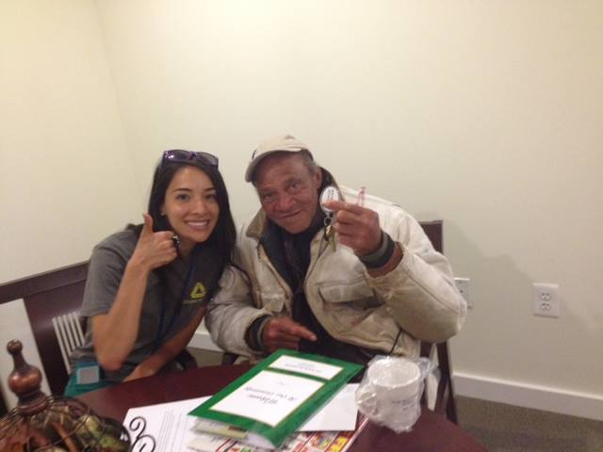
Question #6
What is more HF?
A or B?
Respond to the consumer’s current crisis? e.g., agree to buy a bus ticket to see his/her family in Quebec City because that is all that he/she is talking about OR
Stay focused on the program mission and respectfully explain that we will get the bus ticket in good time, but this about getting them a place to stay?
fairly assessed using the fidelity scale.

Slide 92
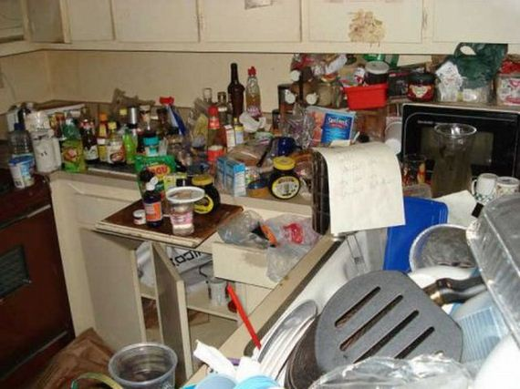
Question #7
True or False?
If one of your participants has lost two apartments and is not doing well in the third, this is the time to decide that this program is not right for this person.

Slide 93

Question #8
True or False?
When a team member visits a participant's apartment and the participant says from behind a closed door that he/she wants their privacy and there is no need for this visit, the right thing to do is for the team member to leave until the tenant changes his/her mind about accepting a visit.

Slide 94

Question #9
True or False?
In HF programs the responsibility for maintaining decent, quality apartments is the responsibility of community landlords.

Slide 95



Question #10
Harm Reduction can be used most effectively for which issue? A, B, C, D or E
Hoarding b) Mental health problems c) Budgeting
d) all of these
e) none of these, it a substance use intervention

Slide 96
CHAPTER VI
Program Fidelity and
Program Effectiveness
How Do you Measure Effectiveness?

Slide 97
Fidelity Self-Assessment Survey & Residential Outcomes for California Full Service Partnerships
93 programs
6,584 participants
Diagnosis – Schizophrenia 62%
Housing Outcomes 1 year pre- and post-enrollment into housing & services

Slide 98
Housing First Self-Assessment Survey:
Overall Fidelity & Residential Outcomes
High Fidelity programs: Enrolled consumers with much longer histories of homelessness
High = 101 days Low = 46 days
Declines in homelessness were greater among high fidelity programs. (p = .039)
Days living independently in an apartment or SRO increased among high fidelity programs, but declined among low fidelity programs (p<.01)
UCSD: Gilmer et al., Psychiatric Services, 2014
Notes:
Further understanding what the program is doing and looking at important outcomes, such as consumer goals and whether they are being met.

Slide 99
Housing First for Persons with Substance Use Problems
9 Scatter-site Housing Providers (NYC)
358 Participants
Modified Fidelity Assessment
Participants in programs with greater Housing First fidelity along principles of client-centered services and harm reduction interventions/open communication:
More likely to stay in housing
Less likely to report using stimulants, opiates at 1-yr follow-up
CASAColumbia: Davidson et al., 2014, Psychiatric Services

Slide 100

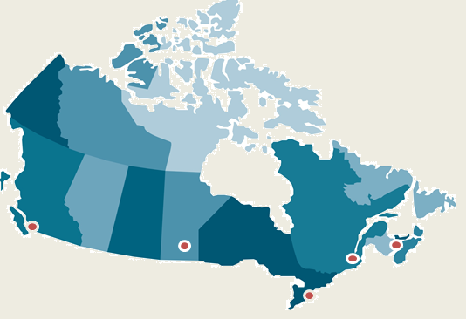
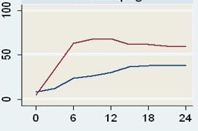
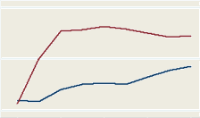
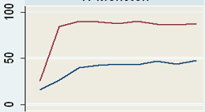
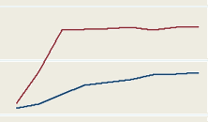
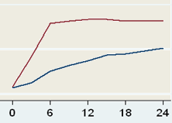
Housing First is Effective in Cities of Different Sizes and Composition Across Canada
Vancouver
Pop: 578, 000
Moncton
Pop: 107,000
Winnipeg
Pop: 633, 000
Montreal
Pop: 1,621,000
Toronto
Pop: 2,503,000
Notes:
The graphs show that housing stability does not differ much across the sites. On the y axis is the % of time spent in stable housing, and on the x axis is the number of months spent in the study. The red line represents participants receiving the Housing First Intervention, the blue line represents the participants receiving treatment as usual.

Slide 101
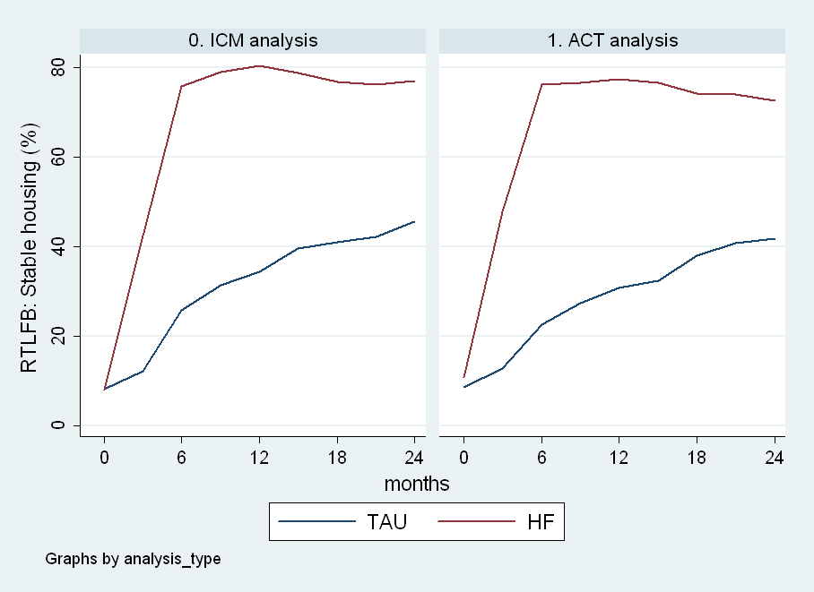
Housing First Achieves Similar Housing Outcomes for Moderate and High Need Participants
Percentage of time housed

Slide 102
Cost Offsets Vary Depending on Need Level
Cost Analysis: HF with ACT
Housing First costs $22K per person per year
Average net cost offset of $21.4K CAD (96%) per person.
$10 CAD invested in HF with ACT saved $9.60 CAD
Cost Analysis: HF with ICM
Housing First costs $14K CAD per person per year
Average net cost offset of $4.8K CAD (34%) per person.
$10 CAD invested in HF with ICM saved $3.42 CAD

Slide 103
Differing Provider Perspectives by Program Model:
A Program Implementation Paradox
TF providers were consumed by the pursuit of housing
HF providers focused on clinical concerns
Front-Line Practice
Housing First Model
Focus on Housing
Treatment First Model
Focus on Treatment
Stanhope, V., Henwood, B.F. & Padgett, D.K. (2009). Understanding service disengagement
from the perspective of case managers. Psychiatric Services, 60, 459-464.
Notes:
Discuss this paradox in the face of consumer preference literature about wanting housing.

Slide 104
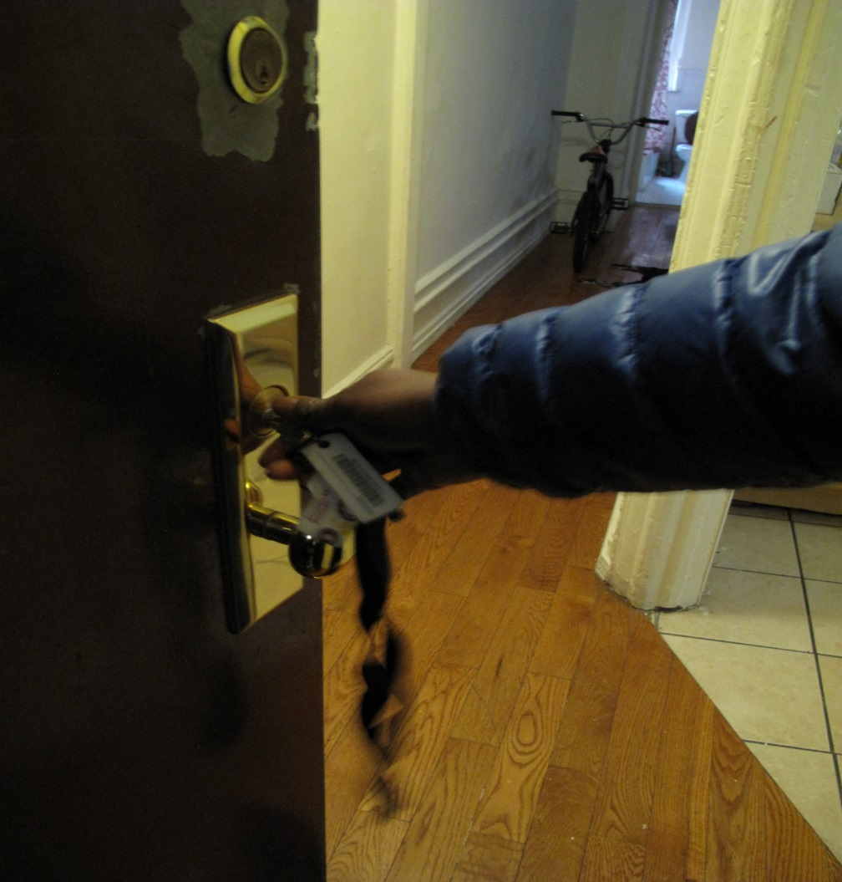
Key Point About Program Fidelity
High program fidelity is associated with greater housing stability and quality of life.

Slide 105
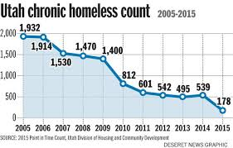
Ending Chronic Homelessness

Slide 106
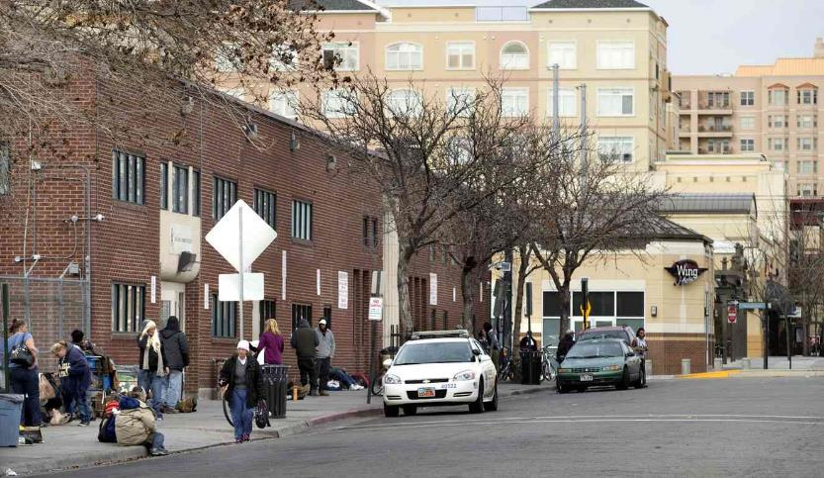
The Road Home SLC, Utah

Slide 107
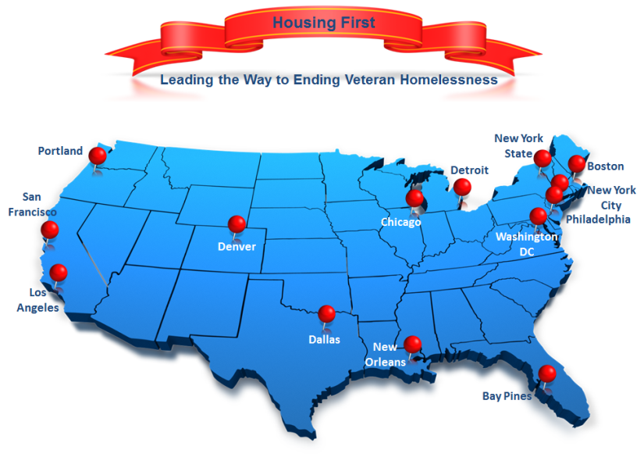

Slide 108

Thank you!
Questions?
For additional information:
pathwaystohousing.org
www.mentalhealthcommission.ca
www.homelesshub.ca
sam@pathwaysnational.org

