Slide 1
Federal & State Legislative Landscape
Carrie Poser
CoC Director, WI Balance of State CoC
February 2020

Slide 2
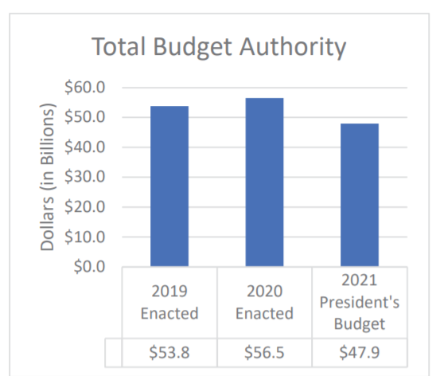
Federal Activity
On February 10th, the Trump Administration released the proposed 2021 HUD Budget. The budget seeks to provide HUD with $47.9 billion in funding.
This is $8.6 billion less than the enacted level for 2020.

Slide 3
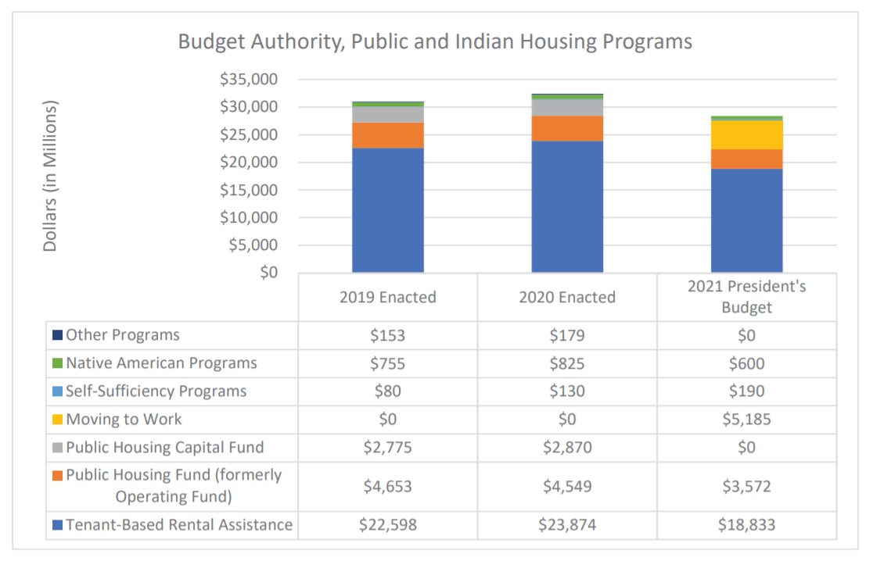
Federal Activity
The Office of Public and Indian Housing (PIH) – proposed $28.4 billion (which is $4 billion less than the enacted level for 2020).
Create new “Moving to Work” program
Designated “MTW” agencies – 39 currently with plan to add 30 new PHAs
Zero currently in Wisconsin
Increase tenant rent contribution
Reduce frequency of income recertification
Work requirements for “work-able” households
Exempt the elderly, disabled, those caring for a disabled family member or small child and pregnant women

Slide 4
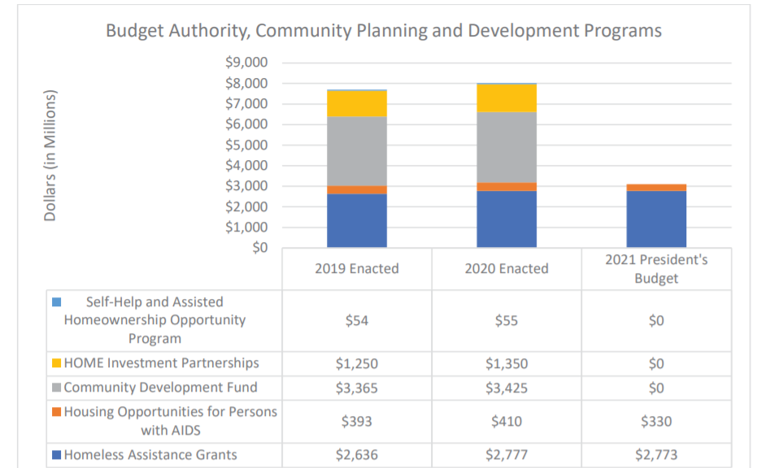
Federal Activity
The Office of Community Planning and Development (CPD) – proposed $3.1 billion (which is $4.9 billion less than the enacted level for 2020).
Eliminate Community Development Block Grant (CDBG) program
Eliminated HOME Investment Partnership Programs
Reduce CoC & ESG by $4 million
Total request for CoC = $2.5 billion
Total request for ESG = $280 million
Total request for HMIS TA = $7 million

Slide 5
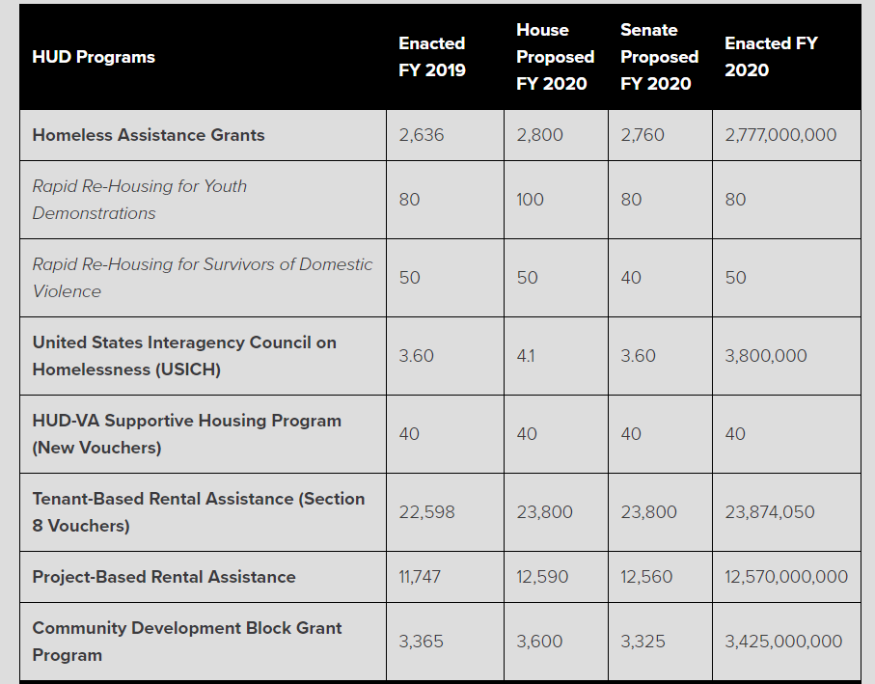
2020 Enacted Budget
Legislative language nullified controversial scoring changes included in the FY2019 NOFA was retained, despite strong Administration objections.
The previous changes undermined Housing First and services to LGBTQ people experiencing homelessness.

Slide 6
H.R. 1856 – The Ending Homelessness Act of 2019 (introduced by Rep. Maxine Waters).
Add $2.65 billion in annual spending for new projects over a period of 5 years
Permanently authorize HUD’s McKinney-Vento Homeless Assistance Grants account
Permanently eliminate the sunset clause for the U.S. Interagency Council on Homelessness.
Annual funding for this bill would include:
$1 billion for new homeless assistance projects, with 75% to be spent on permanent supportive housing, distributed to communities by formula, and renewed out of HUD’s regular CoC homeless assistance program competition (which would require additional appropriations each year).
$500 million for new incremental Housing Choice Vouchers (also known as Section 8) for people who are homeless, distributed to communities according to need and renewed out of regular Housing Choice Voucher appropriations.
$100 million for new outreach and service coordination grants, awarded competitively. Since these activities are eligible for HUD CoC funding, renewals could be done through the regular CoC competition, subject to additional appropriations.
$1 billion in incremental funding for the National Housing Trust Fund to develop housing, with homeless people prioritized for the first five years.
$50 million in incremental rental assistance funding to support National Housing Trust
Update:
This legislation was introduced in the Senate (S.2613) by Senator Kamala Harris (D-CA).
Rumor that this bill will be considered on the House floor in early 2020.

Slide 7
NAEH Policy Brief: https://endhomelessness.org/wp-content/uploads/2019/07/The-Ending-Homelessness-Act-of-2019-H.R.-1856-v2.pdf
National Low Income Housing Coalition Policy Brief: https://nlihc.org/resource/house-financial-services-committee-approves-ending-homelessness-act
Actual Bill: https://www.congress.gov/bill/116th-congress/house-bill/1856?q=%7B%22search%22%3A%5B%22hr1856%22%5D%7D&s=3&r=1

Slide 8
H.R. 4029 –Tribal Access to Homeless Assistance Act of 2019
This bill would enable Indian Tribes and tribally designated housing entities to apply for, receive, and administer grants and sub-grants under HUD’s CoC Program.
H.R. 4029 was marked up by the House Financial Services Committee on 9/19, passed with voice vote. It was passed by the House in late November.
Update:
Attempts in mid-December to “hotline” (i.e. move by unanimous consent) the Senate version of the legislation was blocked by Senate Republicans.
Actual Bill: https://www.congress.gov/bill/116th-congress/senate-bill/2282/all-info
Actual Bill: https://www.congress.gov/bill/116th-congress/house-bill/4029

Slide 9
H.R. 4300 - Fostering Stable Housing Opportunities Act
This bill would ensure that the sudden transition from foster care to adulthood – including the related loss of the financial, educational, and social supports that the child welfare system provides – does not place this vulnerable population at great risk by amending the Family Unification Program to provide vouchers for up to an additional two years, contingent on participation in self-sufficiency activities.
The bill was marked up by the House Committee on Financial Services on 9/19, and it was approved the next day by a vote of 47-0, and it could be considered by the entire House.
Update:
Senate version (S. 2803) was introduced.
Actual Bill: https://www.congress.gov/bill/116th-congress/house-bill/4300/all-info

Slide 10
H.R. 2398 – Expanding Eligibility for HUD-VASH
Chronically homeless veterans who have been other than honorably (OTH) discharged are not receiving the housing and service to end their homelessness. Although an OTH discharge is the most severe administrative discharge a veteran can receive, it is not a punitive discharge, and should not be confused with a dishonorable (“bad-conduct”) discharge.
H.R. 2398 and S. 2061 would make these veterans eligible for the highly effective HUD-VASH program.
H.R. 2398 was approved by House Financial Services committee on 11/14, after having been approved by the House Veterans Affairs committee in May.
Update:
S. 2061 awaits consideration by the Senate Banking, Housing, and Urban Affairs committee.
NAEH Policy Brief: https://endhomelessness.org/wp-content/uploads/2019/07/HUD-VASH-2019-v2-FINAL.pdf
Actual Bills: https://www.congress.gov/bill/116th-congress/house-bill/2398?q=%7B%22search%22%3A%5B%222398%22%5D%7D&s=1&r=1
https://www.congress.gov/bill/116th-congress/senate-bill/2061

Slide 11
Other
Providing Health Care for the Homeless
The Social Determinants of Health Act, which had been introduced in the House (H.R. 4004) in July by Representative Cheri Bustos (D-IL), was introduced in the Senate in December by Senator Todd Young (R-IN). The bill would encourage states to consider social determinants of health (e.g., housing education, neighborhood, income, etc.) in the development of health care policy, which should lead to better and less expensive health care.
Creating New Vouchers for Families in Need
The Family Stability and Opportunity Vouchers Act of 2019 (S. 3083) would establish 500,000 new Housing Choice Vouchers over the next five years for families that are experiencing homelessness, housing instability, or wish to live in areas with quality schools and other opportunities for healthy development.
The legislation was introduced by Senator Todd Young (R-IN), and it is cosponsored by Senator Chris Van Hollen (D-MD). The Center for Budget and Policy Priorities, which was extensively involved in the drafting of this important legislation, reports that, “Housing mobility programs help low-income families with children use Housing Choice Vouchers to move to high-opportunity neighborhoods. These neighborhoods often have less poverty, better schools, less crime, and more resources such as grocery stores and parks, which together promote better health and life satisfaction for parents and children and improve children’s chances of succeeding in school and earning more as adults.”

Slide 12
Next Steps – Federal Level
Reach out to your Congress person in the House of Representatives & Senate.
Educate your Congress person about the impact these bills could have in your community. This includes data and anecdotal information.
Invite elected officials to your community
Prepare to include elected officials in your July PIT count preparations

Slide 13
Opportunity Starts at Home Campaign
Opportunity Starts at Home is a long-term, multi-sector campaign to meet the rental housing needs of low-income people.
Housing affordability is central to other national priorities, like health care, food security, education and more. Yet the gap between rents and incomes is growing, and this is compounded by unprecedented threats to federal housing assistance.
The National Low Income Housing Coalition launched the Opportunity Starts at Home campaign together with the Center on Budget and Policy Priorities, Children’s HealthWatch, and the National Alliance to End Homelessness.
Steering committee of partners including Catholic Charities USA, the Children’s Defense Fund, Community Catalyst, the Food Research and Action Center, JustLeadershipUSA, NAACP, National Alliance on Mental Illness (NAMI), the National Association of Community Health Centers, the National Association of Social Workers, the National Education Association, the National League of Cities, the National LGBTQ Task Force, the National Women’s Law Center and UnidosUS.
https://www.opportunityhome.org/about-us/

Slide 14
State Legislation
Interagency Council approved “A Hand and A Home” – strategic plan to end homelessness. This plan made 8 specific funding recommendations.
Those 8 specific funding recommendations became 8 Assembly initiated bills. These bills were all approved by the Assembly and went to the Senate. These bills included funding for each of the next 2 years.
(1) Assembly Bill 119/Senate Bill 122 – Increase Funding for State Shelter Subsidy Grant ✓
Adding $500,000 per year to the State Shelter Subsidy Grant, attaching performance metrics to be determined by DOA on the new money and gradually adding performance metrics to the entire grant, cleaning up administrative code
Per DEHCR, the 19-20 funds would go to current grantees using the same formula. No performance metrics will be included. No new grantees. For 20-21, DEHCR would begin developing a plan for implementing the additional criteria

Slide 15
Senate: Utilities & Housing Committee
Assembly Bill 123 & Senate Bill 119
Adding $900,000 per year to the Housing Assistance Program (currently funded at $300,000 per year)
Assembly Bill 121 & Senate Bill 120
Creating a new $300,000 per year appropriation to help hire housing navigators
(3) Assembly Bill 125 & Senate Bill 121
Creating a new program to assist landlords in bringing units up to federal standards for the purpose of renting to low-income individuals
(4) Assembly Bill 124/Senate Bill 144
Adding $500,000 per year to the Homeless Prevention Program for the purpose of prevention funds
Adding $300,000 per year for the purpose of diversion funding

Slide 16
Senate: Local Government, Small Business, Tourism & Workforce Development Committee
(1) Assembly Bill 144 & Senate Bill 123
Adding $250,000 per year to the Skills Enhancement program (Community Action Agency Program)
(2) Assembly Bill 122 & Senate Bill 124
Requiring that the state identify homeless populations in its workforce plan under the federal WIOA
Requiring that all workforce boards statewide contain a representative of a local homeless response team

Slide 17
Senate: Public Benefits, Licensing and State-Federal Relations Committee
(1) Assembly Bill 120 & Senate Bill 145
Adding $500,000 per year to the Homeless Case Management Services Grant program for certain case management at homeless shelters

Slide 18
Committee Members
Utilities and Housing Committee https://docs.legis.wisconsin.gov/2019/committees/senate/1964
Senator LeMahieu (Chair) Fox Cities, Lakeshore
Senator Feyen (Vice-Chair) Winnebagoland
Senator Wanggaard Kenosha
Senator L. Taylor x (Milwaukee)
Senator Bewley Northwest, NWISH, Rural North, West Central
Local Government, Small Business, Tourism & Workforce Development https://docs.legis.wisconsin.gov/2019/committees/senate/1961
Senator Jacque (Chair) Brown, Fox Cities, Lakeshore
Senator Bernier (Vice-Chair) Dairyland, North Central, Rural North, West Central
Senator Tiffany North Central, Northeast, NWISH
Senator Schachtner Rural North, West Central
Senator Miller x (Dane)
Public Benefits, Licensing & State-Federal Relations https://docs.legis.wisconsin.gov/2019/committees/senate/1954
Senator Kapenga (Chair) Waukesha
Senator Craig (Vice-Chair) Rock Walworth, Waukesha
Senator LeMahieu Fox Cities, Lakeshore
Senator Johnson x (Milwaukee)
Senator Hansen Brown, Northeast

Slide 19
Next Steps – State Level
Continue reaching out to your Senators
Reach out to Committee members asking for a hearing and/or vote
Educate your Senators about the impact these bills could have in your community. This includes data and anecdotal information.
Invite elected officials to your community
Prepare to include elected officials in your July PIT count preparations

