Slide 1
An Introduction to the DHS FoodShare Team
Stephanie Mabrey, Program and Policy Analyst
May 17, 2018

Slide 2
Agenda
Who we are
What we do
FoodShare Employment and Training (FSET)
FoodShare outreach

Slide 3
Who We Are
Seven permanent positions and two limited term employment (LTE) positions
3.5 full-time positions focused on FoodShare policy
2.5 full-time and 2 LTE positions focused on FSET policy

Slide 4
What We Do
Ensure DHS policy complies with state and federal guidance.
Maintain FoodShare and FSET handbooks.
Participate in or lead eligibility system updates.
Administer FSET and FoodShare outreach contracts, including budget oversight and contract monitoring.

Slide 5
From Legislative Action
Federal rule changes
New state laws
Changes within other programs administered by income maintenance (IM)

Slide 6
To Policy Enactment
Part of the Bureau of Enrollment Policy and Systems (BEPS), which oversees policy implementation
Partner with other areas of BEPS
Write options papers regarding key decisions
Implement explicitly prescribed policies

Slide 7
FSET Program

Slide 8
FSET Purpose
Provide opportunities to gain skills, training, and experience needed to improve employment prospects.
Provide comprehensive, individualized services that will result in successful competitive employment.
Help participants meet the FoodShare work requirement.

Slide 9
Wisconsin’s ABAWD Work Requirement
Wisconsin operates a voluntary FSET program.
ABAWDs can choose to participate in FSET to meet the work requirement.
The ABAWD work requirement limits FoodShare eligibility to 3 months in a 36-month period unless an individual is working or participating in an allowable work program at least 20 hours per week.
There are also exemptions from the work requirement.
Notes:
During times of an economic downturn states can apply to waive ABAWD requirements. But, as the economy continues to improve, many states no longer qualify for time limit waivers.

Slide 10
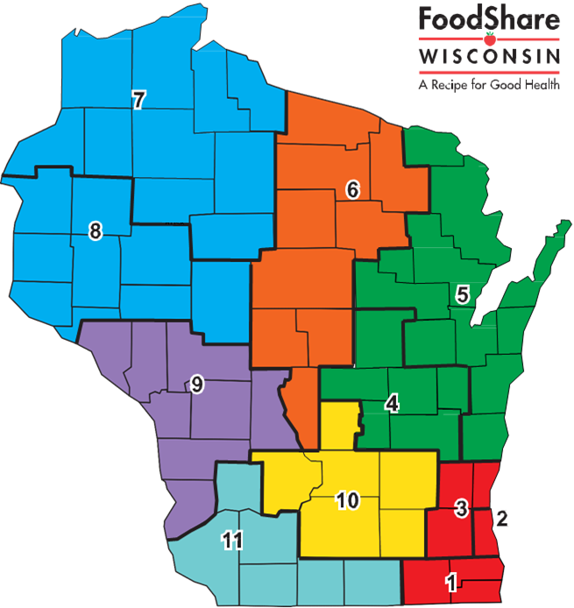
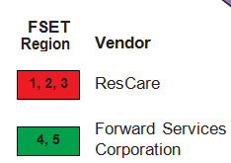
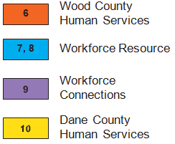
FSET Vendors

Slide 11
FSET Activities
Job search assistance
Education
Job-related training
Work experience
Notes:
I’m now going to give you a bit of information about what our FSET program offers. <Specific to agency.>

Slide 12
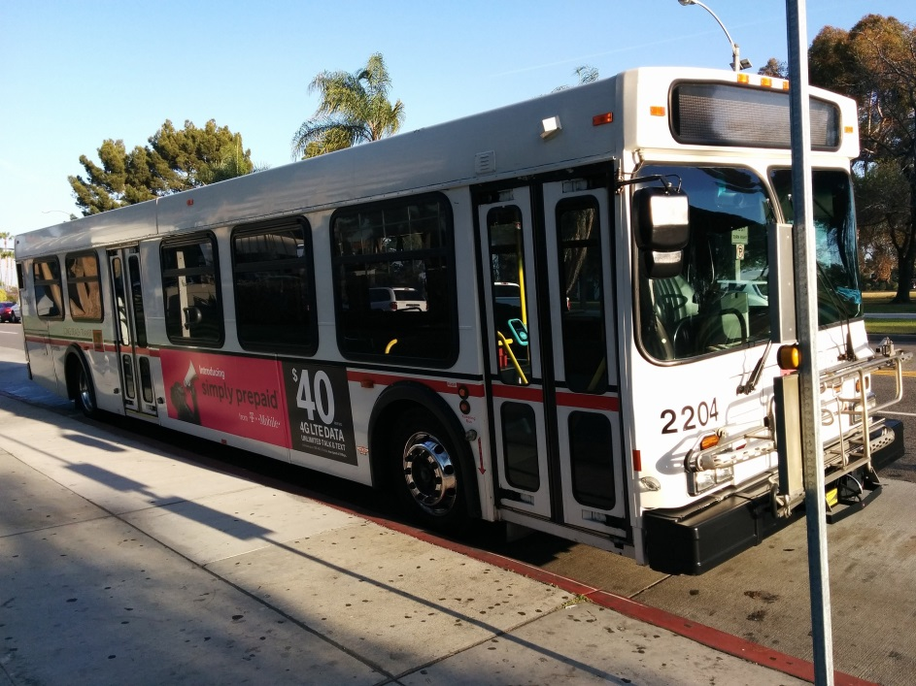
Available Services
Transportation assistance
Clothing for job interviews
Uniforms
Textbooks, test fees, training materials

Slide 13
Job Retention Services
Wisconsin provides job retention services for 90-days after individuals obtain a job in FSET.
Job retention services include supportive services and case management to assist individuals in transitioning to employment.

Slide 14
Expanding Partnerships
FSET agencies may partner with local organizations to expand training opportunities and serve more FoodShare members.
Local funding may be used to draw down 50% matching federal funds.
These partnerships can be established with community-based organizations, education providers, and employers.
Notes:
Today’s job market requires a higher level of skills. One way to address this challenge is to increase partnerships to provide FSET participants short-term training opportunities in gain skills needed for jobs on demand.
Jayne will talk about fun partnership opportunities! ☺

Slide 15
FoodShare Outreach
Connecting Wisconsinites to FoodShare

Slide 16
Supplemental Nutrition Assistance Program (SNAP) Outreach
State SNAP agencies have the option to conduct program informational activities to inform households about the availability, eligibility requirements, application procedures, and benefits of SNAP.
States may receive 50% reimbursement for allowable administrative costs funded under a state outreach plan.

Slide 17
State of Wisconsin FoodShare Outreach
Under the federal fiscal year 2018 FoodShare Outreach State Plan, vendors provide:
In-person assistance in 32 counties.
The Statewide FoodShare Helpline.

Slide 18
Role of Outreach
FoodShare outreach agencies provide:
Information about eligibility requirements and benefits.
Assistance with applications, renewals, and verification.
Assistance with QUEST cards.
Information about policy changes.

Slide 19
Best Practices
Recruit volunteers and/or staff with economic support experience.
Establish partnerships with IM agencies that allow new outreach workers to observe workers and use CARES Worker Web-based training regarding ACCESS.

Slide 20
Best Practices
Build rapport with different communities through trusted community partners.
Resolve conflicts with IM through local area administration.

Slide 21
How to Become Involved
Become a subcontractor with a current outreach vendor.
Initiate an outreach contract in an unserved area (January–March each year).
There is an additional need for outreach assistance in northern/rural Wisconsin.

Slide 22
Thank You for Attending!
For additional information about FoodShare, visit https://www.dhs.wisconsin.gov/ foodshare/index.htm.
To learn more about the FSET program, visit www.dhs.wisconsin.gov/foodshare/fset.htm.
Contact Margaret Rosenthal at margaret.rosenthal@dhs.wisconsin.gov if your organization is interested in becoming a partner for the FSET program.

Slide 23
Questions Stephanie.mabrey@dhs.Wisconsin.g`ov

