Slide 1
Who are we and where do we come from?
This is not a parental conversation!
Or is it?

Slide 2
History of Continuum of Care System
HUD began implementing the COC process in 1995 through the Notice of Funding Available (NOFA).
Each year, the NOFA guided the development of COCs and encouraged communities to work together to address homelessness in a coordinated manner. In addition, HUD published user guides and FAQs and other technical assistance materials to assist communities develop effective COCs.
This method resulted in scattered information not easily located.
The COC Program Interim Rule changes this.

Slide 3
HUD Continuum of Care
The CoC Program is designed to assist individuals (including unaccompanied youth) and families experiencing homelessness and to provide the services needed to help such individuals move into transitional and permanent housing, with the goal of long-term stability. More broadly, the CoC Program is designed to promote community-wide planning and strategic use of resources to address homelessness; improve coordination and integration with mainstream resources and other programs targeted to people experiencing homelessness; improve data collection and performance measurement; and allow each community to tailor its programs to the particular strengths and challenges in assisting homeless individuals and families within that community.
Under the CoC Program interim rule, eligible applicants consist of nonprofit organizations, State and local governments, instrumentalities of local governments, and public housing agencies. An eligible applicant must be designated by the Continuum of Care to submit an application to HUD for grant funds.

Slide 4
HUD Continuum of Care
In essence, HUD set up CoC’s primarily for submission of the application.
Then they added sugar and spice and everything nice.
Planning
Coordination
Data Collection
Performance Measurement

Slide 5
The Root
HUD is the root of this creation

Slide 6
Wisconsin HUD-recognized Continuum of Care Layout
The State of Wisconsin is divided into 4 separate HUD-recognized Continua.
Milwaukee (www.milwaukeecoc.org)
Racine (www.racinecoc.org)
Dane (www.unitedwaydanecounty.org)
Balance of State – remaining 69 counties (www.wiboscoc.org)
Each continua has its own leadership, governance structure, committees/workgroups, coordinated assessment system, policies, and funding.

Slide 7
Responsibilities of the Continuum of Care
Operate the Continuum of Care
Conduct meetings
Monitor projects
Evaluate performance
Establish a coordinated assessment system with written standards and prioritization
Designate & operate an HMIS
Planning
System Coordination
Point-in-Time Count
Annual Gaps Analysis
Participate in the Consolidated Plan
Consult with ETH Administrator (WI Department of Administration, DEHCR)

Slide 8
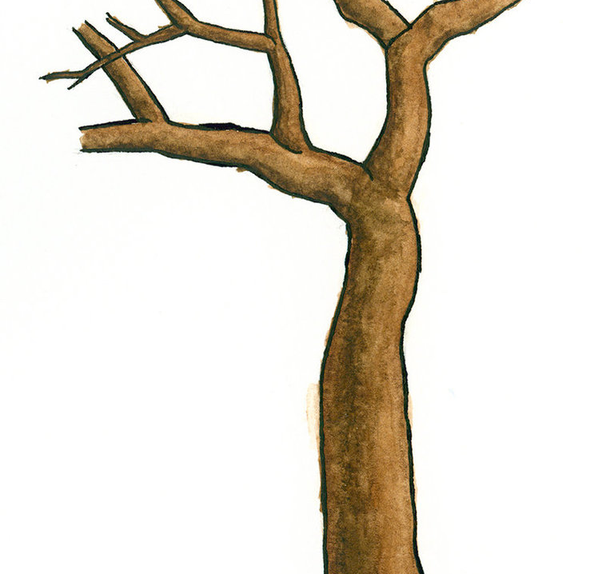
The Trunk and Branches
The Balance of State Continuum of Care is the trunk and branches of this creation

Slide 9
Local Coalitions
In order to accomplish the HUD goals of a CoC, local CoC’s (coalitions) were born.
Since the Balance of State geography is so large, 21 different Local Coalitions were born here in Wisconsin.
Local Coalitions are operated under the auspices of the Balance of State CoC’s bylaws.

Slide 10
Purpose of the Balance of State
According to the bylaws of the organization, the purpose of the Balance of State COC is to:
Provide leadership to the 21 local continua;
Ensure the efficient and effective delivery of housing and supportive services to individuals and families experiencing homelessness or at risk of homelessness;
Promote community-wide commitment to the goal of ending homelessness;
Provide funding for efforts by nonprofit providers, States, and local governments to re-house individuals and families experiencing homelessness rapidly while minimizing the trauma and dislocation caused to individuals and families experiencing homelessness as well as communities as a consequence of homelessness;
Promote access to and effective use of mainstream programs by individuals and families experiencing homelessness;
Optimize self-sufficiency among individuals and families experiencing homelessness;
Meet the educational needs of membership and the public;
Advocate for those it serves;
Collect dues from its members.

Slide 11
The Leaves
Local Coalitions are the leaves of this creation

Slide 12
Questions?

