Slide 1
Balance of State Non-WISP Point in Time Training
January 14, 2016

Slide 2
Agenda
Non-WISP Overview
Data Collection – Sheltered count
Non-WISP Form – Definitions & Explanations
Data Collection – Unsheltered count
Housing Inventory Chart
Survey Tool
Service Based Count
De-duplication chart
Google Tool
Resources
Deadlines
http://www.wiboscoc.org/point-in-time.html

Slide 3
What is the PIT?
A Point-in-Time, or PIT, count is a statistically reliable, unduplicated count of people experiencing homelessness during a designated one-night period.
A PIT count is intended to capture a minimum amount of information on the homeless population in order to create a “snapshot” of what homelessness looks like in a neighborhood, city, or state.
A PIT count does not:
Count everyone that has been homeless ever in a particular community
Promise 100% accuracy
Work without volunteers and community support

Slide 4
Night of the Count
The State of Wisconsin conducts a sheltered & unsheltered PIT count on the last Wednesday of July in each of the 4 HUD-recognized Continua: Balance of State, Dane, Milwaukee, and Racine.
The designated night is the overnight hours between: Wednesday, January 27th - Thursday, January 28th.
The Balance of State CoC has set the following requirements for the time of counting:
No unsheltered street/known location count can begin before 11:00 pm on Wednesday, January 27th. The preferred start time is midnight.
No unsheltered street/known location count can continue after 6:00 am on Thursday, January 28th.
Note: this may change for the July 2016 count.

Slide 5
Geography Continued
The Balance of State 50,000+ square miles has been broken down into 21 local continua.
Each local continua is responsible for their entire geographic footprint.
For January 2016, each PIT lead must extend their count to include areas not previously counted.
Ex: if your continua includes 3 counties and you have typically only covered one – you must identify and visit new potential locations in one or both of the other counties.
Ex: if your continua includes one main city and an outlining rural area and you have typically only covered the city – you must conduct an unsheltered count that includes some part of the outlining rural area.
The post count PIT survey will ask several questions regarding:
Where you went on the night of the PIT,
Where you obtained service-based count information,
What specific areas you covered during the PIT, and
What areas you want excluded from your territory and why.

Slide 6
What does Non-WISP mean?
Anyone that collects and reports data for the Point-in-Time (PIT) without the use of Service Point (WISP).
Manual tallying of surveys to determine how many people in each household type and identify the subpopulation characteristics
This can include sheltered persons – emergency shelter, motel voucher, or transitional housing.
This can include unsheltered persons – overnight street/known location count or service based (post-count).

Slide 7
Similarities between WISP & Non-WISP
Same definitions
Same categories
Same expectations for data accuracy
Same expectations for timely data collection

Slide 8
Difference between WISP & Non-WISP
In Service Point, clients are entered into a database. Then, a report can be run that places people the appropriate categories for household type, age group, demographics, and subpopulations.
Those that do not use Service Point must manually calculate totals for household type, demographics, age groupings, sub-sets, and subpopulations.
Manual calculation can lead to more counting errors and incorrect categorization

Slide 9
Data Collection – Sheltered Count
The total number of people in each emergency shelter, motel voucher program, and transitional housing program must be reported on the Housing Inventory Chart (HIC).
Number of people in households with children
Number of people in households without children
Number of people in households with only children
In addition to totals, all the demographic information and subpopulation information must also be collected from the people reported on the HIC.
Age, gender, race, ethnicity
Household type
Veteran, disability, chronic homeless, victim of domestic violence
This information does NOT go on the HIC, but instead is collected on the Non-WISP Form.

Slide 10
Data Collection – Housing Inventory Chart
The Housing Inventory Chart (HIC) is a list of all the emergency shelters, motel voucher programs, safe havens, and transitional housing projects in each of the 21 local continua that comprise the Balance of State CoC. There is also a section for permanent supportive housing and rapid re-housing projects.
The HIC includes agencies that use HMIS and do not use HMIS.
The HIC includes the number of beds, the number of units, seasonal, and overflow beds.
The last 5 columns of the HIC chart are for the total PIT counts for EACH project listed on the HIC.
Total, # unaccompanied youth, # people in households with children, # people in households without children, utilization rate
The PIT count on the HIC shows total numbers for the SHELTERED COUNT.
It does not provide detailed demographics or subpopulation information.
It does not provide information about the unsheltered count.

Slide 11
More specific information about how the Housing Inventory Chart (HIC), Service Point (WISP), and the Point-in-Time (PIT) all work together can be found in a power point presentation (PPT) called “Putting It All Together 2016.”
This document will be posted on the website.

Slide 12
Non-WISP Form
Demographic, household, and subpopulation information must be collected for everyone that is in shelter, a homeless motel voucher, transitional housing, or included in the overnight unsheltered count and service-based post count.
Once this is done, the collated information must be recorded by the PIT lead in each continua onto a document called “Non-WISP Form” that is created in Google Drive.
https://docs.google.com/spreadsheets/d/10HSIQzPWZ2DIpS33L-zR9m-ut1FCLKHnedSnY1XCVoc/edit#gid=366589481

Slide 13
Household Type
The HIC has 3 households types.
The Non-WISP Form has three separate tabs for each local continua. There is one tab for each of the three households types.
Persons in households with at least 1 adult and one child
There must be one person over the age of 18 (adult) and one person under the age of 18 (child).
Persons in households without children
This category includes single adults, adult couples with no children, and groups of adults. The groups can include adult parents with their adult children. There is no one in the household that is under the age of 18.
Persons in households with only children
This category includes persons under 18, including those in one-child households, adolescent parents (under age 18) and their children, adolescent siblings, or other household configurations composed only of children.

Slide 14
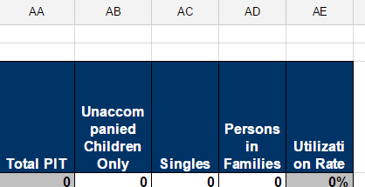
Households vs. People
Total number of households
Total number of people in households – This is what must match the HIC!
Household w/kids
Must match the sum total of all non-WISP Shelter provider numbers from Column AD on HIC
Must match the sum total of all non-WISP Transitional Housing provider numbers from Column AD on HIC
Must match the sum total of all non-WISP data collected (overnight and service based) and reported on the deduplication chart

Slide 15
Household w/out kids
Must match the sum total of all non-WISP Shelter provider numbers from Column AD on HIC
Must match the sum total of all non-WISP Transitional Housing provider numbers from Column AD on HIC
Must match the sum total of all non-WISP data collected (overnight and service based) and reported on the deduplication chart
Household w/only kids
Must match the sum total of all non-WISP Shelter provider numbers from Column AD on HIC
Must match the sum total of all non-WISP Transitional Housing provider numbers from Column AD on HIC
Must match the sum total of all non-WISP data collected (overnight and service based) and reported on the deduplication chart

Slide 16
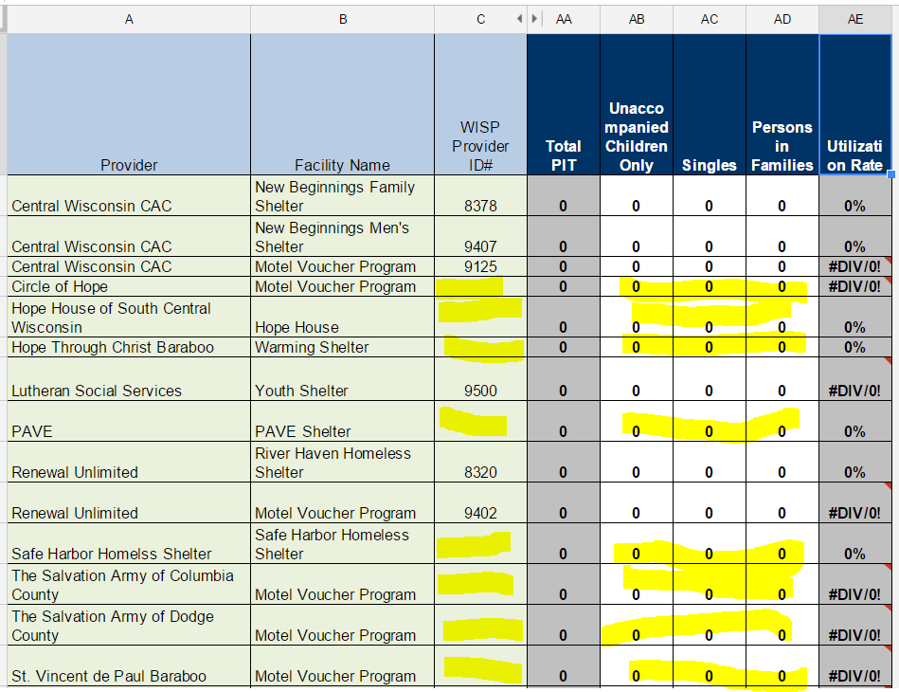
In Column C, if there is no WISP provider ID# for a provider then it is a Non-WISP provider.
These are the providers that need to have their individual numbers reported for:
Column AB added together for a total.
*matching I on the Non-WISP
Column AC added together for a total.
*matching E on the Non-WISP
Column AD added together for a total.
*matching A on the Non-WISP
This is an example of the Emergency Shelter/MV section of 1 local continua’s HIC.

Slide 17
Once the total number of people for each household type matches what is reported on the HIC, all demographic answers:
Does not go on the HIC
Must equal the total number of people answer for each provider type (emergency shelter, transitional housing, etc.)
Add up ages & it should equal the total number of people
Add up genders & it should equal the total number of people
Add up races & it should equal the total number of people
Add up ethnicities & it should equal the total number of people
NOTE: The subpopulation answers will not match the total number of people. However, any one number should not be larger than the total.

Slide 18
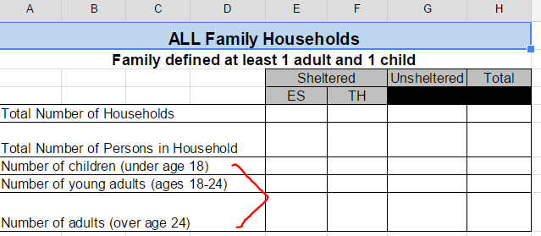
Demographic: Age Group
Household w/kids
The total number from each of the age rows (under 18, 18-24, over 24) must equal the number reported in the row “Total Number of Persons in Household.”
You cannot have more ages than people.
Household w/out kids
The total number from each of the age rows (18-24 and over 24) must equal the number reported in the row “Total Number of Persons in Household.”
You cannot have more ages than people.

Slide 19
Demographic: Gender
Household w/kids
The total number from each of the gender rows (female, male, transgender) must equal the number reported in “Total Number of Persons in Household” on the family tab.
You cannot have more genders than people.
Household w/out kids
The total number from each of the gender rows (female, male, transgender) must equal the number reported in “Total Number of Persons in Household” on the individual tab.
You cannot have more genders than people.

Slide 20
Demographic: Ethnicity
Household w/kids
The total number from each of the ethnicities (non-Hispanic/non-Latino and Hispanic/Latino) rows must equal the number reported in “Total Number of Persons in Household” on the family tab.
You cannot have more ethnicities than people.
Household w/out kids
The total number from each of the ethnicities (non-Hispanic/non-Latino and Hispanic/Latino) rows must equal the number reported in “Total Number of Persons in Household” on the individual tab.
You cannot have more ethnicities than people.

Slide 21
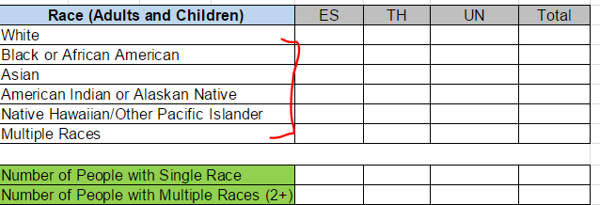
Demographic: Race
To double check your math, you will report the number of people that have 1 race and the number of people that reported they were multi-racial.
These two numbers should equal the “Total Number of Persons in Household.”
Household w/kids
The total number from each of the race rows must equal the number reported in “Total Number of Persons in Household” on the family tab.
You cannot have more races than people.
Household w/out kids
The total number from each of the race rows must equal the number reported in “Total Number of Persons in Household” on the individual tab.
You cannot have more races than people.

Slide 22
Chronic Homeless Definition
Chronic Homeless Individual – An individual who:
Is homeless and lives in a place not meant for human habitation, a safe haven, or in an emergency shelter (or motel voucher program); and
Has been homeless and living or residing in a place not meant for human habitation, a safe haven, or in an emergency shelter (or motel voucher program) continuously for at least 1 year or on at least 4 separate occasions in the last 3 years where the combined length of time homeless in those occasions is at least 12 months; and
Has a disability
Chronic Homeless Family – A family with children with a adult head of household who meets all the criteria for a chronically homeless individual.

Slide 23
Subpopulation: Chronic Homeless
For the chronic homeless question, you must answer the number the households as well as the total number of people in those households.
The number of chronic homeless households cannot be greater than the Total Number of Households for that household type.
The number of persons in the chronic homeless households cannot be greater than the Total Number of Persons for that household type.

Slide 24
Disabilities Definition
Disability – An individual with one or more of the following conditions:
A physical, mental, or emotional impairment, including an impairment caused by alcohol or drug abuse, post-traumatic stress disorder, or brain injury that:
Is expected to be long-continuing or of indefinite duration
Substantially impedes the individual's ability to live independently; and
Could be improved by the provision of more suitable housing conditions.
A developmental disability, as defined in section 102 of the Developmental Disabilities Assistance and Bill of Rights Act of 2000 (42 U.S.C 15002); or
The disease of acquired immunodeficiency syndrome (AIDS) or any condition arising from the etiologic agency for acquired immunodeficiency syndrome (HIV).

Slide 25
Subpopulation: Disabilities
People can have more than one of these disabilities.
Only Adults (people over the age of 18) in households with or without children should be included.
All persons in households with only children (as they will all be under 18) should be included.

Slide 26
Subpopulation: Veterans
Household w/kids
Number of Veterans
Total number of chronic homeless Veteran family households
Total number of people in those chronic homeless Veteran family households
Household w/out kids
Number of Veterans
Total number of chronic homeless Veteran households without kids
Total number of people in those chronic homeless Veteran households without kids
Veteran – adults who have served on active duty in the Armed Forces of the US. This does not include inactive military reserves or National Guard (unless called up to active duty).

Slide 27
Subpopulation: Other
Asking adults whether they were formerly a ward of the child welfare system or foster care agency. This question is designed to generate data related to the number of people that age out of foster care & subsequently experience homelessness.
Victims of Domestic Violence – those who have been victims of domestic violence, dating violence, sexual assault, or stalking.
Make sure to record adults and children separately.

Slide 28
Subset #1: Veterans
Subset #1 is a closer look on those people & households identified in Households with and without children as being veterans.
The total number of Veterans in Veteran household should match the numbers reported in the subpopulations for each provider type.
The additional demographics (age, gender, ethnicity, and race) should only be recorded for Veterans.

Slide 29
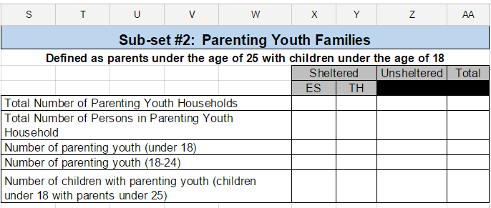
Subset #2: Parenting Youth
Subset of Households with children
Subset #2 is a closer look on those people & households with adults between the ages of 18-24 who have children under the age of 18 or youth under 18 who have a child under 18.
If there is 1 adult, that 1 adult must be between 18-24.
If there are 2 adults, BOTH adults must be between 18-24.
The additional demographics (age, gender, ethnicity, and race) should only be recorded for Parenting Youth (not their children).

Slide 30
Subset #2: Young Adults
Subset of Households without children
Subset #2 is a closer look on those people & households without children who are between the ages of 18-24.
The additional demographics (age, gender, ethnicity, and race) should only be recorded for Young adults only.

Slide 31
Youth
“Youth” is defined as persons under age 25, including children under 18 and young adults ages 18-24.
There are 2 main types of youth that can be counted during the PIT:
Parenting Youth
A youth who identifies as the parent or legal guardian of one or more children who are present with or sleeping in the same place as the youth parent, where there is no person over the age of 24 in the household.
Unaccompanied Youth
Unaccompanied youth are persons under age 25 who are not accompanied by a parent or guardian and are not a parent presenting with or sleeping in the same place as his/her child(ren).
Young Adults = 18-24
Unaccompanied = under age 18
Unaccompanied youth are single youth, youth couples, and groups of youth presenting together as a household.

Slide 32
Data Collection – Unsheltered Count
The Unsheltered Count consists of two parts:
(1) Overnight street count or known location count
(2) Service based post-count
To collect demographic and subpopulation information, a survey must be administered.
Determine eligibility under the homeless definition
Avoid deduplication
The surveys are collected, reviewed, screened, and submitted to the PIT lead.
The PIT lead is required to complete the Non-WISP Form.
Unsheltered PIT information is NOT recorded on the HIC.

Slide 33
Survey Tool
For the January PIT count, the approved Survey Tools are similar but NOT the same as the ones used in the July 2015 PIT count. The revised Interview survey and the Observation form will be posted on the website & emailed out to PIT leads.
One of these survey tools must be completed for all persons counted in the unsheltered count of the PIT.
This includes the overnight street/known location count and the service based count.
The Observation tool should only be considered as a last resort during the overnight street/known location count. It cannot be used in the service based count.

Slide 34
VI-SPDAT & F-VI-SPDAT
A continua can choose to administer the VI-SPDAT and the F-VI-SPDAT in addition to the survey tool.
It is NOT required for the PIT.
However, to be added to the priority list for Coordinated Entry, a VI-SPDAT/F-VI-SPDAT is required to be administered.
See Coordinated Entry policy & prioritization for RRH, TH, and PSH programs.

Slide 35
Survey Tool
The Unsheltered PIT Count Survey – must be used for both the overnight street count/known location count AND the service-based post-PIT count.
The survey is in WORD and has 5 parts:
Questions for the person administering the survey
Eligibility for the survey
Head of Household
Subpopulation for Head of Household
Household Type
Optional Questions
If the survey should include additional adults and/or children, there are pages dedicated to those specific people. You can make additional copies as needed.
In addition, if the child is an unaccompanied youth under the age of 18, then there are specific information required.

Slide 36
Observation Only Form
This form should only be used as a last resort in connection with the overnight street count/known location count.
It cannot be used with the service-based post PIT count process.
Part 1: questions about person administering the survey
Name, local continua, type of surveyor, city/location
Part 2: observations
Number of people, adults, children, homeless*
Age range, gender, race, ethnicity
Other information/identifying characteristics
*Note: unless you can say with reasonable certainty that based on a observer’s professional judgment the signs/clues indicating that the person is “definitely” unsheltered on Wednesday night and experiencing homelessness, they cannot be included.

Slide 37
Service Based Counts
Service-based counting focuses on conducting interviews with people experiencing homelessness but not seeking shelter and unable to be found during the overnight street or known location count.
The service-based counting will serve as a SUPPLEMENT to the night of the count approach.
It requires face-to-face contact with the person and the administration of the Unsheltered Survey.
The Balance of State CoC will allow post-count surveys to be administered and collected until Friday, January 29th at 5:00 pm.

Slide 38
Service Based Counts
Service Based Counts are an opportunity to connect with other partner agencies and community locations in which people experiencing homelessness may frequent.
This can include:
Emergency shelters
meal sites, food pantries
drop-in centers, day shelters
human services, job service/workforce resource
community mental health center, hospital emergency rooms, free clinics
Alcohol & Drug service centers
police department, probation/parole
libraries
Faith-based organizations
Youth Providers & Runaway programs

Slide 39
How to Organize a Service Based Count?
Host a homeless connect or outreach event on the Thursday and/or Friday after the count
There are many examples of how this has been done across the Balance of State – in large & small communities.
Common theme – a meal, information about services, opportunities to engage with providers, and a short survey about where they slept Wednesday night
Ask emergency shelters to administer the survey to people presenting for shelter on Thursday or Friday – asking where they slept on Wednesday night
Ask meal sites, food pantries, drop in sites, free clinics, police department, and other places people experiencing homelessness may go or services they may access on Thursday or Friday to administer the survey asking people where they slept on Wednesday night

Slide 40
Service Based Counts
The service-based count uses the same survey that is used during the overnight street/known location count.
Each person identified as potentially homeless and unsheltered on the night of the PIT count should be interviewed to determine:
homeless status,
whether he/she has already been interviewed, and
collect additional data elements.
If the person being interviewed meets the requirements of the PIT count homeless definition and was not interviewed during the PIT overnight count, then the survey should be administered.
The survey should then be submitted to the PIT lead for the screening and de-duplication process.

Slide 41
Data Collection – Deduplication Chart
By allowing people to be counted on Thursday & Friday, we increase the possibility of duplication. Therefore, HUD requires policies to ensure a de-duplicated count can be obtained.
The Balance of State CoC is going to use a new form, “De-duplication Chart” in Google Drive to ensure that those unsheltered persons counted during the overnight count are not duplicated with those counted during the post-count window.
The PIT lead will be required to enter certain data fields for each person counted as unsheltered. This includes during the night of the count (both in HMIS and non-WISP) as well as surveys completed during the post count window through service-based counting.
The CoC Coordinator will work with the HMIS lead to identify potential duplications among the 21 continua.
The PIT lead will be responsible for “cleaning” the data to ensure de-duplication within his/her continua.

Slide 42
Deduplication Chart - Example
Survey ID | First in. | Last in. | Age | Gen. | Eth. | Race | Vet | DV | S/F | Dis. | CH | Locate
1 | A | S | 32 | M | N | W | N | N | S | N | Y | HMIS
2 | F | A | 55 | M | N | W | N | Y | S | MI | N | OV
3 | H | R | 23 | F | Y | B | Y | N | S | PD | N | OV
4 | G | W | 43 | F | N | As | N | N | F2 | N | N | SB
5 | N | S | 19 | F | N | AI | N | N | F1 | AA | N | OV
6 | S | J | 4 | M | N | AI | N | N | F1 | N | N | OV
7 | L | K | 2 | F | N | As | N | N | F2 | N | N | SB
HMIS = entered into HMIS
OV = counted during the overnight street count
SB = service based count

Slide 43
Google Tool
Created by the Institute for Community Alliances (ICA) to assist with the Non-Service Point Point-in-Time data collection process.
Demetri Vincze (ICA) – Demetri.Vincze@icalliances.org

Slide 44
Resources & Documents for the Count
PIT Training #1 slides and webinar posted on website
PIT & HIC Changes for 2016 posted on website
PIT Training #2 slides and webinar posted on website
PIT Training: Non WISP Data Collection slides and webinar posted to website within a week of 1/14
Putting it all Together PPT will be updated soon & posted to website by 1/11
Survey – Interview and Observation Forms posted on website
Chronic Homeless Definition Documentation will be updated soon & posted within a week of 1/19

Slide 45
Google Drive Documents for the Count
Deduplication Chart (google drive) link posted to website by 1/11
https://docs.google.com/spreadsheets/d/12LfudbcItG3UKVbWViF4UVDBLD7TruLm1a0j6UuC1V4/edit#gid=981389640
Non-WISP Chart (google drive) link posted to website by 1/11
https://docs.google.com/spreadsheets/d/10HSIQzPWZ2DIpS33L-zR9m-ut1FCLKHnedSnY1XCVoc/edit#gid=366589481
January 2016 Housing Inventory Chart (HIC) will be sent to PIT leads, COC & ETH leads last week of January
Post-January PIT Survey (google drive) will be updated soon & link posted to website by 2/1

Slide 46
Deadlines for the PIT
The overnight street/known location count must occur not earlier than Wed. January 27th at 11:00 pm and must be completed by Thurs. January 28th at 6:00 am.
The service based post-PIT count must be concluded by Friday, January 29th at 5:00 pm.
Completion of January Housing Inventory Chart (HIC): Monday, February 15th at 5:00 pm.
Completion of Non-WISP PIT form: Monday, February 15th at 5:00 pm.
Completion of Deduplication Chart: Monday, February 15th at 5:00 pm.
Completion of Post-PIT Survey: Monday, February 29th at 5:00 pm.
Note: It is the PIT lead’s responsibility to ensure the accuracy of the HIC, Non-WISP PIT form, all data entered into the Deduplication Chart (this includes the unsheltered count – in HMIS and surveys not in HMIS and the service based count), and HMIS data for the continua are “cleaned and correct” before submission to COC Coordinator.

Slide 47
Deadlines for the PIT (part 2)
Following the February 15th deadline for the HIC, Non-WISP PIT form, and Deduplication chart, there will be an brief opportunity for additional corrections and technical assistance by both HMIS staff and the COC Coordinator.
This deadline will be announced during the Point-in-Time Training #3. This training will be an opportunity for leads to ask questions or discuss concerns related to the January PIT and the data collection process.

Slide 48
PIT Lead Responsibilities
The PIT lead is the person(s) selected by a local continua to be ultimately responsible for the continua’s PIT count submission.
The PIT lead is responsible for the coordination and execution of the sheltered and unsheltered PIT count for their continua’s entire geographic area.
The PIT lead is responsible for ensuring that staff, partner agency staff, and community volunteers have received adequate training on privacy, methodology, safety, and data collection requirements.
The PIT lead is responsible for the submission of data, including demographics and subpopulation information, for the sheltered and unsheltered PIT count.
This includes both HMIS and non-HMIS data.
This includes the HIC, the Non-WISP form, the deduplication chart, and the post-count survey.

Slide 49
Other Responsible Parties
All of the HUD COC-funded agencies and Division of Housing ETH-funded agencies in a continua are required to participate in the overnight street/known location unsheltered PIT count.
Institute for Community Alliances (ICA) as the HMIS lead for the Balance of State is responsible for providing training and technical assistance to ensure the HMIS data is extractable from the system for the purposes of the PIT count.
COC Coordinator is responsible for providing training to the PIT leads, working with the PIT workgroup on methodology and training requirements, working with the HMIS lead to consolidate and de-duplicate HMIS data, and assist PIT leads in consolidating and de-duplicating non-HMIS data.
COC Coordinator consolidates the HMIS and non-HMIS data for final review.
ICA and the COC Coordinator work together to complete the PIT data submission through the Homeless Data Exchange (HDX) to HUD.

Slide 50
Chronic Homeless Definition Training
Scheduled for Tuesday, January 19th from 9:00 – 10:30 am.
The training will be conducted via go-to webinar, recorded, and posted on the website.
The agenda items will include:
Chronic Homeless Definition
Documentation requirements
This training will be Part 1 of a two part training. The second part will be conducted by ICA on Friday, January 22nd 11 am - noon. The ICA training will include scenarios & data entry related to the Chronic Homeless definition.

Slide 51
Point-in-Time Training #3
Scheduled for Thursday, February 25th from 9:00 – 10:30 am.
https://attendee.gotowebinar.com/register/2531231170063044097
The training will be conducted via go-to webinar, recorded, and posted on the website.
The agenda items will focus on Data Collection related to:
Housing Inventory Chart (HIC)
Non-WISP Chart
WISP Data
De-duplication chart
And an opportunity for Questions & Answers

Slide 52
Questions?

