Slide 1
Balance of State Point in time Training #3
Thursday, March 1, 2016

Slide 2
Agenda
Status of Post Count Process
Common Issues/Errors
HMIS data
Non-WISP data
HIC
Deduplication
Impact of Service Based Counting
Impact of Observation
Next Deadline

Slide 3
Status of the Post-PIT Data Collection Process
4 of the 21 Continua have successfully completed the Data Collection Process.
What does that mean?
HMIS numbers match what is reported on the HIC for agencies using HMIS.
Non-WISP numbers match what is reported on the HIC for agencies not using HMIS.
Both HMIS and Non-WISP unsheltered persons are reported on the deduplication chart.
HMIS data
14 of the 21 continua have errors, HIC and HMIS do not match.
Non-WISP data
14 of the 21 continua have errors, HIC and Non-WISP do not match.
Housing Inventory Chart (HIC)
1 of the 21 continua have errors with RRH.
2 of the 21 continua have errors with >100% utilization
8 of the 21 continua has a different HIC related error (i.e. completing new columns on the HIC)
Deduplication
9 of the 21 continua have errors, HMIS and/or Non-WISP unsheltered persons do not match with chart.

Slide 4
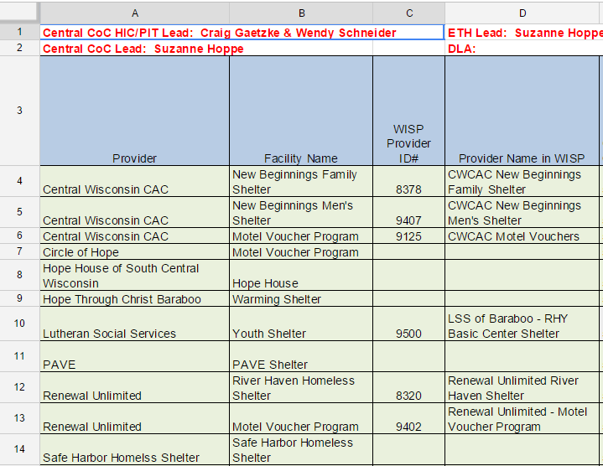
Housing Inventory Chart (HIC) & HMIS
On the HIC, there are two types of projects:
those that use HMIS
those that do not use HMIS
On the HIC:
If a project uses HMIS, information should be written in Column C & D.
If a project does not use HMIS, nothing should be written in Column C & D.

Slide 5
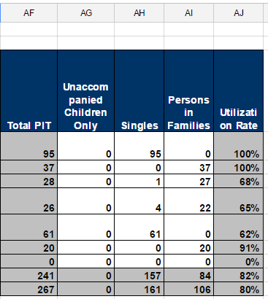
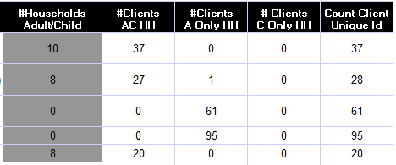
For the HMIS agencies, Column AF (Total PIT) should be compared to the PIT report run out of ART. (either 0628 for PSH/RRH or 0630 for ES or TH).
0628 Report: Permanent Supportive Housing and Rapid Re-housing
0630 Report: Emergency Shelter, Safe Haven, and Transitional Housing

Slide 6
For the Non-WISP agencies, the numbers for the HIC come from the Non-WISP PIT form.
Column AG (unaccompanied children only) – this corresponds directly with the “Unacc. Youth” tab.
Column AH (singles) – this corresponds directly with the “individual” tab.
Column AI (persons in families) – this corresponds directly with the “Families” tab.

Slide 7
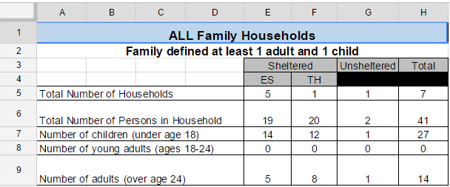
Non-WISP PIT Form
On the Non-WISP PIT form, there are 4 columns on each tab.
Emergency Shelter (ES)
Transitional Housing (TH)
Unsheltered
Total
The numbers that translate over to the HIC are found in row 6 – Total Number of Persons in Household in the ES column & TH columns ONLY.
Unsheltered – does not go on the HIC

Slide 8
Double Check Your Math
Using the HIC, group up the HMIS and Non-HMIS agencies.
By hiding the rows for agencies using HMIS, you will be able to add up the total number of unacc. Youth, singles, & persons in families reported on the HIC with the totals listed on the Non-WISP PIT form.
To hide a column, right click the column number on the HIC.
Then, make sure you are looking at the right row on the Non-WISP PIT form = Row 6 “Total Number of Persons in Household.”

Slide 9
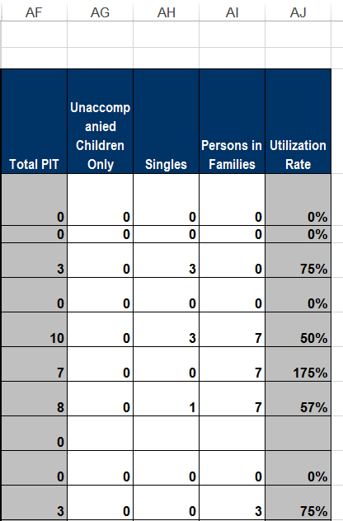
Common Issues and Errors – HIC & HMIS
If the 5 projects on the HIC have reported numbers, but the ART report only shows 4 projects.
The numbers that do show up on the ART report do not match what was reported on the HIC.
Example: 9 people in families, but the provider on the HIC shows 10 people (3 singles & 7 in families).

Slide 10
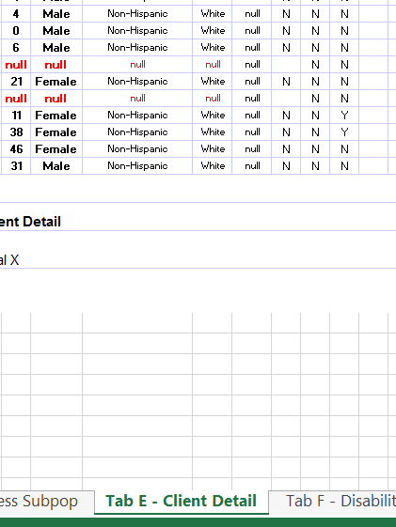
Data Completeness Issues
In both the 0630 and 0628 ART reports, there is a tab dedicated to Client Detail. This tab allows you to see the actual answers included in the PIT.
Each agency is responsible for ensuring their data is completed and correct.

Slide 11
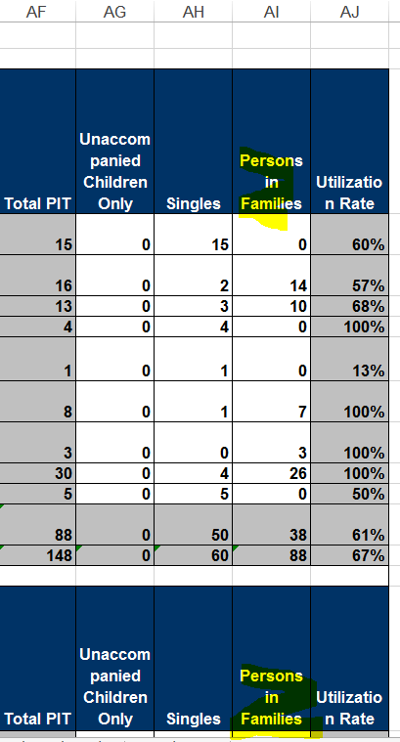
Common Issues and Errors – Non-HMIS
Non-WISP PIT form: families tab and emergency shelter column equals the total number of people served in emergency shelter projects not reported in HMIS and reported in Column AI (persons in families).
Non-WISP PIT form: families tab and transitional housing column equals the total number of people served in transitional housing projects not reporting in HMIS and reported in Column AI (persons in families).

Slide 12
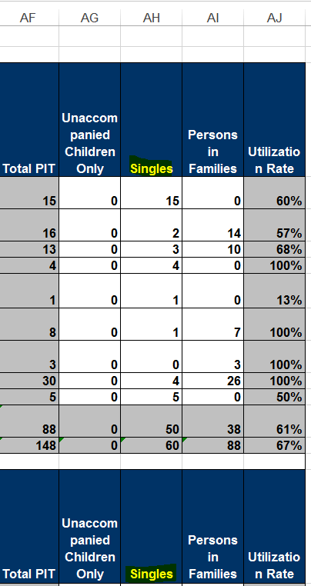
Common Issues and Errors – Non-HMIS
Non-WISP PIT form: families tab and emergency shelter column equals the total number of people served in emergency shelter projects not reported in HMIS and reported in Column AC (singles).
Non-WISP PIT form: families tab and transitional housing column equals the total number of people served in transitional housing projects not reporting in HMIS and reported in Column AC (singles).

Slide 13
Non-WISP PIT Form Errors
In this example, the numbers entered for Unsheltered show 6 households, but only 1 person in those households.
In this example, the numbers entered for Emergency Shelter (ES) show 7 households, but only 5 people in those households. In addition, there are 8 ages collected over the age of 24.

Slide 14
Common Issues and Errors – HIC
Rapid Re-housing (RRH):
Data reported in Column AH (singles) and Column AI (persons in families) must match the number of beds indicated in Columns K (family beds) and Column M (single beds).
In Column L (family units), the number of family households should be listed.
If the project uses HMIS, Column P & Column Q should match as well.
This must change each month to reflect 1:1 relationship between people served and beds available

Slide 15
Common Issues and Errors – HIC
Shelter > 100%:
Emergency Shelters report the total number of beds in Column O.
If the number total number of people served during the PIT (indicated in Column AF) is greater than the total number of beds (in Column O), then you have to put that difference in Overflow (Column AD).
If the project uses HMIS, then you have to put that number in Overflow in HMIS (Column AE) as well.

Slide 16
Common Issues and Errors – HIC
Shelter > 100%:
Motel Voucher Programs do not report a total number of beds. There should be a ZERO in Column O (Total Year Round Beds).
If a voucher program serves people the night of the PIT (indicated in Column AF), then that is the number that is reported in the Overflow/Voucher Column AD.
If the agency in question uses HMIS, then you have to put that number in Overflow/Voucher in HMIS (Column AE) as well.

Slide 17
Common Issues and Errors – Deduplication
The Unsheltered people recorded in HMIS show up on the PIT report run out of ART.
These people should have completed a survey.
All people who completed a survey should be recorded on the deduplication chart.
Unsheltered people are recorded on the Non-WISP PIT form on the Unsheltered column = singles on the “individual” tab and persons in families on the “families” tab.

Slide 18
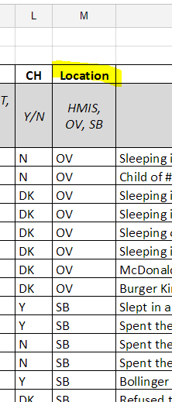
Common Issues and Errors – Deduplication
Both unsheltered persons recorded in HMIS and on the Non-WISP PIT form were to be included on the deduplication chart in google drive.
Column M instructions:
Each row should have HMIS, OV, or SB.
The number with “HMIS” should match the number of people in the PIT report.
The number with “OV” added with the number with “SB” should match the number of people on the Non-WISP PIT form, column titled “Unsheltered,” on the “single” tab and “families” tab.

Slide 19
Impact of Service Based Counts
Of the 21 continua:
Only 3 continua reported a total of 5 people counted through the service based post-PIT count process.
17 continua reported 0 people counted through the service based post-PIT count process.
What else needs to be done to increase the outreach for the use of service based counting during the July 2016 PIT count?
Questions?

Slide 20
Impact of Observation Option
Reliance on professional judgement
Unclear impact of observation on the overnight night street count
Of the estimated 118 people counted during the street/known location count, only 4 identified as using the “observation” form.
12 local continua indicated that they used observation-only forms.
6 indicated they did not use observation-only forms.
3 continua did not respond to this question – answer pending
More information will be needed to continue to allow observation in the PIT count process.

Slide 21
PIT Survey
I will be formulating a compilation of responses from the PIT survey.
It is clear that there needs to be a “rebranding” of the PIT count as street outreach, rather than a HUD requirement.
This is an opportunity to generate community attention, awareness, and support for the issue of homelessness.
We need to move forward with PIT methodology, additional training, and more develop more resources for homeless connect events.

Slide 22
Next Step - Deadline for the PIT
Data Correction – next deadline: Friday, March 25th.
The HIC, Non-WISP, and HMIS must match at this point.
The deduplication number should match the number of unsheltered reported in the Non-WISP and HMIS.
Note: It is the PIT lead’s responsibility to ensure the accuracy of the HIC, Non-WISP PIT form, all data entered into the Deduplication Chart (this includes the unsheltered count – in HMIS and surveys not in HMIS and the service based count), and HMIS data for the continua are “cleaned and correct” before submission to COC Coordinator.

Slide 23
Questions?

