Slide 1
Verification of Homelessness Eligibility and documentation
Meredith McCoy
WIBOS Monitoring and Compliance Coordinator
June 30, 2020

Slide 2
New Forms
Old forms have been used since 2013. Time for an update!
Clarification on HUD regulations and requirements for proper documentation
More guidance when there are new staff
Four new/updated documents
Documenting Homelessness Eligibility Guide
WIBOS Verification of Homelessness
WIBOS Verification of Homelessness Category 3 ONLY
WIBOS Self-Certification Form

Slide 3
Determining and Documenting Homelessness Eligibility
Required to ensure compliance with HUD’s homeless definition.
Eligibility must be based on homeless status at intake
Intake is the time the individual or family enters the project and begins receiving assistance under the grant program.
Example 1:
Individual presents at a homeless shelter, the verification of homelessness will be for the night prior to entering that homeless shelter.
Example 2:
A family that has been staying in an emergency shelter for the past 20 days has been offered, and has accepted, an opening from an agency for a COC funded housing project. Upon acceptance, their verification of homelessness form would indicate their eligibility the night prior to accepting the opening in the COC funded housing project.

Slide 4
Complete Eligibility Documentation
Every participant file should include
Verification of Homelessness Form
Documentation of Homelessness
Third-party verification (HUDs preference)
Intake worker observation
Self-Certification by participant
Intake worker observation and Self-certification should only be used if third-party verification cannot be obtained and MUST be accompanied by Due Diligence and any supporting documentation for that.

Slide 5
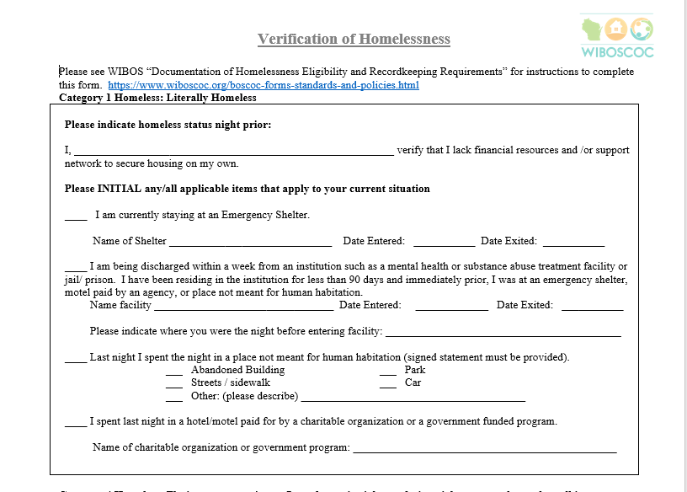
Verification of Homelessness Form
Layout
Similar to original form
Only two pages
Has Category 1, 2, and 4 identified on the form

Slide 6
Verification Homelessness Form
Guidelines
Staff should assist in filling out the form. This can help clarify that only the night prior should be recorded on the form.
Every household file MUST have this form.
All households enrolled in COC funded project should be Category 1.
COC RRH can be Category 1 or Category 4
ESG RRH is only Category 1
Category 2 homeless verification is for shelters and prevention programs.
Supporting Documentation MUST be attached (included in the participant file)

Slide 7
Categories of Homelessness
Category 1 Homeless: Literally Homeless
An individual or family who lacks a fixed, regular, and adequate nighttime residence, meaning:
An individual or family with a primary nighttime residence that is a public or private place not designed for or ordinarily used as a regular sleeping accommodation for human beings, including a car, park, abandoned building, bus or train station, airport or camping ground;
An individual or family living in a supervised publicly or privately operated shelter designated to provide temporary living arrangements (emergency shelter, hotel/motel paid for by charitable organization** or government programs for low income individuals); or
An individual who is exiting an institution where he or she resided for 90 days or less and who resided in an emergency shelter or place not meant for human habitation immediately before entering that institution.
**A charitable organization is a type of non-profit organization whose primary objectives are philanthropy and social well-being. Examples of charitable organizations can include educational institutions, religious groups and churches, non-profit agencies, volunteer associations, The Red Cross. This could also include government entities such as Police or Sheriff’s department, Department of Corrections, Probation and Parole, etc.

Slide 8
Categories of Homelessness
Category 4 Homeless:
Any individual or family who:
Is fleeing, or is attempting to flee, domestic violence, dating violence, sexual assault, stalking, or other dangerous or life-threatening conditions that relate to violence against the individual or a family member, including a child, that has either taken place within the individual’s or family’s primary nighttime residence or has made the individual or family afraid to return to their primary nighttime residence, including
Trading sex for housing
Trafficking
Physical abuse
Violence (or perceived threat of violence) because of the youth’s sexual orientation;
Has no other residence; and
Lacks the resources or support networks, e.g., family, friends, and faith based or other social networks, to obtain other permanent housing.

Slide 9
Categories of Homelessness
Category 2 Homeless: Imminent Risk of Homelessness
An individual or family who will imminently lose their primary nighttime residence, provided that:
The primary nighttime residence will be lost within 14 days of the date of application for homeless assistance;
No subsequent residence has been identified; and
The individual or family lacks the resources or support networks, e.g., family, friends, faith-based or other social networks, needed to obtain other permanent housing.

Slide 10
Documenting Homelessness
HUDs general documentation standards
Identify the entity or party needing assistance (Who is the service provider)
Identify household needing assistance
Provide sufficient detail regarding the specific condition or criterion being documented (this includes places and dates homelessness occurred)
Notes:
Documentation needs to include 1. The role of the service provider; 2. Where the client was/is homeless with dated timeframe; and 3. Include workers name, title, agency, date and signature on a letterhead/work email

Slide 11
Preferred order of homelessness verification
HUDs preferred order
Third-party documentation
Intake Worker Observation
Self-certification from person seeking assistance

Slide 12
Third-party Verification
Must conform to general standards for documentation
All documentation should show it is coming from an appropriate source and provide information about the households current living situation.
Source documentation from third-party. (example: HMIS or discharge paperwork from an institution. Must contain dates of stay in institution or shelter)
Written Verification – must demonstrate it has come from appropriate source (agency letterhead, email, etc) and must be signed and dated.
Oral Verification – must identify third-party providing oral statement and date statement was given, identify worker taking the oral statement, and signed and dated by worker taking statement indicating the statement is true and complete.
Notes:
Documentation needs to include 1. The role of the service provider; 2. Where the client was/is homeless with dated timeframe; and 3. Include workers name, title, agency, date and signature on a letterhead/work email

Slide 13
Acceptable forms of third-party Documentation
An individual record of a stay in an emergency shelter, a safe haven, or from a street outreach contact from an HMIS, or comparable database used by victim service or legal service providers;
A written observation by an outreach or intake worker of encounters with the individual or head of household that includes a description of the conditions where the individual or head of household was living or is currently living;
A written observation by a community member that has observed where the individual or head of household was living or is currently living; and
A written referral by another housing or service provider.

Slide 14
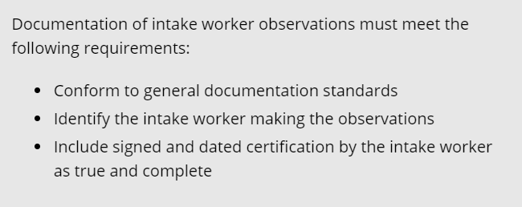
Intake Worker Observation
In the event staff has done their due diligence to obtain third-party documentation and were unable to confirm, staff conducting intake may record their observations as a form of verification. Intake Worker Observation must be on Agency Letterhead and clearly articulate to the best of their knowledge and based on their professional judgment, that the individual or head of household was residing in a place not meant for human habitation, or in an emergency shelter, at the time of intake. It is important to remember that the “Due Diligence” section must be filled out when using intake worker observation as a form of documentation.

Slide 15
Self-Certification
As a last resort to establish eligibility after all efforts to collect third-party verifications have been exhausted, HUD allows households to provide written statements that are signed and dated in lieu of third-party verification.
Self-certifications should be completed by the household. If that presents an undue burden, intake staff may assist with completion, using the household’s own words.
Must include a description of where and when the household was homeless.
All Self-Certification of Homelessness Forms must be signed by the individual/family AND intake staff as a witness.

Slide 16
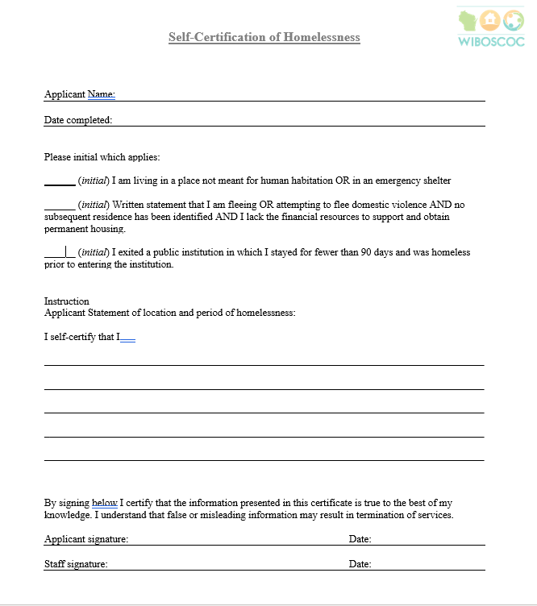
Notes:
Important to note, self-certification can be used until third-party documents are received. So example, someone is offered an opening for a COC RHH project and they do not have any verification at the time of enrollment. They should still be enrolled, and fill out the self-cert and then staff can work with this household to obtain third-party verification. Once obtained, it should be put in the file.

Slide 17
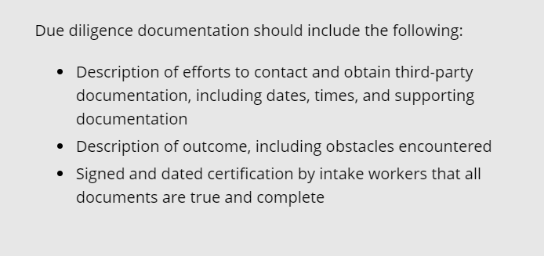
Documenting Due Diligence
MUST be filled out for Intake Worker Observation as well as Self Certification
Due Diligence is a section on page 2 or the Verification of Homelessness form
Due Diligence can be accompanied by copies of emails and letters sent to try and obtain verification

Slide 18
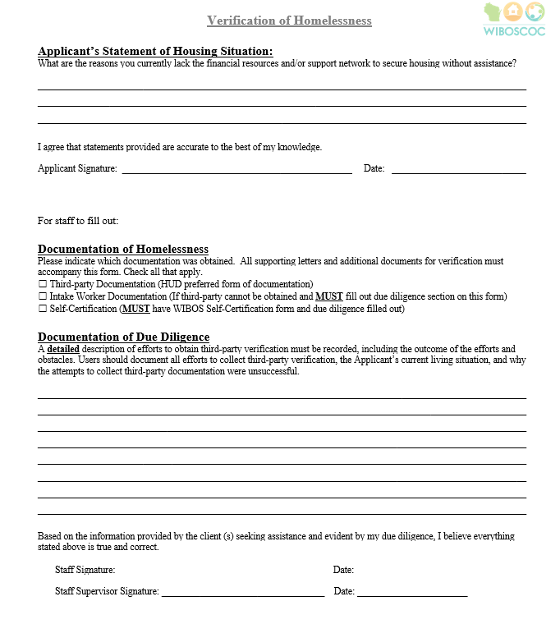

Slide 19
Due Diligence
Intake worker observation due diligence example:
The Smiths present at a local service agency. They state they have been staying in their car for the past several nights. When asked if anyone can verify this, they do not indicate anyone. This worker asks if he can see the vehicle. The family shows him their vehicle and upon inspection there are several blankets, pillows, bags of clothes, containers with food and beverages in the car. Based on this workers observations, it appears this family is staying in their car. Upon further discussion, the family is new to this area and has not had any local connections that can verify their homelessness.
Self certification Example:
John D indicates during intake that he has been sleeping in a storage unit and the storage unit owner could verify he has been sleeping there. John said he has been staying there most nights in the month of May, definitely for the past week. Intake worker sent email on 5/25 (attach email). Intake worker sent follow-up email 5/28 (attach email). Intake worker called the owner 6/1 and left a message. As of 6/3 this worker has not received a phone call from the storage unit owner.

Slide 20
Documentation
While third-party documentation is HUDs preferred form, there are a few requirements under certain categories.
For Category 1 – third-party documentation is not required to receive outreach services or to enter emergency shelter for those coming from a place not meant for human habitation.
For Category 4 – third-party documentation is not recommended if it will jeopardize the safety of an individual or family.
For Category 1 – Stays in institutions must be accompanied by a third-party source which includes dates of stay and that the individual was literally homeless the night prior to entering that institution. Intake worker observation CANNOT be used for documentation.

Slide 21
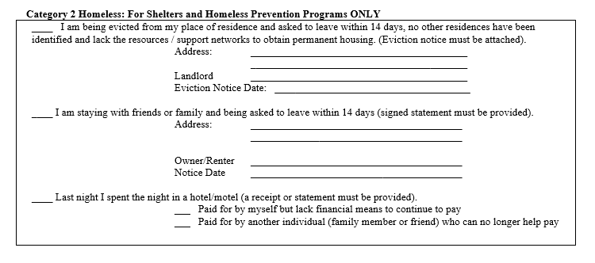
Category 2 Documentation
A court order resulting from an eviction action notifying the individual or family that they must leave; or
For individuals and families leaving a hotel or motel – evidence that they lack the financial resources to stay; or
A documented and verified oral statement; and
Certification that no subsequent residence has been identified; and
Self-certification or other written documentation that the individual lacks the financial resources and support necessary to obtain permanent housing.

Slide 22
Category 3: Homeless under other Federal Statutes
Separate Form
COC projects must have permission from HUD to serve youth under this category
Unaccompanied youth under 25 years of age, or families with children and youth, who do not otherwise qualify as homeless under this definition, but who:
i. Are defined as homeless under the other listed federal statutes; (MUST have third-party documentation for this)
ii.Have not had a lease, ownership interest, or occupancy agreement in permanent housing during the 60 days prior to the homeless assistance application;
iii. Have experienced persistent instability as measured by two moves or more during in the preceding 60 days; and
iv. Can be expected to continue in such status for an extended period of time due to special needs or barriers

Slide 23
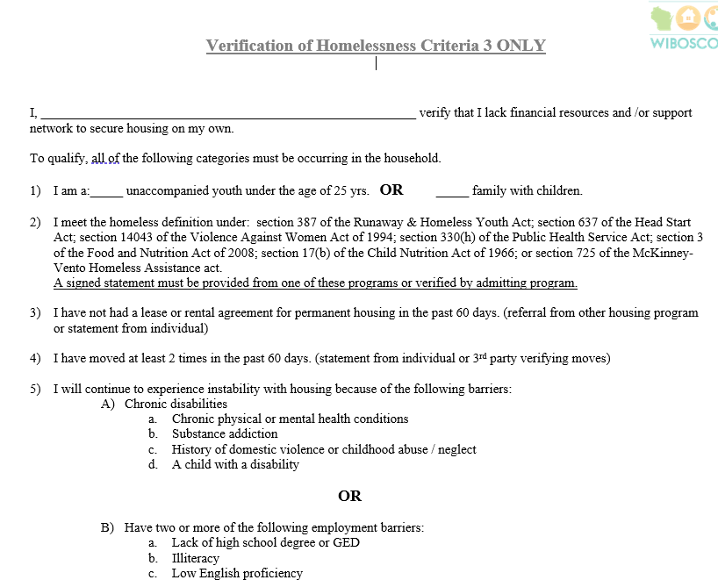

Slide 24
Contact Information
Meredith McCoy
Monitoring and Compliance Coordinator
Wisconsin Balance of State CoC
meredith.mccoy@wibos.org
PO Box 272, Eau Claire, WI 54702
Phone: 608-385-6543
Website: www.wiboscoc.org

