Slide 1
Rights and Responsibilities Under the Americans with Disabilities Act and the Fair Housing Amendments Act: What Homeless Services Providers Need to Know about Serving People with Disabilties
Monica Murphy
Managing Attorney
Disability Rights Wisconsin

Slide 2
ADA History
The ADA became law on July 26th 1990.
Regulations issued 1991
The ADA Amendments Act was passed 2008
Became effective 2009

Slide 3
The Purpose of the ADA
To provide a clear and comprehensive national mandate for the elimination of discrimination against individuals with disabilities;
To provide clear, strong, consistent, enforceable standards addressing discrimination against individuals with disabilities;
To ensure that the federal government plays a central role in enforcing the standards established in the Act on behalf of individuals with disabilities; and
To invoke the sweep of Congressional authority, including the power to enforce the 14th Amendment and to regulate commerce, in order to address the major areas of discrimination faced day to day by people with disabilities. (ADA, 42 U.S.C. § 12101)

Slide 4
Congressional findings included;
43, 000,000 Americans have one or more physical or mental impairments
Isolation and segregation of people with disabilities is serious and pervasive problem
People with disabilities face intentional exclusion, architectural, transportation, and communication barriers
People with disabilities occupy an inferior status in our society and are severely disadvantaged socially, vocationally, economically, and educationally
The Nation’s proper goals re:PWD are to assure equality of opportunity, full participation, independent living, and economic self-sufficiency

Slide 5
The Structure of the ADA
Title I: Employment
Title II: State and Local government entities including courts
Title III: Public accommodations and services operated by private entities
Title IV: Telecommunications
Title V: Miscellaneous provisions

Slide 6
Title I: Employment
All employers of 15 or more
Requires Reasonable accommodations
Prohibition against discrimination
Enforcement through the Equal Employment Opportunity Commission

Slide 7
Who is Protected?
Under the ADA a person with disability has:
A physical or mental impairment that substantially limits one or more of the major life activities of such individual;
Has a record of such an impairment; or
Is regarded as having such an impairment. (ADA, 42 U.S.C.§ 12102 [2])

Slide 8
Definition of Impairment
(1) Physical or mental impairment means:
(i) Any physiological disorder or condition, cosmetic disfigurement, or anatomical loss affecting one or more body systems, such as: neurological, musculoskeletal, special sense organs, respiratory (including speech organs), cardiovascular, reproductive, digestive, genitourinary, immune, circulatory, hemic, lymphatic, skin, and endocrine; or
(ii) Any mental or psychological disorder such as intellectual disability, organic brain syndrome, emotional or mental illness, and specific learning disability

Slide 9
Major Life Activities & Bodily Functions
Major life activities include, but are not limited to, caring for oneself, performing manual tasks, seeing, hearing, eating, sleeping, walking, standing, lifting, bending, speaking, breathing, learning, reading, concentrating, thinking, communicating, and working.
Major Bodily Functions include, but are not limited to, functions of the immune system, normal cell growth, digestive, bowel, bladder, neurological, brain, respiratory, circulatory, endocrine, and reproductive functions.

Slide 10
Illustrations
Regarded As:
Sarah, born with a prominent facial disfigurement, has been refused employment with retail store because they think she will not appeal to customers. Sarah is an individual with a physical impairment that substantially limits her major life activities only as a result of the attitudes of others toward her impairment.

Slide 11
Illustrations
Substantial limitation of a major life activity
A person who is deaf is substantially limited in the major life activity of hearing. A person with a minor hearing impairment, on the other hand may not be substantially limited.
During a house fire, Matt received burns affecting his hands and arms. While it is expected that, with treatment, Matt will eventually recover full use of his hands, in the meantime he is substantially limited in performing basic tasks required to care for himself such as eating and dressing. Because Matt’s burns are expected to substantially limit a major life activity (caring for one’s self) for a significant period of time, Matt would be considered to have a disability.

Slide 12
Illustrations
Record of
A person who has a history of an impairment that substantially limited a major life activity but who has recovered from the impairment. Examples of individuals who have a history of an impairment are persons who have histories of mental or emotional illness, drug addiction, alcoholism, heart disease, or cancer.
Persons who have been misclassified as having an impairment.

Slide 13
ADA Amendments Act 2008
Overruled a series of Supreme Court Decisions regarding mitigating measures
Supported broad coverage of people
Moved questions from who is disabled to whether there has been discrimination

Slide 14
Prohibition Against Discrimination: Employment
Applies at all stages of the employment and pre-employment relationship
Limits inquiries about disability to post offer and must be job related and required of all in the position
Prohibits discrimination in hiring, firing, pay, recruitment, promotion, and other terms and conditions of employment

Slide 15
Qualified Person with a Disability
With respect to employment, a person with a disability who, with or without reasonable accommodation, can perform the essential functions of the job in question

Slide 16
Qualified Individuals with Disabilities
Must have the requisite skills and training for the position
Disability means a mental or physical impairment that substantially limits one or more major life activities (life activities include but are not limited to seeing, hearing, speaking, walking, breathing, learning, caring for oneself, reproduction, working, etc.)
Can perform the essential functions of the job with or without reasonable accommodations

Slide 17
Essential Functions
Essential job functions are the fundamental duties of the job. A job duty is an essential function if:
the reason the job exists is to perform that function (for example, a bus driver drives a bus)
only a few employees can perform the function, or
the function is so highly specialized that the employer hires people for the position specifically because of their skill at performing that function.

Slide 18
Reasonable Accommodation
Modifications or adjustments to work environment
Changing the manner or circumstances in which the job is performed
Making existing facilities readily accessible or modifying equipment
Job restructuring, modified work schedules, reassignment to a vacant position

Slide 19
Job Accommodations Network
Information for both Employers and Employees
A-Z of Accommodations
EEOC guidance per disability
Legal Resources organized by disability
Disclosure Rules
Rehab Act and ADA library
https://askjan.org/

Slide 20
Employer Defenses

Slide 21
Undue Hardship
Undue Hardship=significant difficulty or expense
Based on nature and cost of accommodation
Overall financial resources of the facility
Impact on the operation of the facility

Slide 22
Fundamental Alteration
Employer need not provide an accommodation that would fundamentally alter the nature or operation of the business

Slide 23
Direct Threat
Employers can refuse to hire or employ someone if they pose a direct threat to themselves or others
Significant risk of substantial harm to health or safety
Not based on myth or stereotype
Must consider accommodations or modifications to ameliorate any potential risk

Slide 24
ADA Title II: State and Local Government Programs and Services
Applies to all programs of state and local governments
Including such things as;
Access to government buildings
Voting
Courts
Social Services
Recreation programs and Parks
Police and Fire services
Zoning Boards

Slide 25
Program Access Required
Public entity’s services, programs, or activities, when viewed in their entirety, must be readily accessible to and usable by individuals with disabilities.
Not necessarily required to make all existing facilities accessible
May need to move programs or services to alternative location
Not required if Defenses apply:
-fundamental alternation
-undue financial or administrative burden

Slide 26
Prohibition Against Discrimination: Programs
Cannot discriminate against a class of disabilities or based on the severity of disability
Cannot require people with disabilities to participate in separate programs or sites for people with disabilities
No imposition of surcharges for disability related expenses or for people with disabilities
No discrimination through contracting

Slide 27
Qualified Person with a Disability
A person with a disability who meets the general requirements for participation in the program

Slide 28
Government entities must:
Make reasonable modifications to rules, policies or practices
01
Remove architectural, communication, or transportation barriers
02
Provide auxiliary aids and services
03

Slide 29
Illustrations: Reasonable Modifications
Residential Zoning restrictions prohibit fences higher than 4 feet- may need to make modification for a higher fence to protect a child with autism who runs into the street
State agency requires on line application for benefits program; Person with a cognitive disability is unable to navigate the application process. Modifications must be made to provide an alternative application process or provide assistance.

Slide 30
Illustration: Barrier Removal
County run group counseling program held in a basement room without access to elevators– must offer an accessible alternative.
City must make curbcuts to sidewalks
Written communications must be available in alternative formats such as large print, braille, or audible CD

Slide 31
Illustration: Auxiliary Aids
Provision of American sign language interpreters or video relay
Note takers
Assistive listening devices
Large print or braille materials
Assistance with forms or in locating items
does not include personal devices such as eyeglasses or hearing aids

Slide 32
ADA Title III: Public Accommodations and Commercial Facilities
1. Places of Public Accommodation
2. Commercial Facilities
3. Examinations and courses related to applications, licensing, certifications, or credentialing

Slide 33
Places of Public Accommodation include:
PLACES OF LODGING
SOCIAL SERVICES CENTERS
Establishments for food and drink
Places of exhibition or entertainment
Places of public gathering
Sales or rental establishment
Stations for public transportation
Places of public display or collection
Places of recreation
Places of education
Places of exercise or recreation

Slide 34
General Requirements
A public accommodation may not discriminate against an individual with a disability
May not be denied full and equal enjoyment of the “goods, services, facilities, privileges, advantages, or accommodations” offered
Equal opportunity to participate
Equal opportunity to benefit
Receipt of benefits in the most integrated setting appropriate

Slide 35
Specific Requirements
A public accommodation may not impose eligibility criteria that either screen out or tend to screen out persons with disabilities
Public accommodations must ensure that its safety requirements are based on real risks, not on speculation, stereotypes, or generalizations about individuals with disabilities
ADA prohibits unnecessary inquiries into the existence of a disability

Slide 36
Reasonable Modifications
The ADA requires reasonable modifications in policy, practices, or procedures to allow a person with a disability equal access to goods and services.

Slide 37
Commercial Facilities
Accessibility requirements for new construction and alterations apply for office buildings, factories and warehouses whose operations affect commerce even if they are not places of public accommodation.

Slide 38
Title II and Title III overlap
Non-discrimination
Access
Removing Architectural Barriers
Auxiliary Aids and Services
Effective Communication
Service Animals

Slide 39
Ensuring Access Checklist, DRW Accessibility Guide
Accessibility includes removing not only physical barriers to participation, but also cultural and attitudinal barriers.
The Accessibility Guide also will give you practical suggestions and useful ideas to incorporate.
Ensuring accessibility is an on-going process.
Tailored for Women with Disabilities but applies to any person with a disability
http://www.disabilityrightswi.org/selfassessmenttool

Slide 40
Readily achievable Barrier Removal Required
Removal of architectural barriers, including communication barriers that are structural in nature, where removal is easily accomplished and able to be carried out without much difficulty or expense
EXAMPLES;
Accessible approach/entrance
Accessible parking and drop-off areas, curb cuts
Widening doorways
Installing visual alarm systems
Restroom usability

Slide 41
Physical access Priorities:
Accessible travel route to and through the building including curb cuts and ramps
Access to areas where goods and services are available including rearranging display racks, providing Brailled and raised character signage, visual alarms, ramps
Accessible restrooms
Any other measures necessary to provide access to goods and services

Slide 42
Accessible Parking Standards

Slide 43
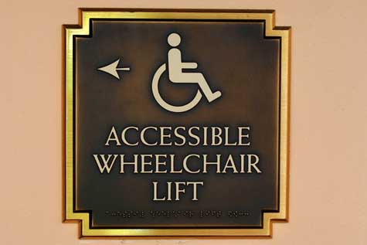
Accessible Doorways and Routes

Slide 44
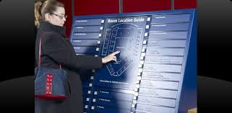
Braille Signage

Slide 45
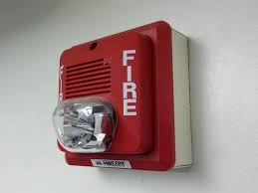
Visual and Auditory Fire Alarms

Slide 46
What can be easily modified?
What if the route of travel is uneven and or slippery?
What if can’t use stairs?
Parking space isn’t wide enough for van accessibility?
What if can’t open the door?
What if can’t read the signage?
What if the door isn’t wide enough?

Slide 47
New or Old Building?
ADAAG guidelines apply to all new construction
Accessibility Guidelines for Buildings and Facilities 1991 Standards with additional updates in 2010
Those built prior to 1990 follow ADA guidelines for readily achievable

Slide 48
Transient Lodging Accessibility
Homeless shelter, halfway houses, and other social service establishments:
Four percent of the first 100 rooms must be accessible to person with mobility impairments and to persons with hearing impairments
At least one type of amenity in each common area must be accessible
Hotels and dormitories alterations include:
Communications
Accessible rooms and showers
Visual emergency alarms

Slide 49
Auxiliary Aids and Services
A public accommodation is required to provide auxiliary aids and services where necessary to ensure that a person with a disability is not excluded, denied services, segregated, or otherwise treated differently than other individuals because of an absence of auxiliary aids and service

Slide 50
Auxiliary Aids and Services Includes
Qualified interpreters, video remote interpreting, note takers, real-time computer aided transcription services, assistive listening devices, etc
Qualified readers, taped texts, audio recordings, Brailled materials,. Screen reader software, large print materials
Acquisition or modification of equipment or devices

Slide 51
Effective Communication; It’s more than you think.

Slide 52
Deaf & Hard of Hearing
Sign language interpreter
Obligation to obtain a sign language interpreter where necessary for effective communication- varies with communication method used by the individual, the nature, length and complexity of the communication
Consult with the individual as to preferred method
Do not rely on family member or companion to interpret
Lip Reading- limited usefulness
Written materials- be aware of limited English proficiency
Video Relay Service for phone calls
Video remote interpreting (VRI)

Slide 53
Requirement Also applies to Spectators Prakel v. Indiana, 2015 US Dist, LEXIS 40123 Decided March 30, 2015
Ms. Prakel on trial in criminal matter. Her deaf son asked for a sign language interpreter for her court appearances and was denied on several occasions,
Court found that Ms. Prakel could bring an associational claim under Title II of ADA. Could sue based on denial of interpreter to her son and her paying for an interpreter herself for one hearing and for compensatory damages based on her son’s inability to assist and support her in court.
Mr. Prakel as a spectator in the court was entitled to effective communication.

Slide 54
Blind &Visually Impaired
Braille books & signage
Audio instructions
A reader/assistant
Voice controlled software
Screen magnifier
Screen reader software

Slide 55
Websites
Websites must be accessible to people who have visual, hearing, and physical disabilities.
Follow website accessibility guidelines: http://www.w3.org/TR/WCAG20/
Any videos you produce or put on your website need to meet accessibility standards including closed captioning and detailed audio descriptions

Slide 56
Effective Communication for Individuals with Intellectual Disabilities
Reading limitations
Provide pictures, symbols, or diagrams instead of words
Read written information to the person
Provide written information on audiotape
Use voice output on computer
Use line guide or highlight one line of text at a time

Slide 57
Effective Communication for Individuals with Intellectual Disabilities cont.
Writing Limitations
Provide template for forms to prompt information requested
Allow verbal response instead of written response
Allow typed response instead of written response
Use voice input on computer
Use spell check on computer
Use a scribe to completer written response
Provide ample space on forms requiring written response

Slide 58
Effective Communication for Individuals with Intellectual Disabilities cont.
Complicated communications
Provide checklists
Divide large task into multiple smaller tasks
Label items or resources
Use symbols instead of words
Color code items
Provide a 1-2-3 of A-B-C chart

Slide 59
Effective Communication Miscellaneous Tips
If a person is using a speech generating device wait for the person to construct her whole message and if you have difficult understanding the message ask to repeat it or be allowed to look at the screen.
If a person has speech that is difficult to understand watch how the person says their words, take your time, ask them to repeat or say it a different way. Don’t pretend to understand if you don’t.
Keep communication simple. Avoid jargon and technical terms. Use plain language. For tips go to www.plainlanguage.gov

Slide 60
Mental Health Disabilities and Accommodations Examples:
Noise proof headphones
Quiet times/areas
Extra lights/sunshine
Privacy (as much as reasonably possible)
Flexibility in scheduling and procedures
Checklists, organizers
Service animals

Slide 61
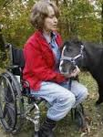
Service Animals
ADA and Fair Housing Act protections for Service Animal
Emotional Support Animals protected only under Fair Housing Act

Slide 62
Service Animals Modified by ADAAA
Dogs that are trained to do work or perform a task for the benefit of an individual with a disability.
Work or tasks must be directly related to the individuals disability such as assisting individuals who are blind navigate, alerting individuals who are deaf to the presence of people or sounds, pulling a wheelchair, retrieving items, providing physical support for balance or stability, assisting an individual during a seizure, or helping people with psychiatric or neurological disabilities by preventing or interrupting impulsive or destructive behavior. (Does not include emotional support animals that have not been trained.)
Also included miniature horses as long as the facility can accommodate the horse’s size, type, and weight.

Slide 63
Inquiries are Limited
Can ask:
Is the animal required because of a disability?
What work or task has this animal been trained to perform?
Cannot ask:
The nature or extent of an individual’s disability
Cannot require documentation or proof of training
Cannot require animal to wear a vest

Slide 64
Service Animals Cont.
Allowed wherever public allowed unless its presence interferes with the legitimate safety requirement of the facility
Must be on a leash or harness unless a tether would interfere with the animals ability to safely perform tasks or because of person’s disability
Animal must be under control and housebroken
Care of the animal is responsibility of individual with a disability
Cannot charge a surcharge for the presence of the animal

Slide 65
Service Animals in WI
Wisconsin Public Places Accommodation Act
Includes transient housing
Does not have to be a dog
Applies just as Title III of the ADA does
Also prohibited from requiring documentation
Wis. Stats. §106.52 and Wisconsin Open Housing Law §106.50
Enforcement Through the Equal Rights Division

Slide 66
Service Animals in Transient Homes
May not require additional documentation
May not exclude or deny because of having a service animal
May only ask two questions:
Is this animal required because of a disability?
What work or task(s) has the animal been trained to perform?
WI law does require rabies vaccinations for all dogs, may ask to see the required tags

Slide 67
ADA Defenses: Fundamental Alteration and Undue Burden, Safety

Slide 68
Fundamental Alteration
Public entities do not have to provide modifications to programs, services, or activities if to do so would fundamentally alter that program, activity, or service.
A fundamental alteration is a change to such a degree that the original program, service, or activity is no longer the same.

Slide 69
Undue Financial or Administrative Burden
Public entities are not required to take any action that it can demonstrate would result in an undue financial or administrative burden on that entity.

Slide 70
Safety
May have legitimate safety requirements for the safe operation of services, programs, or activities,
However,
requirements or exclusions must be made based on real risks, not speculation, stereotype or myth, and must look at reasonable modifications to mitigate potential risks.

Slide 71
Complaint Process
School discrimination file claim with Office of Civil Rights
Employment claim may file with EEOC
Housing complaints filed with HUD
Title III cases file with DOJ
Does not have to file with DOJ prior filing a lawsuit in federal court

Slide 72
Enforcement and Remedies
Enforcement:
Complaint to US Department of Justice
File a complaint in federal district court
Remedies:
Injunctive relief to enforce ADA compliance
Compensatory damages
7th Circuit has not ruled on standard: deliberate indifference or discriminatory animus

Slide 73
Department of Justice Enforcement
Refer to other Federal Agency such as Department of Health and Human Services or Housing and Urban Development for investigation
Conduct own investigation including negotiations and prosecution
Refer for Mediation
Refer to local U.S. Attorney’s Office
Decline to process

Slide 74
Access Checklist
Opportunity to review your practices and procedures
Be Proactive not reactive
Knowledgeable staff
Collect resources

Slide 75
Fair Housing Amendments Act of 1988
Added disability as protected class in all housing prohibiting discrimination against people with disabilities
Added accessibility requirements for multifamily housing (four or more units) available for first occupancy after March 13, 1991

Slide 76
Coverage of Homeless Shelters
Under the Fair Housing Act, a dwelling is “any building, structure, or portion thereof which is occupied as, or designed or intended for occupancy as, a residence by one or more families . . . .” 42 U.S.C. § 3602(b)
Generally applies to homeless shelters and transitional living- case-by-case basis
Factors include: duration of stay, intent to return each night, housing as purpose of the program, inclusion of amenities, program fee or rent charged, rental or occupancy agreement

Slide 77
Other basis for non-discrimination on basis of disability
Americans With Disabilities Act
Section 504 of the Rehabilitation Act if receiving federal funds
State Law

Slide 78
Discrimination Prohibited
Cannot refuse to rent or sell to someone because of their disability
Cannot charge higher rents or deposits to people with disabilities
Cannot segregate people based on their disabilitiy
Cannot subject people with disabilities to different lease terms
Cannot harass or intimidate people because of their disability (NIMBY issues)

Slide 79
Accessibility Requirements for New Construction
Applies to housing for first occupancy after March 13, 1991
Applies to Multi-family units of 4 or more

Slide 80
Accessibility Requirements:
Public and Common areas must be accessible and usable
Doorways must be wide enough to allow wheelchair passage
Must have an accessible route to and through the dwelling
Light switches, electrical outlets, thermostats, and other environmental controls in accessible locations
Reinforcements in walls to allow the installation of grab bars
Usable kitchens and bathrooms so a person in a wheelchair can maneuver in the space

Slide 81
Reasonable Accommodations
Housing providers must allow a reasonable accommodations which is a change, exception, or adjustment to a rule, policy, practice, or service.
Generally provided at housing provider’s expense unless it results in an undue financial or administrative burden
There must be a nexus between the disability and the requested accommodation
Provider cannot charge extra fee or deposit for accommodation

Slide 82
HUD and DOJ guidance on Reasonable Accommodations
U.S. Department Of Housing And Urban Development (justice.gov)

Slide 83
Illustration: Reasonable Accommodation
Allowing an assigned parking space along an accessible route to an individual with a mobility impairment even if other spots are first come first serve
Moving an individual with a mobility impairment to a first floor unit
Allowing early termination of lease if individuals disability makes it difficult to enjoy housing unit
Allowing service animal or emotional support animal in “no pets” housing

Slide 84
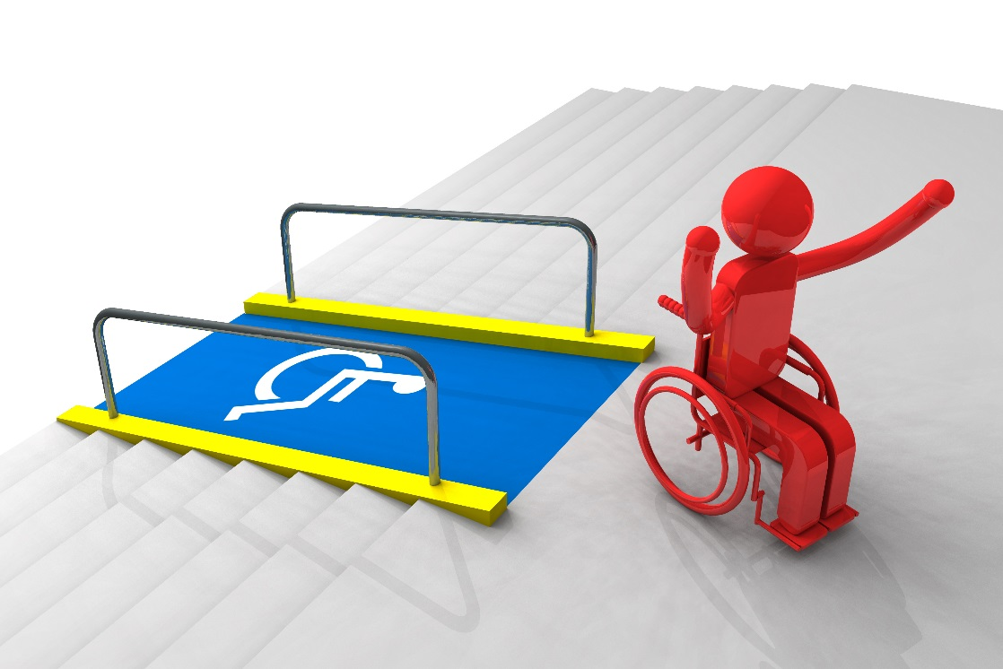
Example of Issue: Ramps
Tenants often cannot use stairs and require a ramp to access the building.
Landlords often claim that ramps are too expensive or while ruin the value of part of their property.

Slide 85
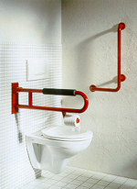
Example of Issue: Grab Bars
Many tenants require grab bars in parts of their home, specifically the bathroom, to safely maneuver.
Common issues include landlords not being willing to allow the installation of grab bars for a variety of reasons such as the type of bathroom wall will not allow the installation or that the installation will affect the value of the premise.

Slide 86
Example of Issue: Parking Spaces
It is generally a reasonable accommodation under the Fair Housing Act to allow a tenant with a mobility impairment to have their own assigned parking space close to where they enter the building even if the building has designated disabled parking spots.

Slide 87
Reasonable Modification
Housing provider’s must allow reasonable modifications to a premises. Reasonable modifications are structural changes necessary to allow a person with a disability full enjoyment of the premises
Generally modifications are the tenant’s expense (different requirements for federally funded housing)
Housing provider can require workman like manner and meeting building permit requirements
Housing provider may require the premises be returned to prior state when tenant moves out if it effects tenantability at tenant’s expense

Slide 88
Illustration: Reasonable Modification
Putting a ramp on the entrance way to an apartment building
Allowing a tenant to install grab bars in their unit
Removing cabinet doors to allow access to a sink or countertop
Widening doorways

Slide 89
HUD and DOJ guidance on Reasonable Modifications
Joint Statement on Reasonable Modifications - March 5, 2008 (hud.gov)

Slide 90
Allowed Inquiry
Housing provider is allowed to obtain information sufficient to determine if the requested accommodation is necessary because of a disability
If disability is obvious or known to the provider no additional information about the disability is necessary
If disability is known but the need is not readily apparent the provider can ask for information necessary to evaluate the disability related need
If disability is not known, provider can ask for information verifying the disability, the needed accommodation, and the relationship between the disability and the requested accommodation

Slide 91
Emotional Support Animals
Distinct from Service Animals
Not limited to dogs
Does not need specific training or certification
Cannot charge pet deposit or additional rent
Can inquire as to whether individual has a disability and whether there is a disability related need for the animal

Slide 92
HUD Memo on Assistance Animals
HUDAsstAnimalNC1-28-2020.pdf

Slide 93
Landlord/Housing Provider Defenses
Fundamental Alteration
Undue Burden
Direct Threat- Must be real and substantial, not based on stereotype, cannot be ameliorated by reasonable accommodations

Slide 94
Complaint Process
State Law complaints: State of Wisconsin Equal Rights Division
ERD-10240, Discrimination Complaint - Fair Housing (wisconsin.gov)
Fair Housing Act Complaint: Housing and Urban Development
File a Complaint – Main Page | HUD.gov / U.S. Department of Housing and Urban Development (HUD)

Slide 95
Enforcement Procedures
Investigation
Negotiation/ Mediation
HUD- findings and order: Possible U.S. DOJ involvement
ERD hearing results in Finding and Order, may be removed to circuit court

Slide 96
Remedies
Affirmative order to provide accommodation/modification
Damages for Moving or other expenses
Emotional Distress damages
Attorney’s Fees
Training orders
Notice Posting
Forfeitures

Slide 97
Further Questions?
Monica Murphy
disabilityrights|WISCONSIN
6737 W. Washington St., Suite 3230
Milwaukee, Wisconsin 53214
414-773-4646 Voice
414-773-4647 Fax
www.disabilityrightswi.org

