Slide 1
Racial Disparities in Homelessness
WI BOS COC Quarterly Meeting, AUGUST 2019

Slide 2
National Disparities
40%
13%
Notes:
Data from 2017 (AHAR)
Whites and Asians underrepresented

Slide 3
National Disparities
21%
18%

Slide 4
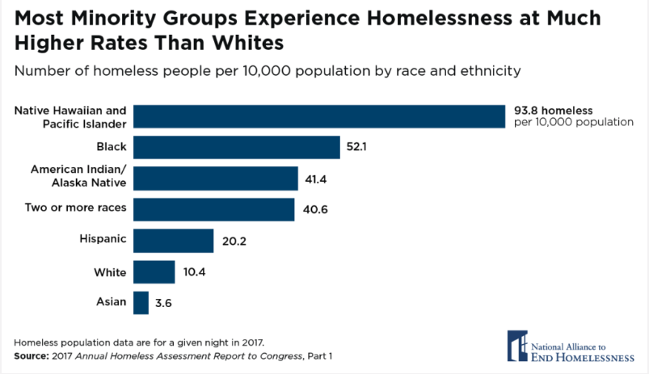
National Disparities
9 x
5 x
4 x
4 x
2 x
36% as likely

Slide 5
Why?
"This is no accident; it is the result of centuries of structural racism that have excluded historically oppressed people—particularly Black and Native Americans—from equal access to housing, community supports, and opportunities for economic mobility."
SPARC Phase One Findings, Center for Social Innovation (C4)
History of Housing Segregation in America

Slide 7
Restrictive Covenants
“Less than a half-mile away from where Sink owned a home [in De Pere] in 1900, racially restrictive covenants barred African American home-ownership in the 1940s.” - Green Bay Press Gazette
“Some white homeowners in Northeast Wisconsin communities embraced racially restrictive real estate covenants barring African American home ownership in the 1930s and 1940s” – Door County Magazine
Notes:
Covenants ruled unenforceable by the state in 1948

Slide 8
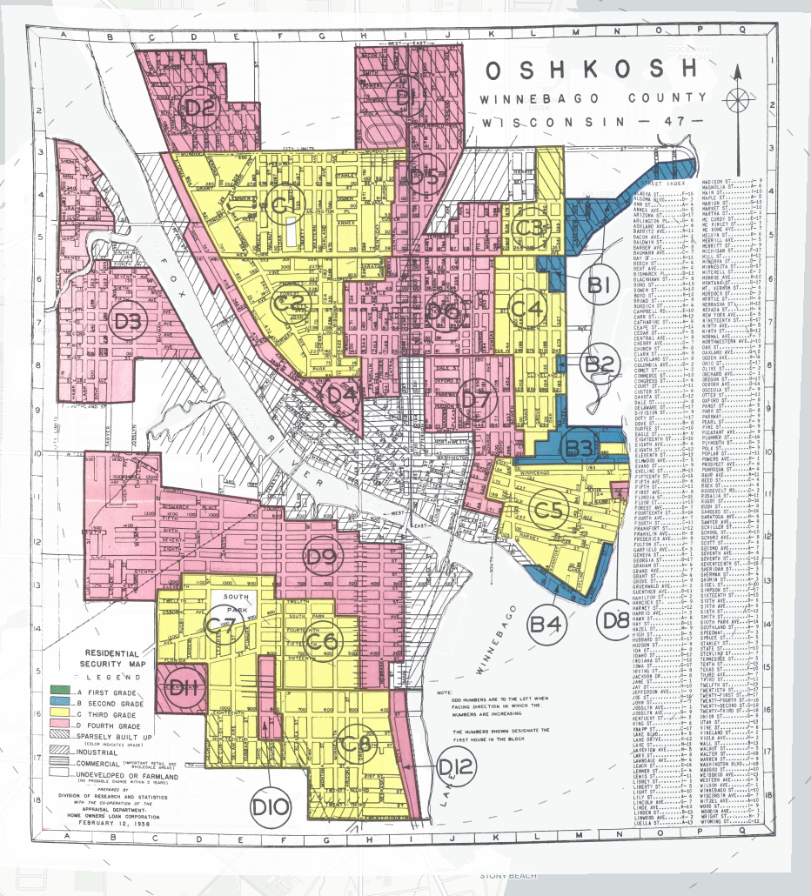
Redlining: Oshkosh, 1938
Four Designations:​
Green (A) = “Best”​
Blue (B) = “Still Desirable”​
Yellow (C) = “Definitely Declining”​
Red (D) = “Hazardous”
Source: Mapping Inequality
Notes:
Residential security map from the Home Owners Loan Corporation (HOLC)

Slide 9
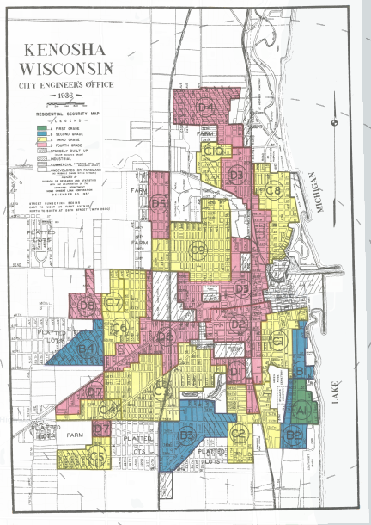
Redlining: Kenosha, 1936
Four Designations:​
Green (A) = “Best”​
Blue (B) = “Still Desirable”​
Yellow (C) = “Definitely Declining”​
Red (D) = “Hazardous”
Source: Mapping Inequality

Slide 10
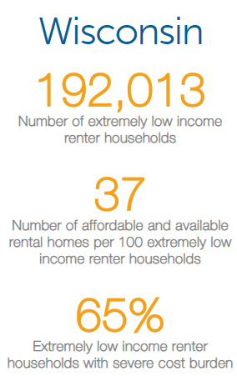
Housing Shortage
37 Number of affordable and available rental homes per 100 extremely low income renter households (National Low Income Housing Coalition, 2017)
Notes:
Severe cost burdened: spending more than half of income on housing costs

Slide 11
Housing Discrimination
The Federal Fair Housing Act and Wisconsin Fair Housing Law prohibit housing discrimination based on an individual’s protected class.
HUD’s 2012 Housing Discrimination Study found that “real estate agents and rental housing providers recommend and show fewer available homes and apartments to minorities than equally qualified whites.”
Current zoning regulations (large minimum lot/home sizes) contribute to continued housing segregation by preventing the development of affordable housing.
Sources: Southeastern Wisconsin Regional Planning Commission (SEWRPC); Housing Discrimination Against Racial and Ethnic Minorities 2012 (HUD)
Notes:
Blatant discrimination has decreased
Metropolitan Milwaukee Fair Housing Council conducts systemic testing and complaint-based testing to enforce Fair Housing law.
Satellite Northeast Wisconsin office (Appleton)
Disparate impact of local land use

Slide 12
SPARC Report
Supporting Partnerships for Anti-Racist Communities
Key Findings:
Rates of homelessness for Native Americans and Black people were disproportionately high
Poverty alone does not explain inequity
Homeless services workforce not representative of folks experiencing homelessness
Domains of Inequality Influencing Homelessness for People of Color
Economic Mobility
Housing
Criminal Justice
Behavioral Health
Family Stabilization
Network Impoverishment
Notes:
6 participating communities, HMIS data 2013 – 2015
2/3 homeless pop Black, homeless services workforce 2/3 white
Domains of inequality from oral histories
Family stabilization – child welfare, foster care, domestic violence

Slide 13
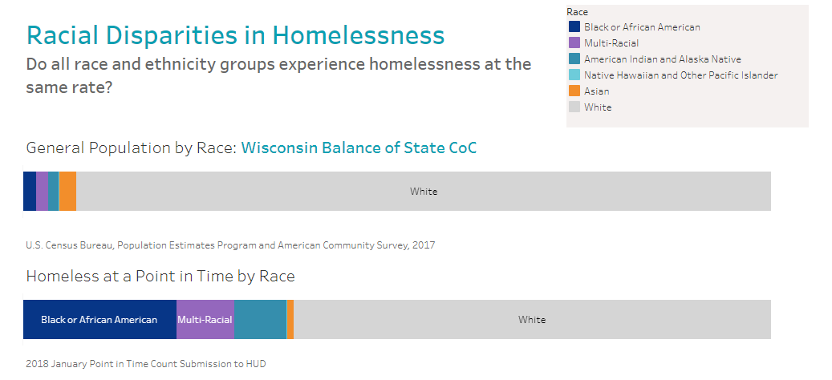
Local Disparities: WI BoS
2%
93%
21%
64%
Notes:
2019: 66% White, 17% Black, 1% Asian, 8% American Indian, 9% Multi-Racial

Slide 14
Local Disparities: WI BoS
5%
7%

Slide 15
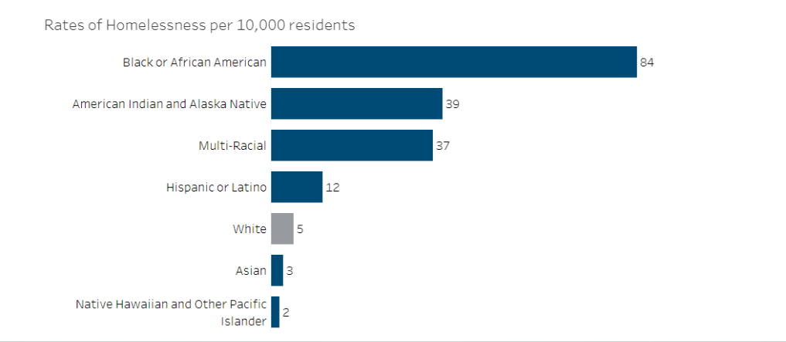
Local Disparities: WI BoS
16 x
8 x
7 x
2 x
0.5 x
0.4 x
Notes:
Native Hawaiian/Pacific Islander likely due to very low percentage of pop (0.1%)

Slide 16
Local v. National Disparities
5 x
16 x

Slide 17
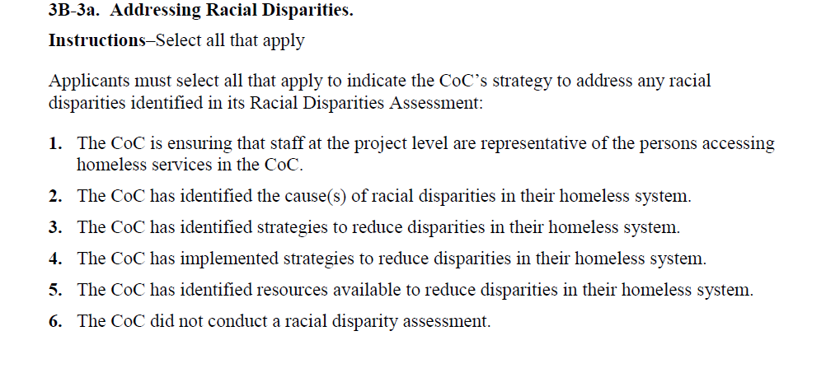
From the NOFA
Notes:
Disparities in provision or outcome of homeless assistance

Slide 18
From the NOFA
Ensuring that staff at the project level are representative of the persons accessing homeless services in the CoC
Identified cause(s) of racial disparities
Identified strategies to reduce disparities
Implemented strategies to reduce disparities
Identified resources available to reduce disparities
Did not conduct a racial disparity assessment

Slide 19
Strategies
Board and decision-making bodies representative of population served
Communication is inclusive of underrepresented groups
Train staff to better understand racism and the intersection of racism and homelessness
Create professional development opportunities for emerging leaders of different races

Slide 20
Strategies
Review coordinated entry processes to understand impact on people of different races and ethnicities
Collecting data to better understand patterns of program use for people of different races and ethnicities
Conducting additional research to understand the scope and needs of different races or ethnicities experiencing homelessness

Slide 21
Strategies
Sustained economic investment in communities of color
Expand affordable housing availability, and make sure units go to folks most at risk of homelessness
Implement and enforce fair housing legislation

