Slide 1
Youth Services Framework
Emily Tofte and Brooke Hobbs
Wisconsin Department of Children and Families,
Bureau of Youth Services
May 2017

Slide 2
Background: Wisconsin Child Welfare Model for Practice
The Wisconsin Department of Children and Families (DCF) created the Wisconsin Child Welfare Model for Practice in 2016.
The Wisconsin Child Welfare Model for Practice is the compass which informs the development of standards, codes and regulations that direct our work and guide decision-making.
The Model for Practice aligns what we do with how and why we do our work, and provides a vision for quality services.
Notes:
-DCF recognizes the complexities of the work we engage in as part of the Child Welfare System. We believe how we do our work is as important as what we do.

Slide 3
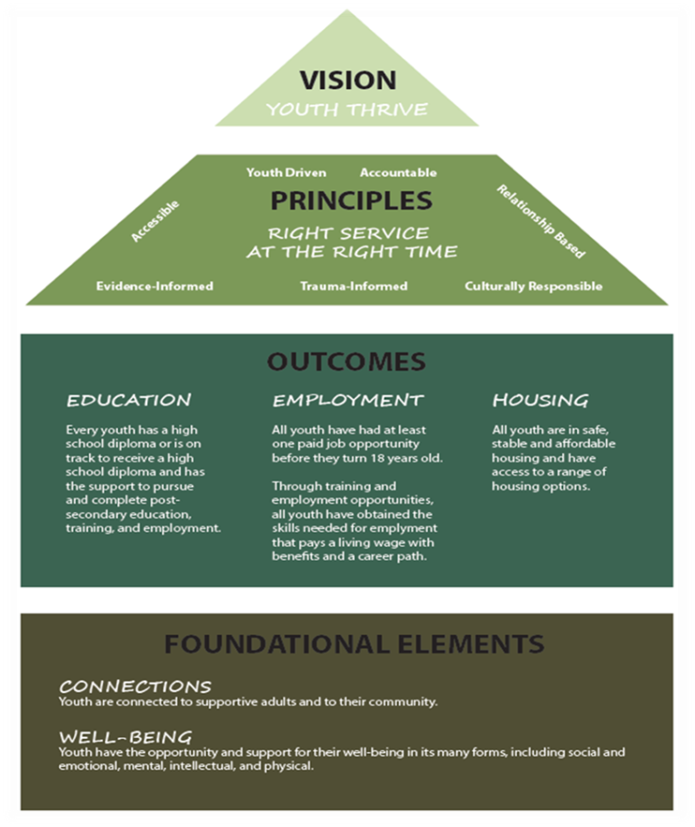
Youth Services Framework
From this Model, the Bureau of Youth Services created the Youth Services Framework as a way to guide and implement the Model in the Bureau’s work, including extending this Framework to its partners and programs.

Slide 4
Youth Services Framework
The Youth Services Framework establishes a unifying vision, core principles, foundational elements, and outcomes to guide the work of the Bureau of Youth Services (BYS) and its partners.
Guided by the overarching vision and embodying the principles, BYS and its partners can work together to provide all youth the foundational elements they need to achieve positive outcomes.

Slide 5
Youth Services Framework
Under this Framework, the vision is that no matter which system “door” a youth enters, a coordinated and comprehensive response is available to provide the support needed to fulfill the youth-driven vision that “all youth have the tools to thrive in adulthood.”

Slide 6
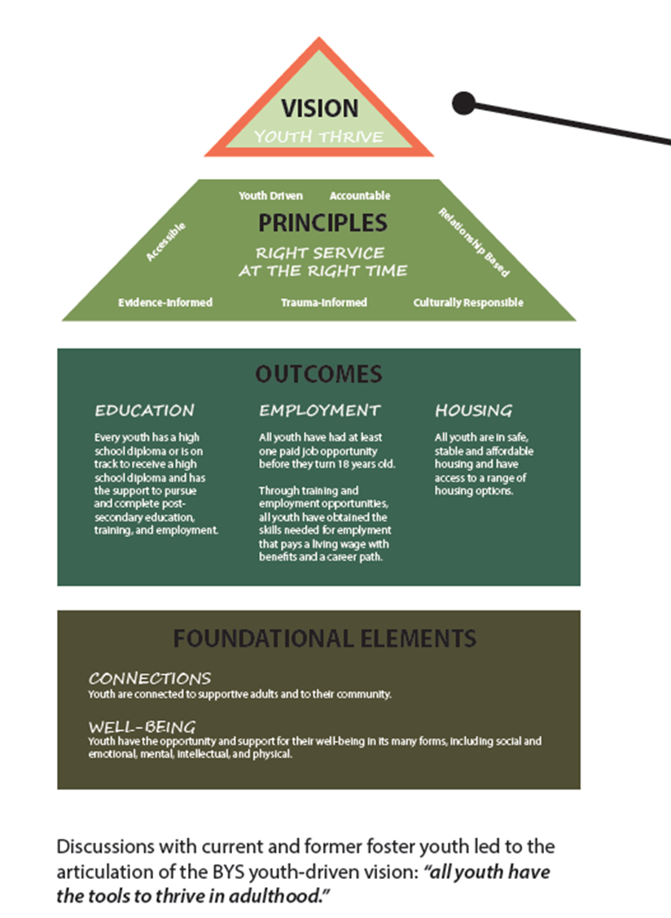
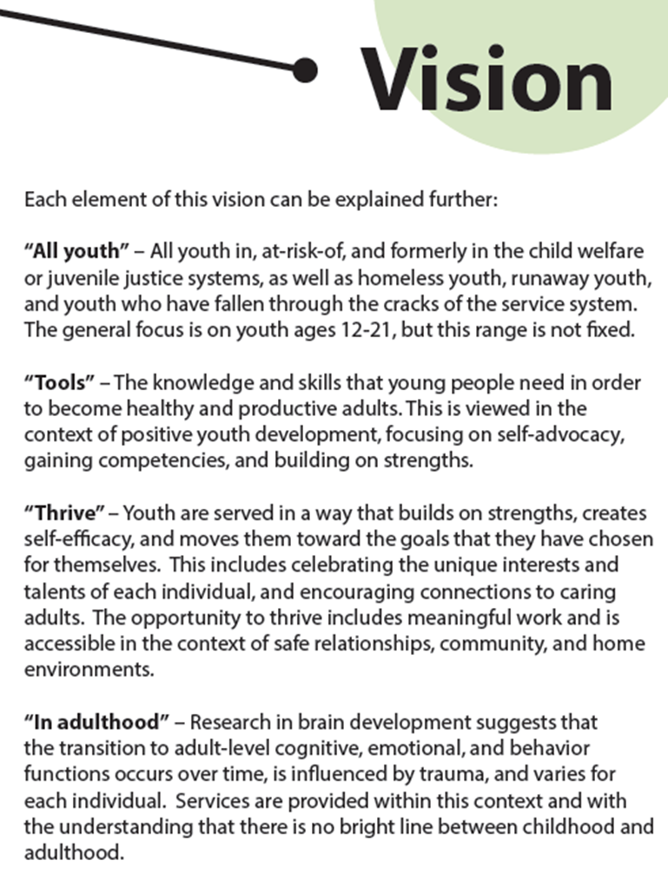

Slide 7
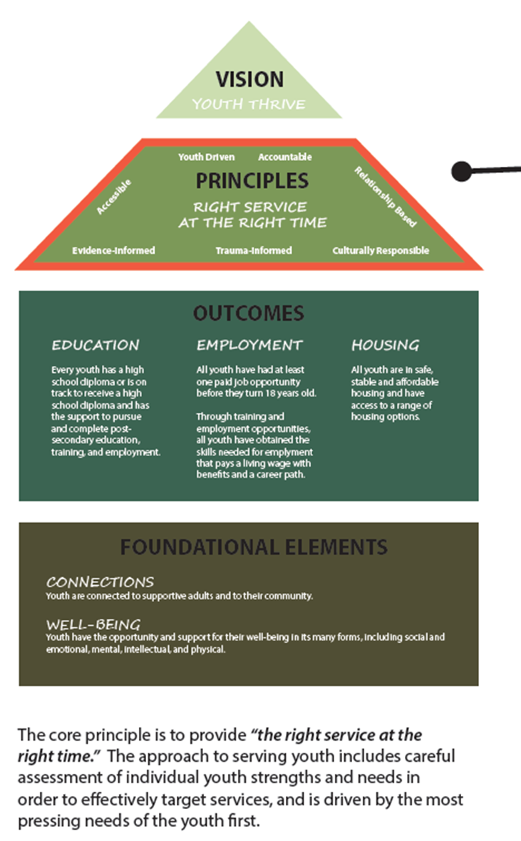
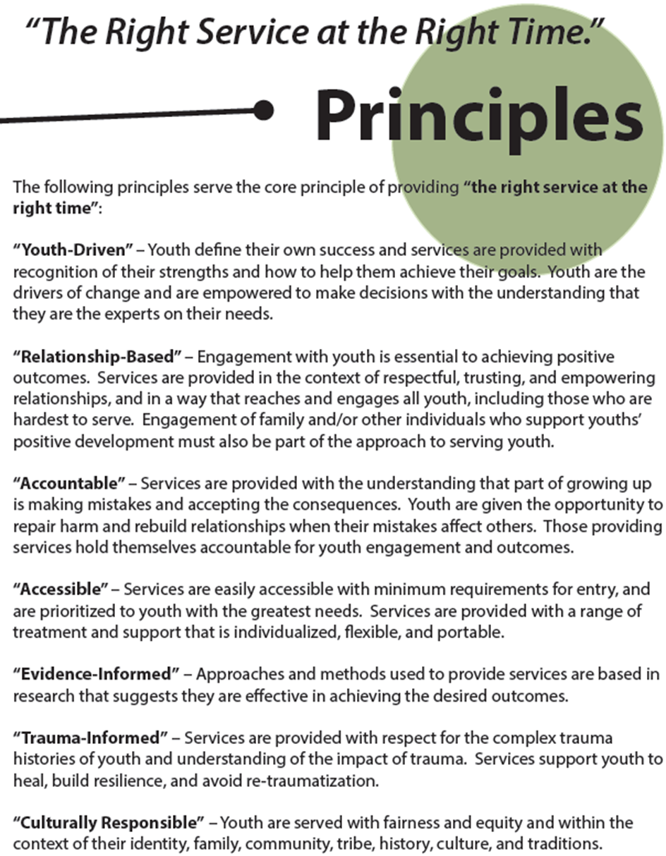

Slide 8
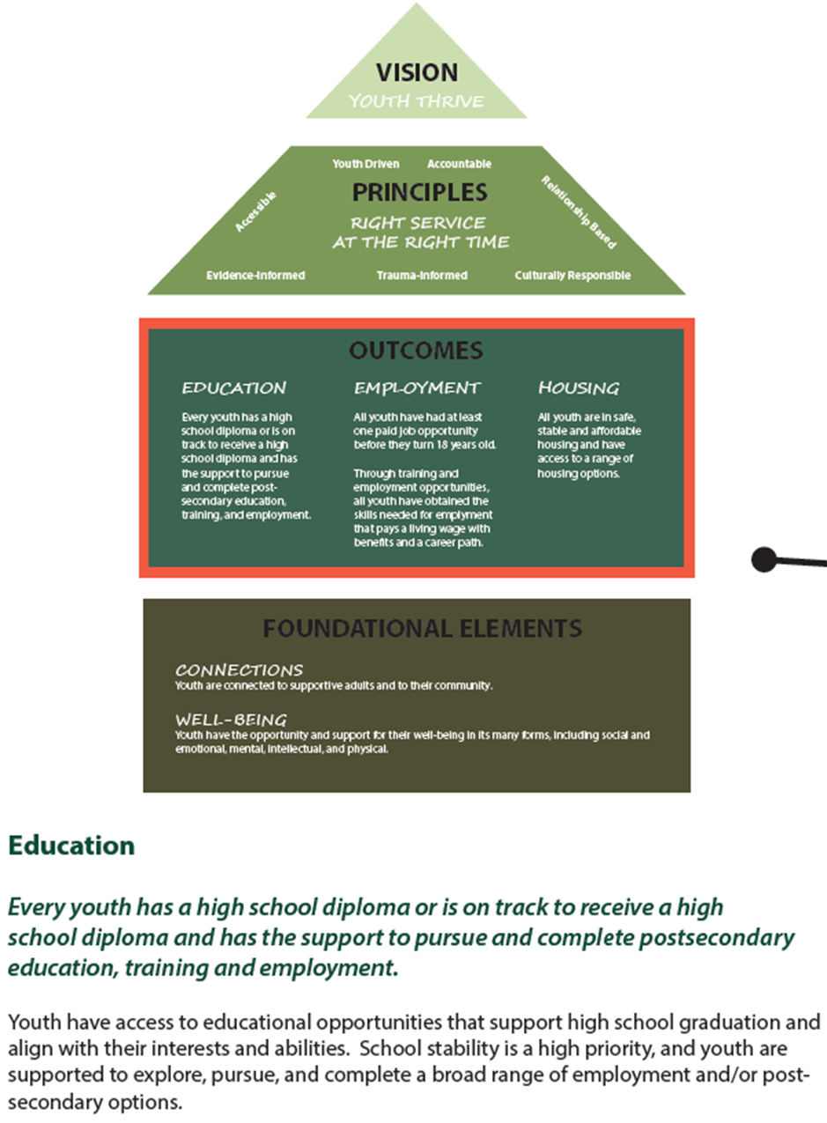
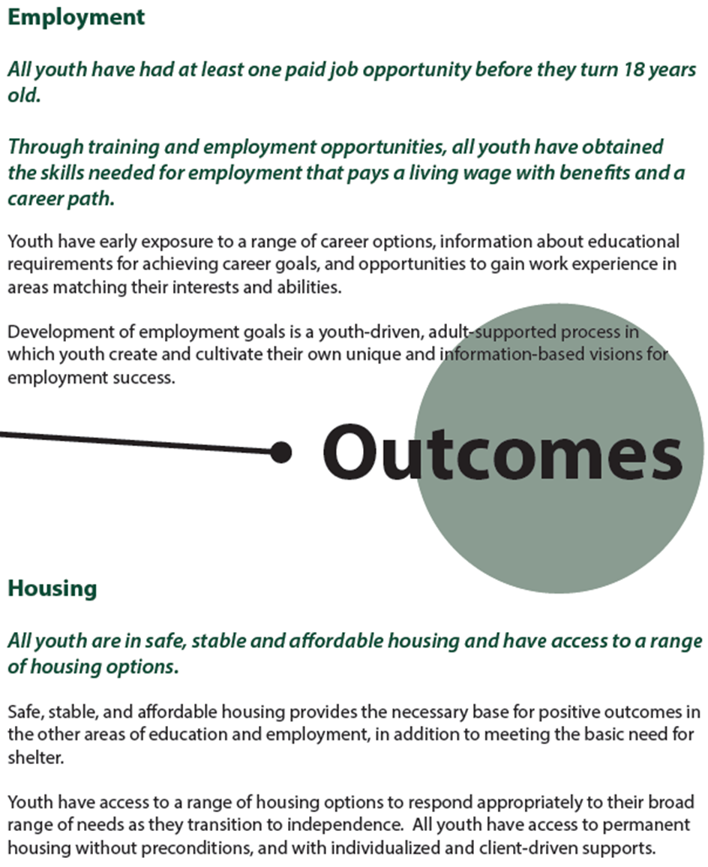

Slide 9
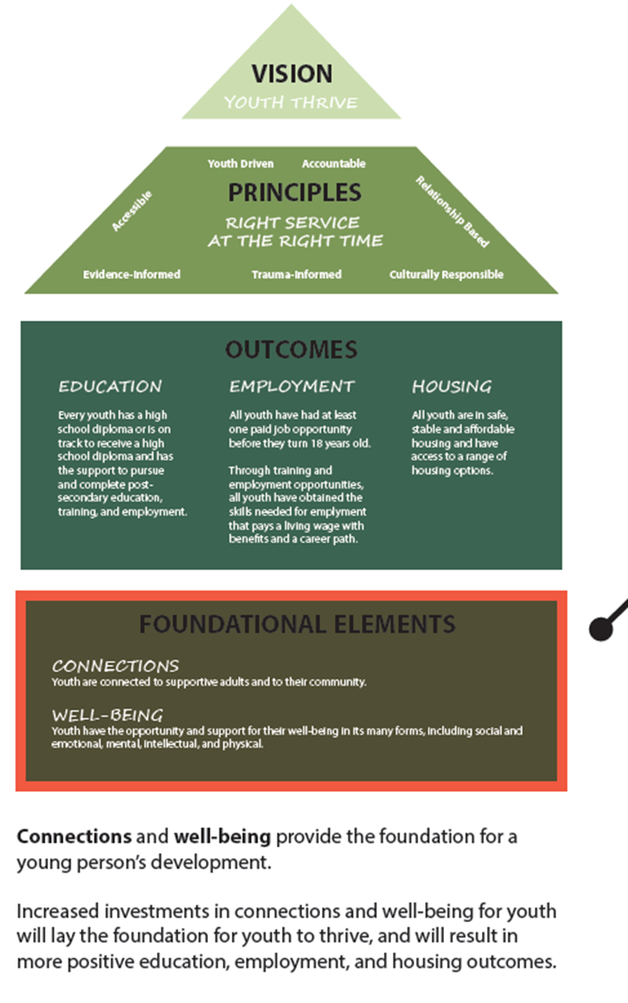
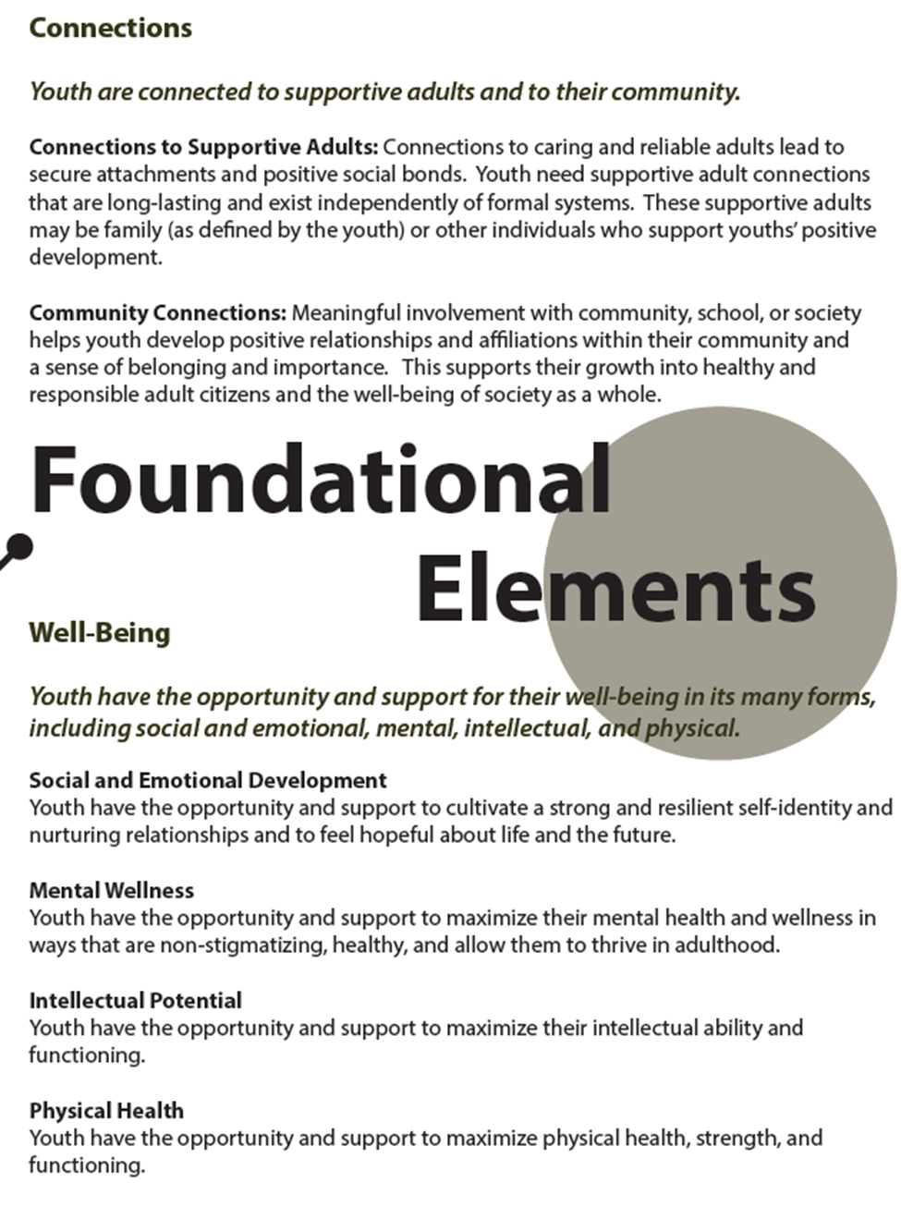

Slide 10
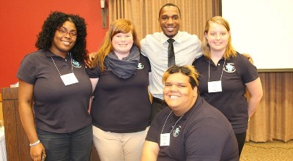
The Framework: BYS and its Partners
BYS’ partners and grantees are expected to work within the Youth Services Framework.
Additionally, those programs are located within regions specifically designed for regional community collaboration to provide a streamlined and comprehensive response to youth needs in those areas.
Notes:
BYS’ partners and grantees are expected to work within the Youth Services Framework which include the Child Welfare system, the Youth Justice system, and programs such as the Independent Living Transition Resource Agencies that provide Independent Living Services to eligible youth aging out of care, Brighter Futures programs that provide prevention services to youth and young adults, Runaway and Homeless Youth programs that provide services to homeless youth and young adults, and the PATHS program that provides housing and additional services to homeless and at-risk youth who age out of care.

Slide 12
Bureau of Youth Services Contact Info
Wendy Henderson, Bureau Director
608-422-6989, wendy.henderson@wisconsin.gov
Emily Tofte, Bureau Manager
608-422-6993, emily.tofte@wisconsin.gov
Kinnic Eagan, Education & NYTD Coordinator
608-422-6988, HaiPhuong.Eagan@wisconsin.gov
Brooke Hobbs, Housing & Employment Coordinator
608-422-6992, brooke.hobbs@wisconsin.gov
Kelsey Hill, Independent Living Coordinator
608-422-6990, kelseyr.hill@wisconsin.gov
Bryn Martyna, Youth Justice Coordinator
608-422-6897, bryn.martyna@wisconsin.gov
Ragen Shapiro, Youth Justice Coordinator
608-422-6899, ragen.shapiro@wisconsin.gov
Vacant, Prevention & Intervention Coordinator

