Slide 1
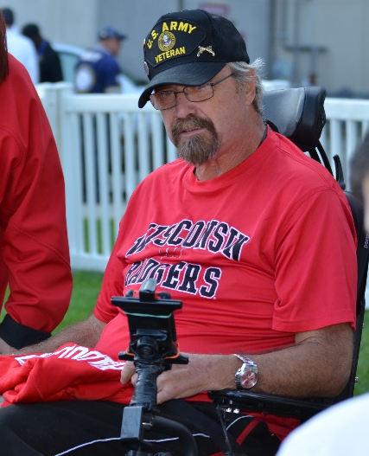
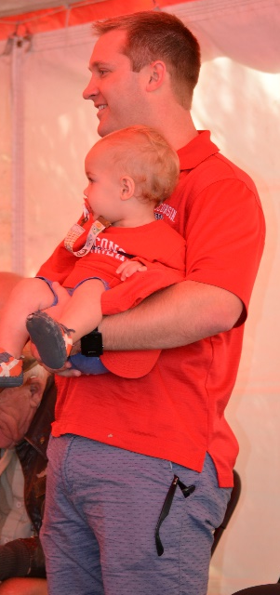
Who is a Veteran?

Slide 2
Presenters
Ken Corry
Wisconsin Department of Veterans Affairs, Veterans Outreach & Recovery Program Region 6
Jesse P. Cuff
Waupaca County Veterans Service Officer
Heather Grasse, LICSW
Department of Veterans Affairs, Green Bay HUD-VASH

Slide 3
Definitions
Federal VA
Benefits
Health
State VA
Benefits
VORP
Local Government

Slide 4
Military Culture
Military service can be significant piece of one’s background
Each branch represented by its’ own unique symbols, values, and mottos
Active Duty, Reserve, and National Guard
Generational differences
*Taken from VA Community Provider Toolkit - Understanding Your Client’s Military Background

Slide 5
Myths
Myth 1: Veterans are a small subset of the population.
Federal data show veterans make up 8 percent of the U.S. population.
Myth 2: Veterans join the military because they could not get into college and are uneducated.
35 percent of post-9/11 veterans have a bachelor’s degree or higher, compared to 31 percent of all veterans and 32 percent of the general U.S. population.
Myth 3: All veterans are eligible for VA Health Care.
Only 40% of those that serve in the Military are eligible for VA Services.
Notes:
Myth 1: Veterans are a small subset of the population.
The number that’s often thrown out is 1 percent, but that applies to active duty troops, researchers said. As of 2017, federal data show veterans make up 8 percent of the U.S. population, with post-9/11 veterans the fastest growing group among them.
Myth 2: Veterans join the military because they could not get into college and are uneducated.
According to federal data collected in the 2017 Current Population Survey, 35 percent of post-9/11 veterans have a bachelor’s degree or higher, compared to 31 percent of all veterans and 32 percent of the general U.S. population.
Rosalinda Maury, a researcher with the Syracuse Institute for Veterans and Military Families, said education benefits tend to be a top recruiting incentive, and the military promotes and prepares service members for post-secondary education.
Myth: 3 All veterans are eligible for VA Health Care
Only 40% of those that serve in the Military are eligible for VA Services.

Slide 6
Why People May Not Identify as a Veteran?
“Have you ever served in the military?” vs. “Are you a veteran?”
Don’t want to fall into the stereotypes
Non-combat
“Bad Paper”
Gender, Sexual Identity
Reserves and National Guard
Notes:
Don’t want to fall into the stereotypes: PTSD, damaged goods, gun-waving, outraged
Non-combat: Military fraught with hazardous, psychologically taxing assignments that don’t involve direct combat
“Bad Paper”
Actual quotes said to female veterans - “You don’t qualify because veterans are men.” “Being married to a solider doesn’t make you a veteran.” “Thank your husband for his service.”
Don’t Ask, Don’t Tell
Trauma

Slide 7
Screening
Ensure that veterans have access to the health care and support services that they have earned
Awareness strengths and unique challenges
Ask client if close family members have served in military

Slide 8
Who Ya Gonna call?
County Veteran Service Office
http://wicvso.org/locate-your-cvso/
Veterans Outreach and Recovery Program
https://dva.wi.gov/Pages/benefitsClaims/VORP.aspx
Federal VA Services for Homeless and At-Risk Veterans
https://www.va.gov/homeless/
Dial 1-877-4AID-VET (1-877-424-3838)

Slide 9
County Veterans Service Officers (CVSO)
Liaison between veteran benefits and those who may be entitled to them including veterans, their dependents, and the survivors of veterans
Federal: Veteran Affairs (VA) disability and pension claims, G.I. Bill education, VA home loans, medical care, nursing homes, replacement discharge certificates and military medals, death benefits, veteran cemeteries, funeral honors, life insurance, employment, vocational rehabilitation, etc.
State: Emergency aid grants, participation in veteran assistance programs for the homeless, state nursing home care, education programs and state eligibility applications
County: Emergency financial assistance and assistance to any veteran or veteran's dependent in need

Slide 10
Veterans Outreach & Recovery Program (VORP)
Veteran Hub: Help navigate service systems with special focus on treatment and recovery support
Funded through State of Wisconsin
Provide short and long term case management depending on need
All who have served in any component of the U.S. Armed Forces including those that have previously served and continue to serve in the National Guard and Reserve
Notes:
Funding available for treatment
Cannot enroll those with a Dishonorable Discharge but can refer them to services

Slide 11
U.S. Department of Veterans Affairs Homeless Programs
Mission: To help prevent and end homelessness among Veterans. We seek to empower Veterans to lead their own recovery process toward independence and a full life in the community.
Health Care for Homeless Veterans (HCHV)
Community Resource and Referral Center (CRRC)
Contract Transitional Housing
Grant & Per Diem (GPD)
HUD-VASH
Healthcare for Re-entry Veterans (HCRV)
Veteran Justice Outreach

Slide 12
HUD-VASH
Served in active military and discharged or released under conditions other than dishonorable
Homeless or at risk for becoming homeless
Eligible for VA health care
Have substance abuse disorder, mental illness or disability
Require clinic case management services and be willing and able to engage in clinical case management services in order to remain housed in the community
For the tribe HUD VASH program, the Veteran must be a full member of a federally recognized tribe
Veterans with spouses and dependent children and also eligible to participate
The Veteran’s family’s total household income must fall within HUD income guidelines
Housing situation meets HUD criteria for participation in the program

Slide 13
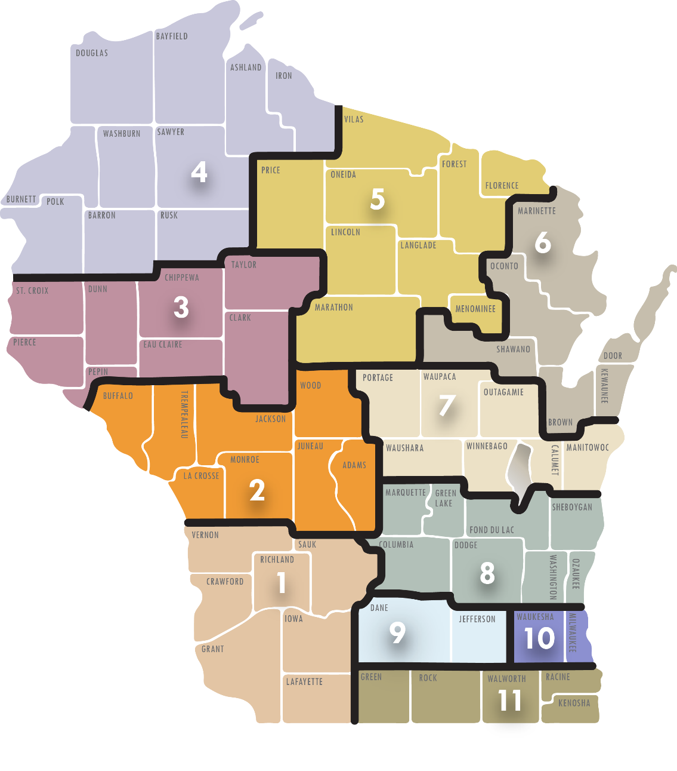
VORP Field Staffing
11 VORP Regions
Region 1
Region 2
Region 3
Region 4
Region 5
Region 6
Region 7
Region 8
Region 9
Region 10
Region 11

Slide 14
Resources
Veterans Crisis Line: 1-800-273-8255 Press 1
VA Community Provider Toolkit
https://www.mentalhealth.va.gov/communityproviders/
PsychArmor
https://psycharmor.org/
Center for Deployment Psychology (CDP)
https://deploymentpsych.org/military-culture-course-modules
The Citizen Soldier Support Program (CSSP)
http://www.aheconnect.com/citizensoldier/

Slide 15
Questions?
Visit WisVets.com to learn more >>

