Slide 1
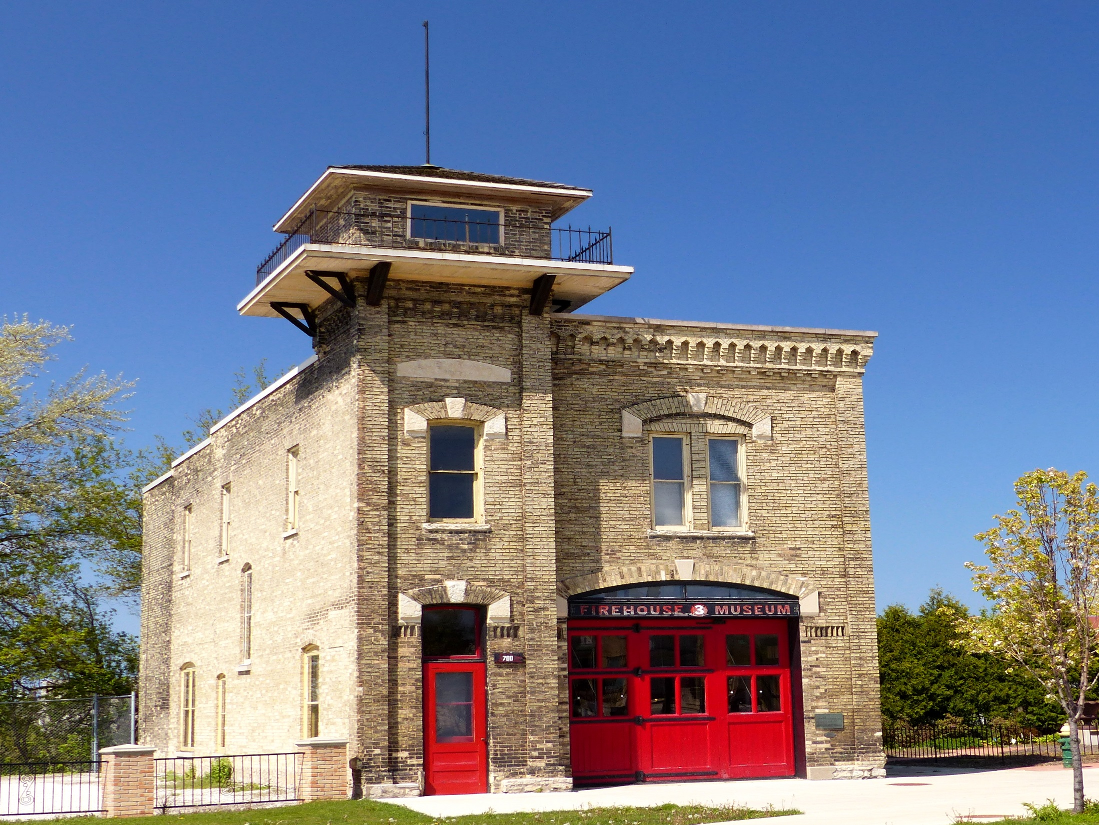
Fair Housing And CoC’s
A Brief Overview

Slide 2

Overview:
What is Fair Housing
Protected Classes
Reasonable Accommodations and Modifications
Fair Housing and Shelters
Using Fair Housing as a Housing Search Tool
Affirmatively Furthering Fair Housing

Slide 3
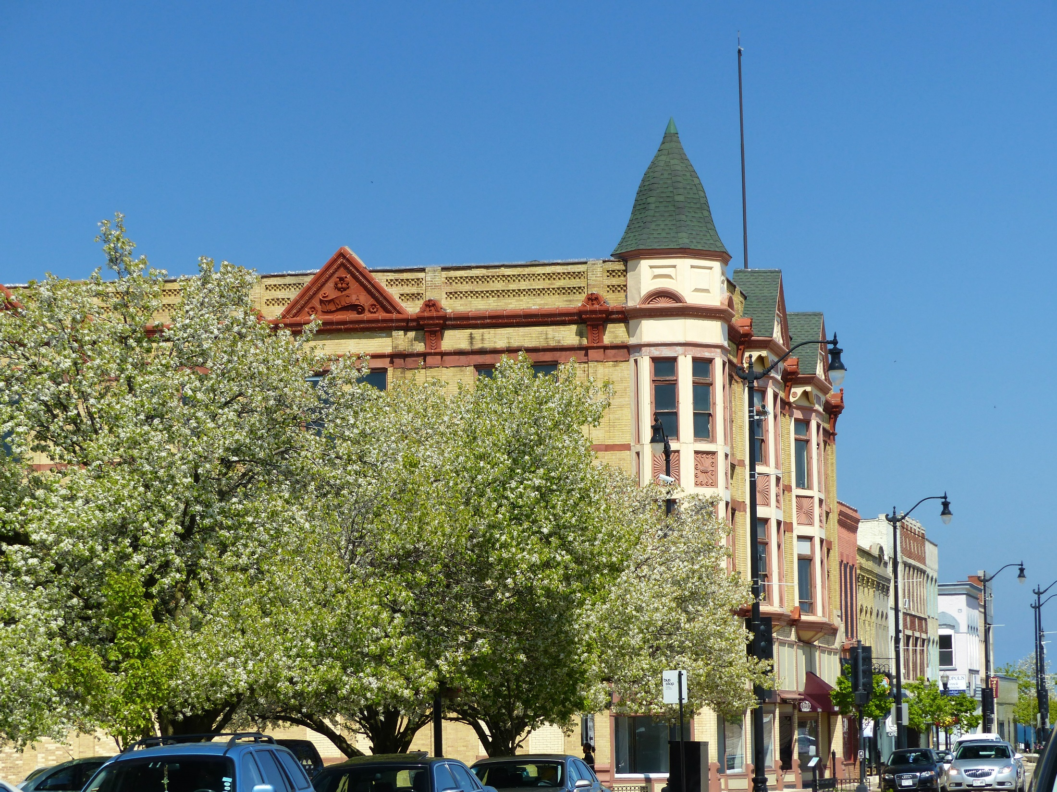
What is Fair Housing

Slide 4
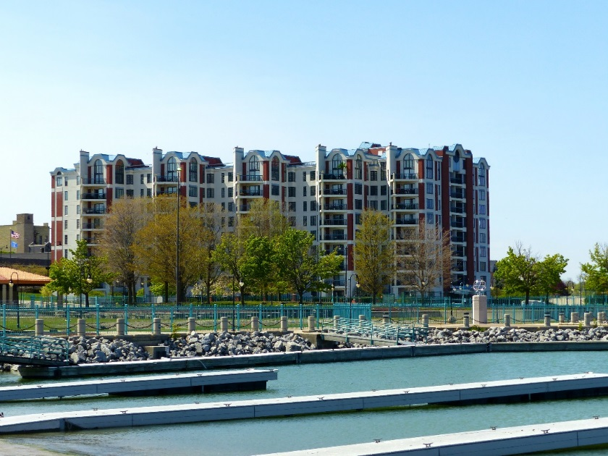
What is Fair Housing:
Fair housing is the right for all people to live where they choose, have equal access to housing (which includes finding, purchasing, renting, and selling) and enjoy the full use of their homes without unlawful discrimination, interference, coercion, threats, or intimidation by owners, landlords, real estate agents, banks or any other persons.

Slide 5
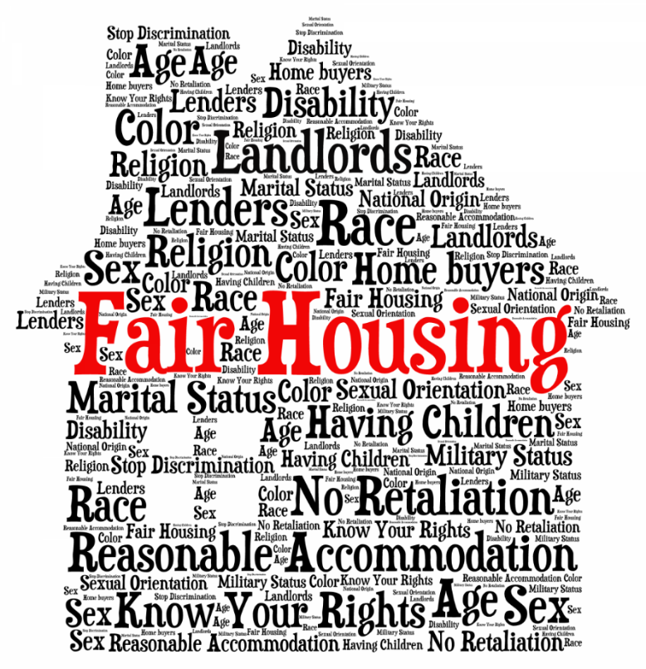
What is Fair Housing:
It shall be unlawful to:
Engage in any conduct relating to the provision of housing which otherwise makes unavailable or denies dwellings because of a protected class.
http://tompkinscountyny.gov/humanrights/fairhousing

Slide 6
What is Fair Housing:
In the sale and rental of housing no one may take any of the following actions based on protected class:
Refuse to rent or sell housing
Refuse to negotiate for housing
Make housing unavailable
Deny a dwelling
Set different terms, conditions or privileges
Provide different housing services or facilities
For profit, persuade owners to sell or rent (blockbusting)
Falsely deny that housing is available for inspection, sale, or rental
Deny anyone access to or membership in a facility or service (such as a multiple listing service)

Slide 7
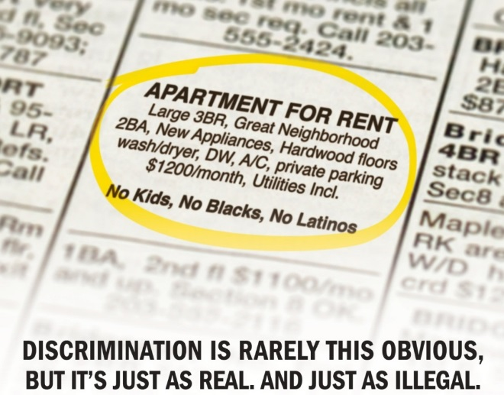
What is Fair Housing:
It is illegal for anyone to:
Threaten, coerce, intimidate or interfere with anyone exercising a fair housing right or assisting others who exercise that right.
Advertise or make any statement that indicates a limitation or preference based on (protected classes).

Slide 8
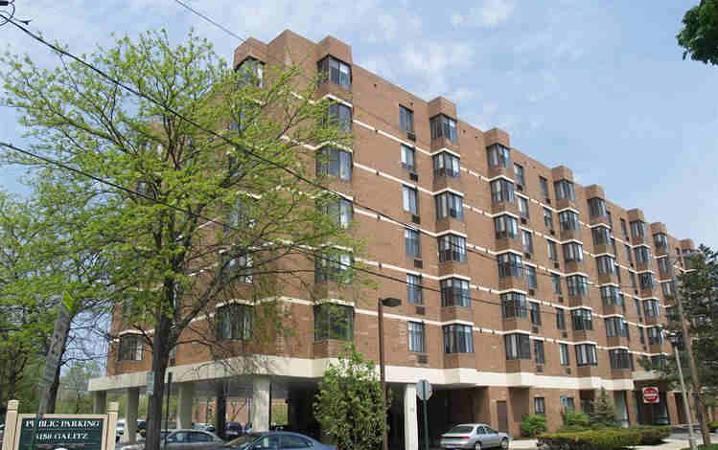
What is Fair Housing:
Types of Housing Covered by the Fair Housing Act:
Properties for sale/rent
  Houses/Condos
  Apartments
  Mobile Homes
Retirement Communities
Assisted Living Facilities
Time Shares
Nursing Homes
Homeless Shelters
*There are some exemptions including senior housing or small, owner-occupied buildings.

Slide 9
Housing Discrimination Complaints, 2005-2015:
There were 28,181 reported complaints of housing discrimination in 2016.
55% of these cases involved discrimination on the basis of disability.
91.5% of all acts of housing discrimination in 2016 occurred during rental transactions.
National Fair Housing Alliance: The Case For Fair Housing; 2017 Fair Housing Trends Report

Slide 10
Approximately 4 million instances of housing discrimination occur annually.
National Fair Housing Alliance: The Case For Fair Housing; 2017 Fair Housing Trends Report

Slide 11

Protected Classes

Slide 12
Protected Classes:* | Federal | State
Race | X | X
Color | X | X
Religion | X | X
Sex | X | X
National Origin | X | X
Disability/Handicap | X | X
Familial Status | X | X
Sexual Orientation |  | X
Marital Status |  | X
Ancestry |  | X
Public Assistance/Lawful Source of Income/ Economic Status |  | X
Age |  | X
Status of a Victim of Domestic Abuse, sexual abuse, or stalking |  | X
* Some WI municipalities/jurisdictions may have local Fair Housing Ordinances.

Slide 13
Potential Violations:
Fair Housing violations are rarely blatant and are often done with a handshake and a smile.
We can’t allow a teenage boy and girl to sleep together in the same room.
Parking is first come, first served, no exceptions.
I’m sorry, I cannot work with a translator.

Slide 14
Complaints By Type:
National Fair Housing Alliance: The Case For Fair Housing; 2017 Fair Housing Trends Report

Slide 15
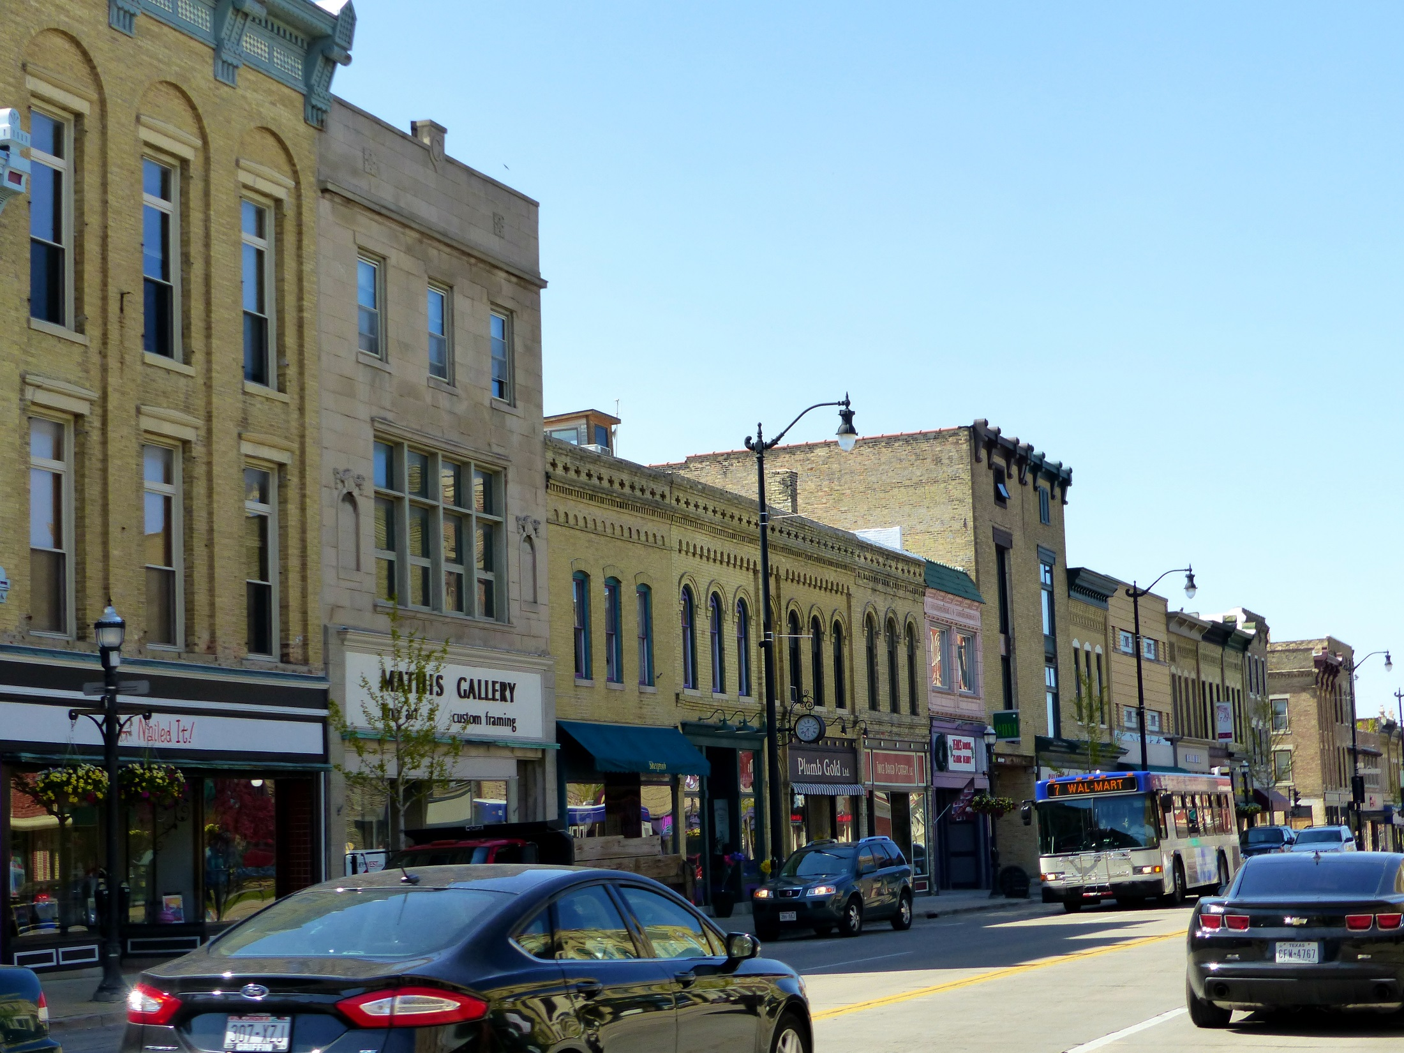
Reasonable Accommodations and Modifications

Slide 16

Reasonable Accommodation:
A change in rules, policies, practices or services when such accommodations are necessary to afford a person with a disability the equal opportunity to use and enjoy a dwelling.
Disability is typically defined as an individual with a physical or mental impairment that substantially limits one or more major life activity.

Slide 17
Persons Not Covered
Individuals currently engaged in illegal drug use.
Individuals who pose a direct threat to the health or safety of other individuals or substantial physical damage to the property of others.

Slide 18
Reasonable Accommodation:
A housing provider may ask for medical documentation for the requested documentation, but cannot inquire into the nature of the disability.
A reasonable accommodation cannot cause the housing provider undue hardship or cause financial burden.
A reasonable accommodation can be requested verbally or in writing. It is recommended to put a request in writing.

Slide 19
Reasonable Accommodations:
Designating an accessible parking spot.
Allowing a live-in aid to stay in the tenants apartment.
Allowing a service animal in a pet free building.

Slide 20
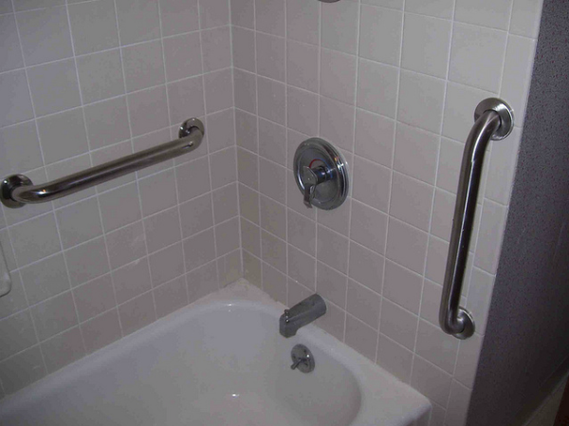
Reasonable Modifications:
A structural change made to an existing premises occupied by a person with a disability in order to afford such a person the full enjoyment of the premises.
Disability is typically defined as an individual with a physical or mental impairment that substantially limits one or more major life activity.

Slide 21
Reasonable Modifications:
Installing grab bars in a bathroom.
Allowing a tenant to widen doors to accommodate a wheelchair.
Allowing a tenant to install handrails in the entryway to the apartment.
Installing flashing smoke alarms for a deaf tenant.

Slide 22

Fair Housing and Shelters

Slide 23
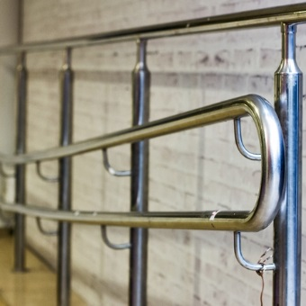
FHA May Apply to:
Shelters
Transitional Housing Programs
Group Homes
Apartments, Condos and Houses

Slide 24

Section 504:
Applies to any program receiving federal money.
Programs must be physically accessible for persons with disabilities.
Programs must be programmatically accessible for persons with disabilities.
Housing providers must provide reasonable accommodations in all rules, policies and procedures to ensure equal access.

Slide 25
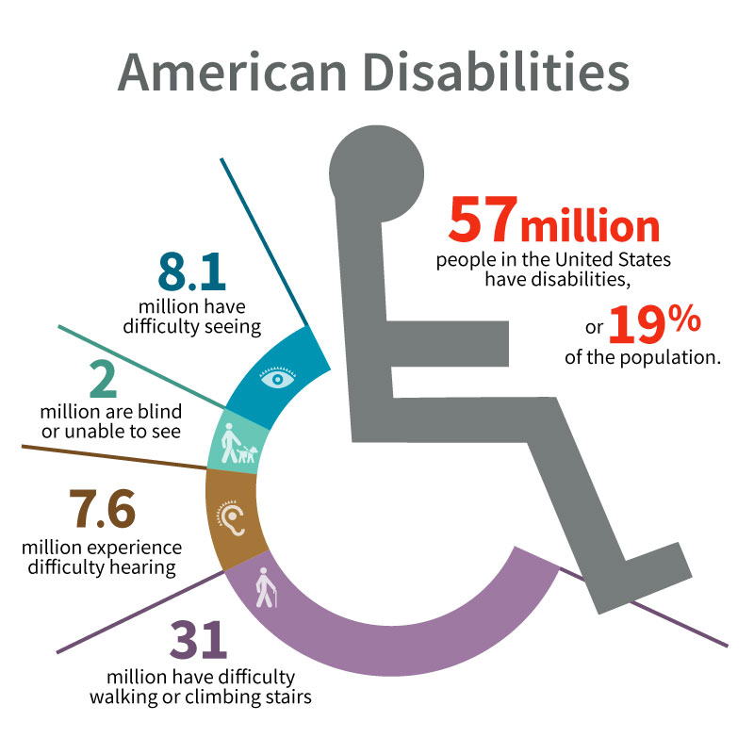
ADA Title III:
Extends protections of Section 504 to all state and local government funded programs.
Applies to any shelter or transitional program receiving state or local funding.
Reasonable accommodations and modifications must be made upon request.
http://www.cerebral-palsy-career-builders.com/images/blog_graphic_ada_800px.jpg

Slide 26
ADA Title III VS Fair Housing:
Short – Term:
If a shelter is for transient or short-term stay, Title III (Americans with Disabilities Act) and potentially Section 504 apply.
Short-Term generally means a nightly shelter with no guaranteed bed for the night.
Long – Term:
If a shelter is intended and used for long-term stay, Fair Housing laws apply.
Long-Term generally means a program with a fixed bed night after night.

Slide 27

Shelters and Transgendered Persons:
Allow the client to identify their gender.
Participate in HUD conversations and webinars.

Slide 28
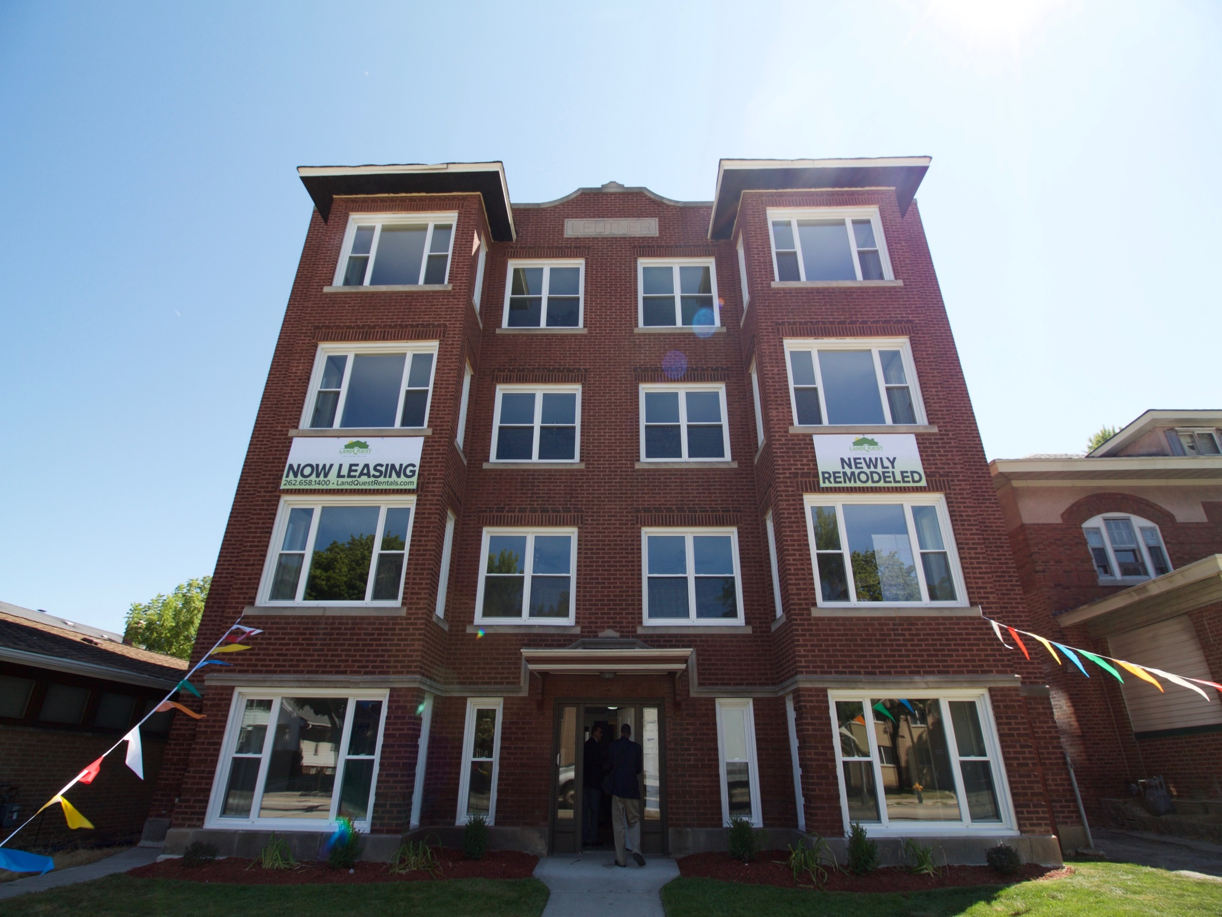
Fair Housing and Housing Search:

Slide 29
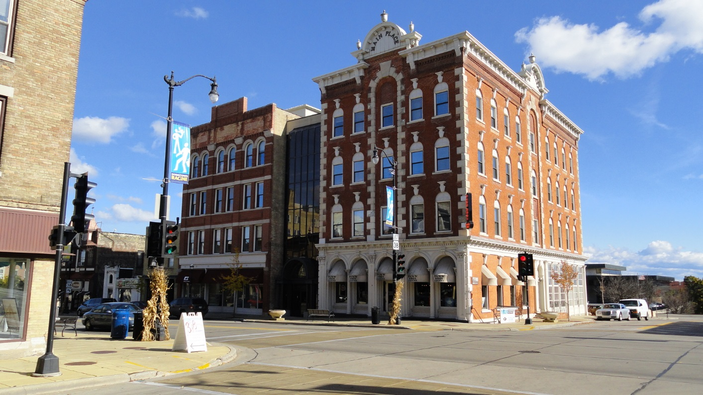
The FHA Does Not:
Protect against a history of eviction.
Protect against a presence of a criminal history.
Guarantee housing if you have a Housing Choice Voucher (Section 8).

Slide 30
Recognizing Discrimination:
“I can’t seem to find a unit. “
“The person told me the place was rented, but the sign is still outside.“
“I was told the rent was $750, not $675. “

Slide 31

Recognizing Discrimination:
Remember discrimination often happens with a handshake and a smile.

Slide 32


What to do:
Contact a local Fair Housing Organization
File with HUD FHEO
File with State of Wisconsin Department of Workforce Development Equal Rights Division
File a lawsuit
Educate residents about their fair housing rights

Slide 33
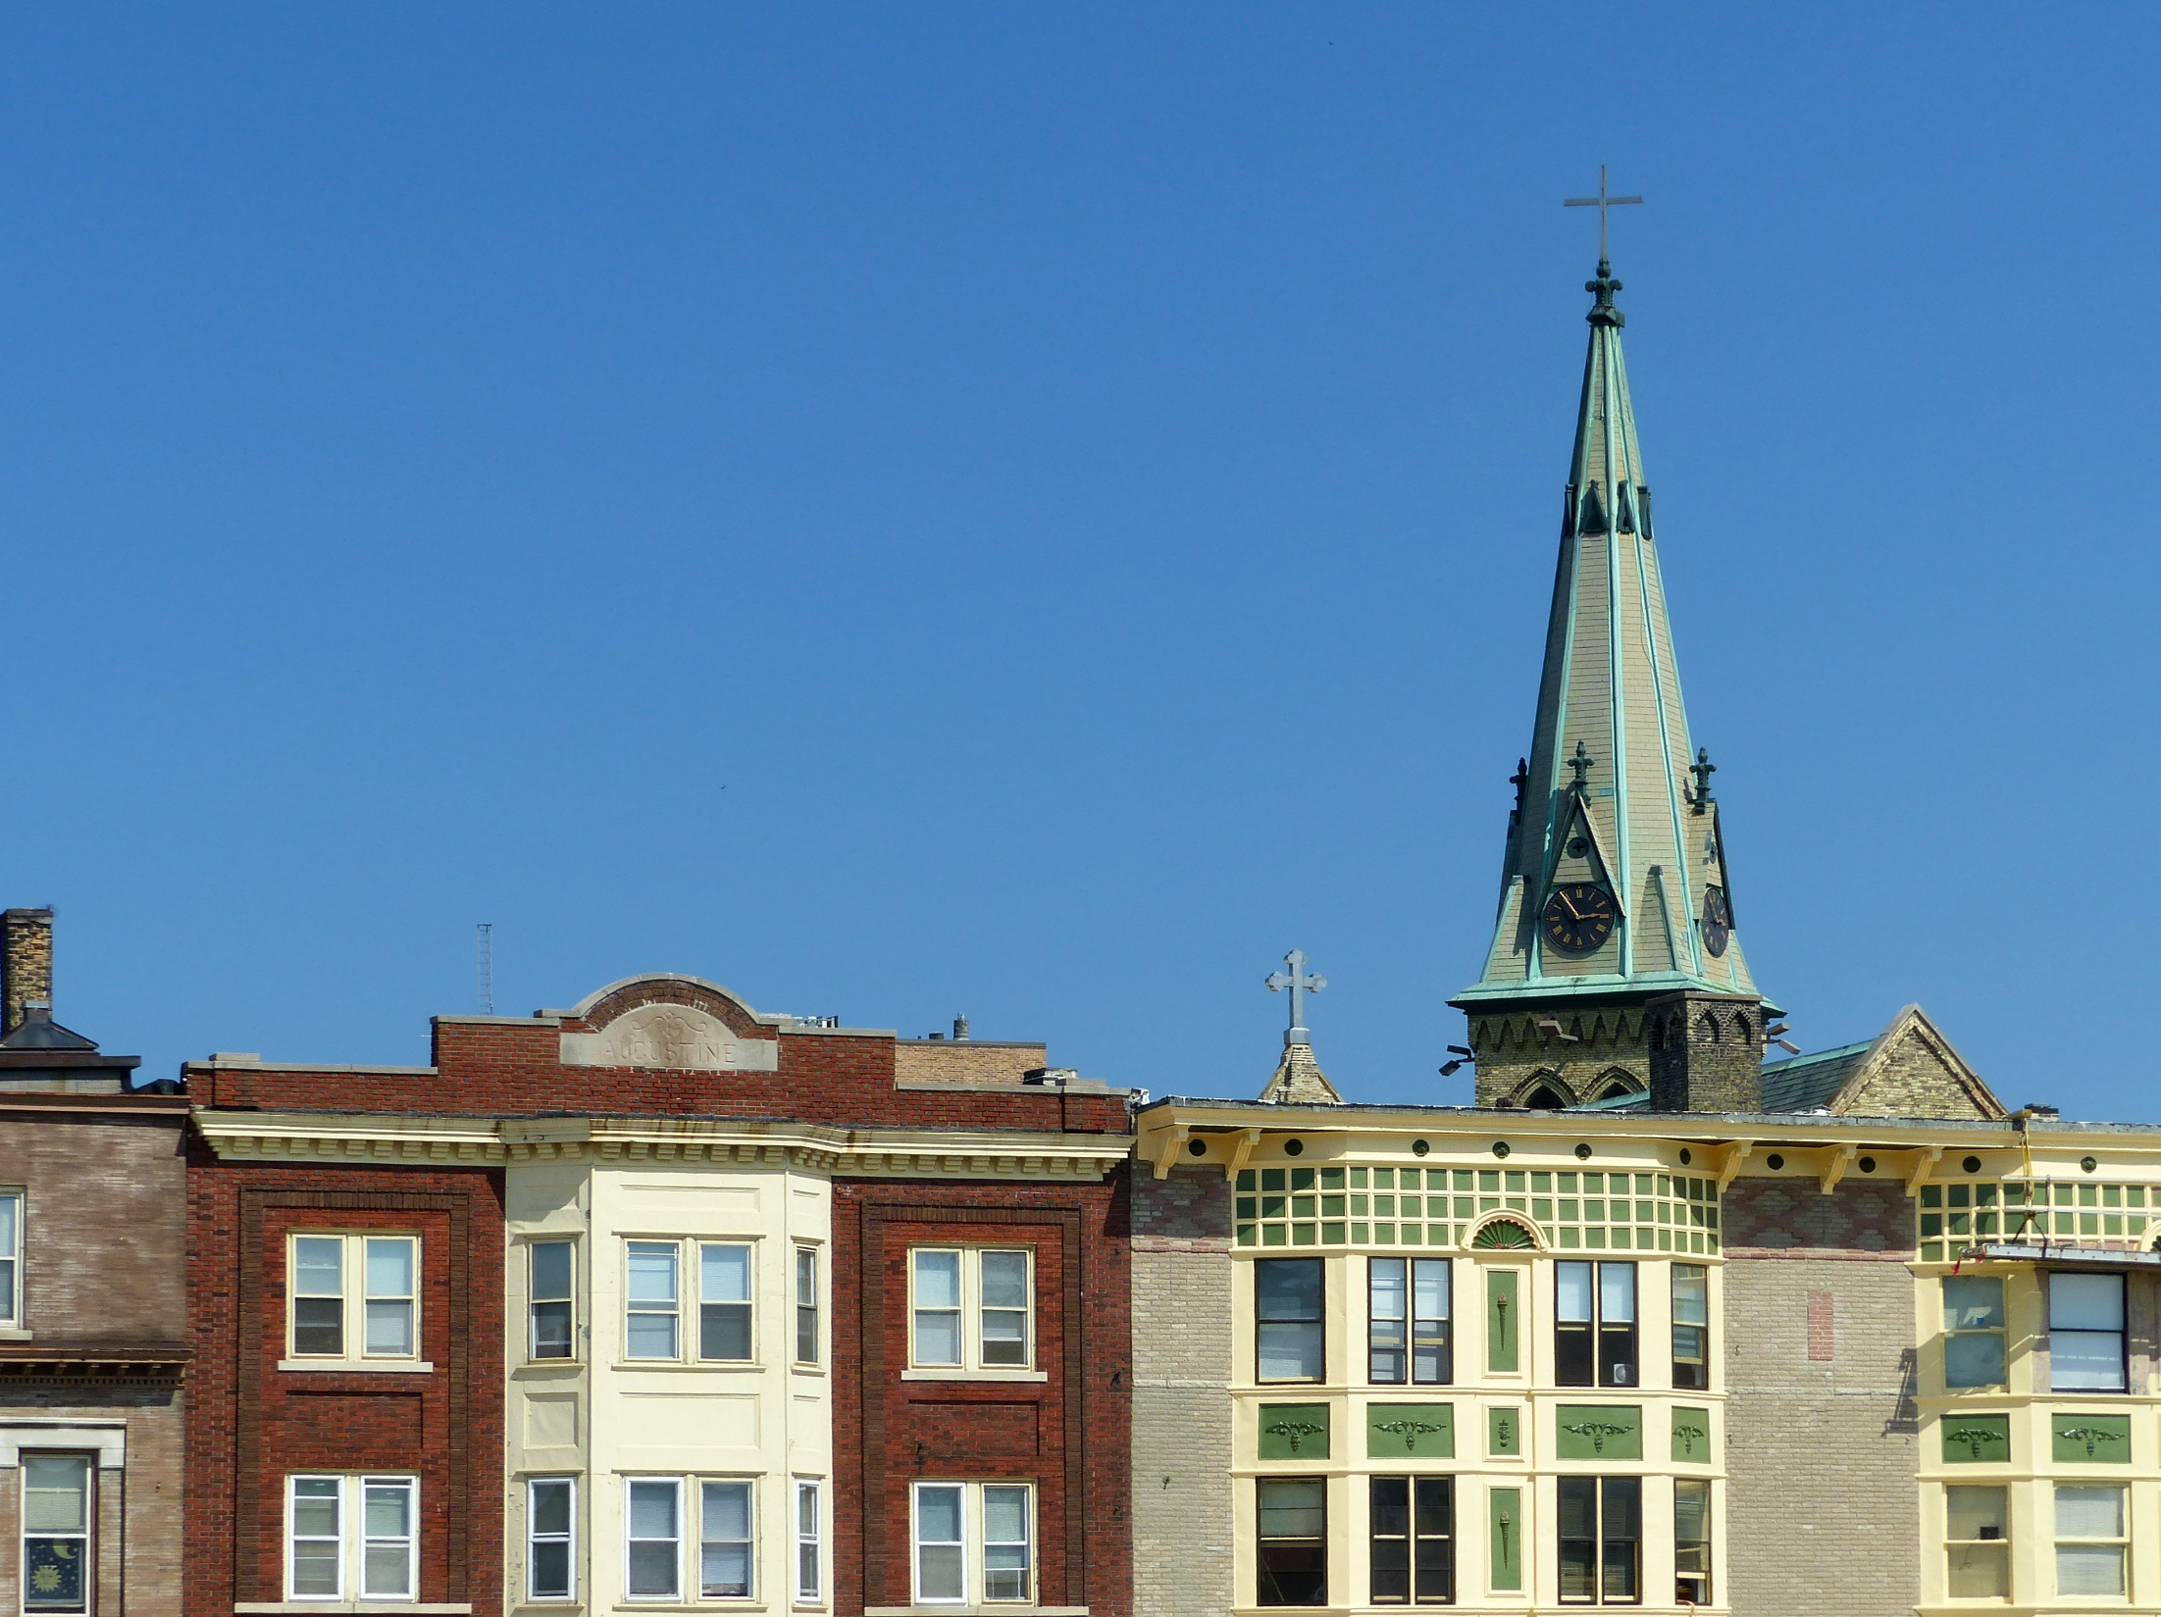
Affirmatively Furthering Fair Housing

Slide 34
AFFH:
The Fair Housing Act has two goals:
1) To end housing discrimination;
2) To promote diverse, inclusive communities.
Affirmatively Furthering Fair Housing, embodies our strongly-held American values of fair access and equal opportunity. Affirmatively Furthering Fair Housing has been part of the Fair Housing Act since its inception in 1968.

Slide 35
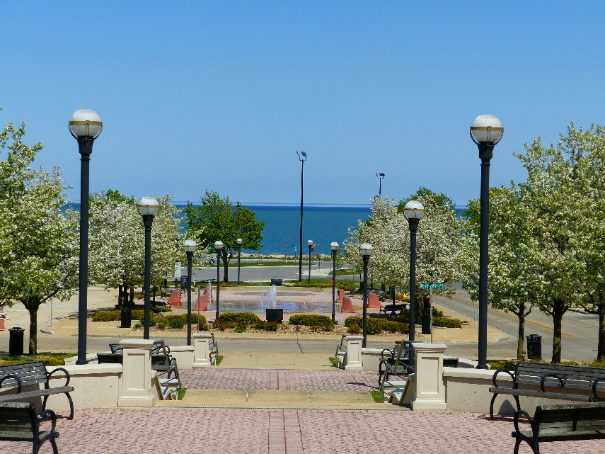
AFFH:
AFFH can include actions such as:
  Integrating segregated neighborhoods and communities.
  Transforming racially and ethnically concentrated areas of poverty into areas of opportunity.
  Fostering and maintaining compliance with civil rights and fair housing laws.

Slide 36
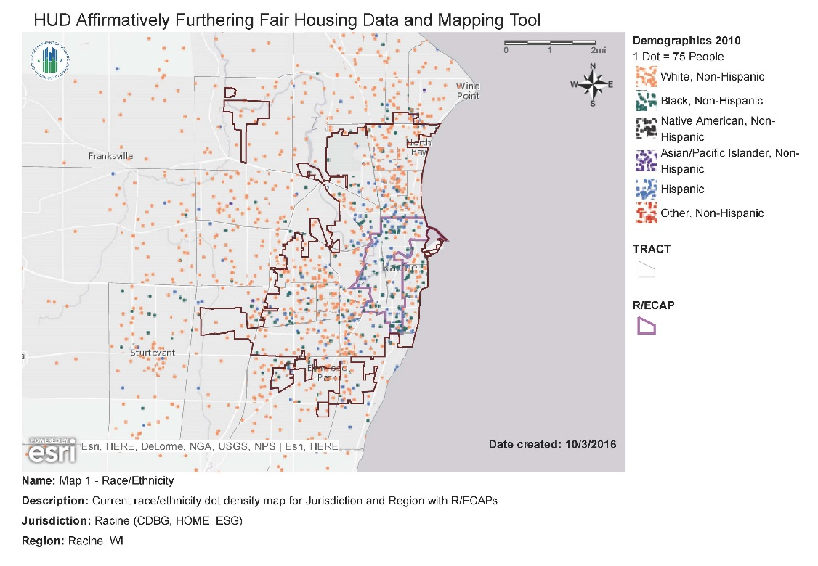
AFFH:
In July 2015 the Department of Housing and Urban Development published the new AFFH Rule. This rule set guidelines, gave data, and defined a process for communities to formally further fair housing.

Slide 37
AFFH:
Public participation is a critical part of the new AFFH planning process, groups that were previously uninvolved should be given a seat at the table.
Disability Advocacy Groups
Civil Rights Groups
Immigrant Associations
Local Planning Groups
Fair Housing Groups
Neighborhood Associations

Slide 38
AFFH:
Affirmatively Furthering Fair Housing means taking proactive steps beyond combating discrimination to foster more inclusive communities and access to community assets for all persons protected by the Fair Housing Act.
Improving Integration
Reducing
Racial and ethnic concentrations of poverty
Ending Dissimilarities
Creating access to amenities in the community and region
Overcoming historic patterns of segregation
Responding
To unfair treatment and disproportionate housing needs

Slide 39
Thank You:
Laura Detert
Manager of Housing and Community Development
City of Racine
730 Washington Avenue
Racine, WI 53403
Laura.Detert@cityofracine.org
262-636-9476
http://cityofracine.org/CityDevelopment/FairHousing/

