Slide 1
Housing First: What it is and Why the Data Tells us it is Effective
Zach Chartrand

Slide 2
Housing First: What is it?
Housing First is an approach to providing housing to households experiencing homelessness without requiring them to prove preconditions, such as sobriety, engagement with treatment, or psychiatric stabilization.
An approach that focuses on housing stability, reduction in emergency services utilization, improved health outcomes, income acquisition and permanently ending cycle of homelessness
Supportive services are then offered to provide support for clients to maximize housing stability and prevent returns to homelessness.
“This is opposed to addressing predetermined treatment goals prior to permanent housing entry”
(HUD, 2014)

Slide 3
Housing First: Where it Began
In the 1990’s, a researcher by the name of Sam Tsembaris began to study the idea of providing housing to folks before having them meet the prerequisites that housing programs operated on (e.g. sobriety, psychiatric stabilization, engagement with treatment, etc.)
Many felt forcing people to prove these prerequisites was essentially making them “earn” permanent, affordable, and supportive housing.
In the beginning, Housing First was aimed at reducing barriers to housing entry, and providing housing to folks experiencing homelessness without prerequisites.

Slide 4
Housing First: Where are We Now
Since the late 1990s and early 2000s, Housing First has developed into a “distinct approach to delivering permanent supportive services”
The services provided to folks in Housing First programs are informed by Harm Reduction, Trauma Informed Care, and Motivational Interviewing
Program or “project level policies and procedures that prevent lease violations and evictions”
E.g. Mutual lease terminations
A focus on prioritizing and serving the most vulnerable
Elderly, folks living with disabilities, etc.
(HUD, 2014)

Slide 5
Housing First: Key Principles
Everyone is “Housing Ready”
Everyone’s journey transitioning from homelessness looks different, but everyone is ready for housing today
Immediate access to Safe and Affordable Housing
Everyone can achieve housing stability in permanent housing; their supports may just look different
“Right to determination, dignity, and respect”
Client choice is a large part of Housing First. Clients should have the dignity and determination to choose where they want to live in their community.
Improved quality of life, health, mental health, and employment can be achieved through housing
Social & Community Integration
Configuration of housing and services based on participants needs and preferences
Cost savings associated with housing retention
Housing First contributes to drastically reducing the public cost of services (health, mental health, substance abuse, emergency shelter, and incarceration)
(HUD, 2014)

Slide 6
Housing First: Principles into Practice
Permanent housing programs that have few to no programmatic prerequisites to entry
Low barrier admission policies
(e.g. not requiring folks to have no criminal convictions within 3 years)
Rapid and streamlined entry into housing
Housing navigation can be critical here (can be challenging for one case manager to find housing for all their clients)
A collaborative and robust outreach network
Consistent documentation and verification processes
Collaboration on providing the best services to folks experiencing unsheltered homelessness
Supportive services are voluntary
Participation in services not a condition of tenancy.
This does not mean we stop providing services – consistent engagement is key (especially during outreach/prior to project entry!)
Solution focused Case Management
Provider is obligated to bring robust support services to the housing program. Services are predicated on assertive engagement, not coercion.
Utilizing Motivational Interviewing and Trauma Informed Care to provide services

Slide 7
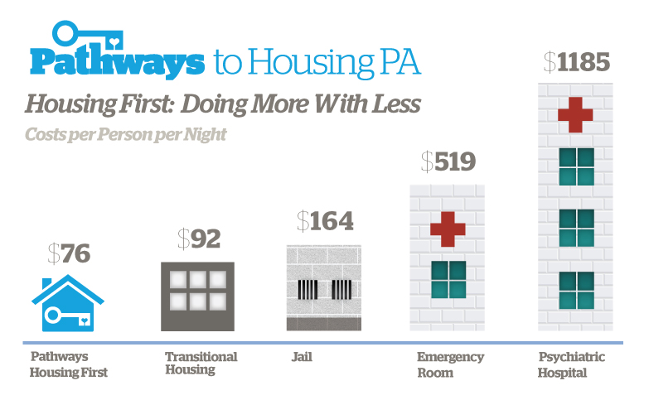
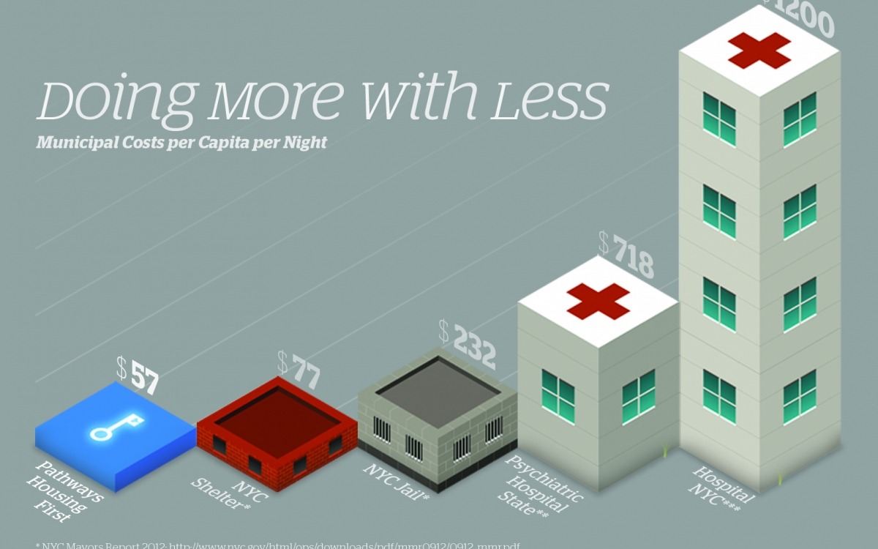
Housing First: The National Data
Pathways PA = $76 per day
Pathways NY = $57 per day
HF Milwaukee = Current numbers at less than $30 per day
(MCHD, 2019)

Slide 8
Housing First: Milwaukee County Data
Psychiatric hospitalizations = 100x more often for Chronically Homeless individuals
Any Hospital Stay = 4x longer for Chronically Homeless individuals
Behavioral Health Division Psychiatric Crisis Services = $605.00 per visit (non-admission)
Behavioral Health Division Psychiatric Crisis Services = $1,829 per visit (admission)
Behavioral Health Division Detox Medicaid Cost = $506 per visit
Behavioral Health Division Crisis Mobile Medicaid Cost = $1,245
Behavioral Health Division Psychiatric Inpatient Medicaid Cost = $2,145
Average Emergency Room Medicaid Cost = $2,235
(MCHD, 2019)

Slide 9
Housing First: Milwaukee County Data (Cont.)
Housing First residents’ average time spent homeless is greater than 7 years. Some more than 20 years.
In the 12 months prior to Housing First, the average time spent in shelter was greater than 180 days. Many slept in a shelter every night.
Our residents experienced a 99% reduction in emergency shelter use.
77% of Housing First residents have experienced an increase in income, including employment.
(MCHD, 2019)

Slide 10
Housing First Impact on Mental Health Crises Services Milwaukee County
Top 4 Utilized Programs
Crisis Mobile
Detox
Psychiatric Crisis Services
Inpatient Services
12 Months Prior to Housing | 627 visits | Difference of 539
12 Months in Housing First | 88 visits
12 Months Prior to Housing | $860,985 | Difference of ($714,638)
12 Months in Housing First | $146,347
12 Months Prior
to Housing
12 Months in Housing First
(MCHD, 2019)

Slide 11
Housing First Impact on Law Enforcement in Milwaukee County
OF HOUSING FIRST RESIDENTS RECEIVED A MUNICIPAL CITATION DURING THE 12 MONTHS PRIOR TO ENTRY
98%
9%
RECEIVED A MUNICIPAL CITATION DURING THE FIRST 12 MONTHS IN HOUSING FIRST
Most Common
Loitering
Trespassing
Public Drinking
Each violation requires attention from valuable resources.
Fines are rarely – if ever – paid.
Warrants require additional resources.
Increased public cost with each resource.
(MCHD, 2019)

Slide 12
Housing First Impact on Law Enforcement in Milwaukee County
Call for Police Service: $950.15 per call
Public Defender: $718.86 per case
District Attorney: $718.86 per case
Jail: $103/day (County)
Jail booking: $197
$7,040
$4,640
EMS: $776
Detox: $506
Psychiatric Crisis: $1829 per visit
Crisis Mobile: $1245 per visit
$2,400
(MCHD, 2019)

Slide 13
Mark – Case Study – Reduction in Crises Utilization
This man unsuccessfully cycled through shelters and housing programs for 6 years.
He began working with Housing First staff in 2016.
He signed his lease in November 2016 and has not required crisis psychiatric services since.
Crisis Program Utilized (past 4 years) | Frequency of Use | Cost
Psychiatric Crisis Services | 91 | $166,439
Crisis Mobile Unit | 18 | $22,410
Detox | 9 | $4,554
Total | 118 | $193,403
(MCHD, 2019)

Slide 14
Municipal Violations by Housing First Participants (2011 – 2017)
(MCHD, 2019)

Slide 15
Total Amount of Individuals Experiencing Homelessness in Milwaukee County
(MCHD, 2019)

Slide 16
How can our local CoC support Housing First?
‘Support the Supports’
Provide consistent Motivational Interviewing (MI) and Trauma Informed Care (TIC) training sessions for service providers
Also provide fidelity checks to help service providers assess their knowledge on MI and TIC
Provide consistent assistance and training on HMIS and the Coordinated Entry process
Having a system that is aware of the correct referral process provides a more streamlined access to services
(e.g. homeless verification/documentation before project entry creates more efficiency for housing case managers)
Housing Navigation available for outreach or shelter case managers working with folks transitioning from homelessness
This helps provide immediate access to housing
Case managers spend the vast majority of their time doing housing navigation if there is none in the community

Slide 17
How can our local CoC support Housing First?
Housing – Focused Street Outreach
Historically, street outreach has focused on bringing basic services and supplies to individuals living on the street
Being a stable and consistent support for folks experiencing unsheltered homelessness can foster rapport and ongoing communication
Some part of your local street outreach efforts should be housing-focused
Services and housing triage are provided on the street
Concerted and collaborative approaches to housing
Develop an awareness of the causes, experience, pattern and politics of homelessness. Knowing the macro aspects of the issue can increase advocacy and push the Housing First movement forward.

Slide 18
