Slide 1
The Federal Strategic Plan to Prevent and End Homelessness: Home, Together
WISCONSIN BALANCE OF STATE CONTINUUM OF CARE QUARTERLY MEETING
November 8, 2019
Notes:
Thank you again for coming. We’re hoping today to do the quick version of who we are and what our biggest work is right now – the implementation of the recently revised federal strategic plan to prevent and end homelessness.
Will try to avoid being too wonky and leave plenty of time for Q&A

Slide 2
Presenter
Beverley Ebersold
Director of National Intiaitives
United States Interagency Council on Homelessness
Beverley.ebersold@usich.gov
www.usich.gov

Slide 3
Together we are ending homelessness
USICH leads the national effort to prevent and end homelessness
USICH drives action among its 19 federal member agencies and fosters the efficient use of resources in support of best practices at every level of government
USICH Council is made up of heads of our members agencies and meets quarterly to advance federal collaboration and support state and local activities.
USICH leads interagency working groups to design and implement federal strategies and provides expert guidance to state and local leaders

Slide 4
Our Results (2010-2018)
Overall Homelessness
Veteran Homelessness
Chronic Homelessness
Family Homelessness
13%
49%
16%
29%
(Based on Point-in-Time Count Data, U.S. Department of Housing & Urban Development)

Slide 5
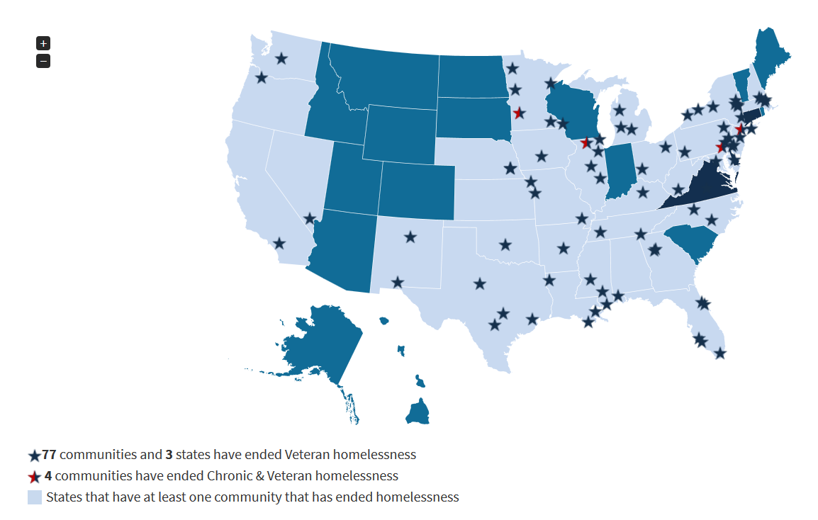
Communities that met the Federal Criteria & Benchmarks and have Ended Veteran Homelessness

Slide 6
Notes:
Encourage you to read the Plan, and to sign up for our newsletter to stay up to speed on the other materials that will go deeper…

Slide 7
Home, Together: The Federal Plan
Home.
Because we know that the only true end to homelessness is a safe and stable place to call home.
Together.
Because the solutions are going to take all of us working together, doing our parts, strengthening our communities.

Slide 8
Our Shared National Goals
Ending homelessness among Veterans
Ending chronic homelessness among people with disabilities
Ending homelessness among families with children
Ending homelessness among unaccompanied youth
Ending homelessness among all other individuals
Notes:
Home, Together has one fundamental goal, a shared goal across federal, state, and local partners: to end homelessness in America. The Plan sets important population-specific sub-goals as well:
Achieving these goals as a nation means achieving these goals in all communities. Therefore, the Plan does not set uniform timeframes. Rather, federal partners will continue to work with communities, and to provide tools and information, that will enable them to set their own ambitious goals, tailored to their local conditions, and grounded in their local data.
Achieving these goals is grounded in a shared vision that every community must have a systemic response in place that ensures homelessness is prevented whenever possible, or if it can’t be prevented, it is a rare, brief, and one-time experience. This focus provides the structure for the Plan.
Achieving these shared goals is not possible through federal action alone—it requires strategic focus, effort, and investments from both the public and the private sectors and across all levels of government.
Achieving these goals as a nation means achieving these goals in all our communities, communities that are also diverse—in their demographics, in their needs, in their geographic characteristics, in their progress to date, in their resources, in their infrastructure, in their housing markets, and in many other ways. Some communities have already succeeded at achieving some of these sub-goals, others are on the cusp of major successes, and many are striving hard to make progress but face very significant challenges.

Slide 9
Areas of Increased Focus
Increasing affordable housing opportunities
Strengthening prevention and diversion practices
Creating solutions for unsheltered homelessness
Tailoring strategies for rural communities
Helping people who exit homelessness to find career success and economic mobility
Learning from the expertise of people with lived experiences of homelessness
Notes:
Matthew
Home, Together also lifts up several areas of increased focus, including:
Increasing affordable housing opportunities
Beyond the critical work to make sure there is enough housing for everyone, we must also focus more attention on preventing people from falling into homelessness in the first place and on diverting people from entering emergency shelter if they have other stable options available.
Strengthening prevention and diversion practices
Time and again, we heard about diversion. We heard that communities are working really hard to develop diversion and prevention strategies and weave them into their programs and systems, as well as work with their partners in other systems to better understand the role they play in prevention.
Creating solutions for unsheltered homelessness.
Tailoring strategies for rural communities.
Helping people who exit homelessness to find employment success.
We also have an urgent need for strategies to address the immediate crisis of unsheltered homelessness—especially in communities with high-cost housing markets—and homelessness in rural communities, where housing and services are scarce. We must also address the racial inequities and other disparities in the risks for, and experiences of, homelessness. And we must be clear that exiting homelessness is not the end point for people, it is a starting place from which they can pursue employment, education, community involvement, and other goals.
Learning from the expertise of people with lived experience

Slide 10
Multiple Levels of Prevention
Activities that reduce the prevalence of risk of housing crises within communities
Activities that reduce the risk of homelessness while households are engaged with or are transitioning from systems
Activities that target assistance to prevent housing crises that do occur from escalating further and resulting in homelessness

Slide 11
Confronting and Addressing Inequities
Developing our own and communities’ skills and capacity to apply a racial equity lens within our organizations and across our efforts to prevent and end homelessness
Analyzing data regarding representation, access, and outcomes and identifying disparities and inequities
Moving conversations forward without shortchanging need for internal work within ourselves and our organizations
Connecting to and collaborating with other equity-focused efforts in communities

Slide 12
Structure of the Plan
Operational definition: Comprehensive response that ensures homelessness is prevented whenever possible, or if it can’t be prevented, it is a rare, brief, and one-time experience.
Criteria and benchmarks: Essential elements of comprehensive systems and the outcomes those systems must be able to achieve.

Slide 13
Ensure Homelessness is a Rare Experience
Objective 1.1: Collaboratively Build Lasting Systems that End
Objective 1.2: Increase Capacity and Strengthen Practices to Prevent Housing Crises and Homelessness

Slide 14
Ensure Homelessness is a Brief Experience
Objective 2.1: Identify and Engage All People Experiencing Homelessness as Quickly as Possible
Objective 2.2: Provide Immediate Access to Low-Barrier Emergency Shelter or other Temporary Accommodations to All Who Need It
Objective 2.3: Implement Coordinated Entry to Standardize Assessment and Prioritization Processes and Streamline Connections to Housing and Services
Objective 2.4: Assist People to Move Swiftly into Permanent Housing with Appropriate and Person-Centered Services

Slide 15
Ensure Homelessness is a One-Time Experience
Objective 3.1: Prevent Returns to Homelessness through Connections to Adequate Services and Opportunities

Slide 16
Sustain an End to Homelessness
Objective 4.1: Sustain Practices and Systems at a Scale Necessary to Respond to Future Needs

Slide 17
Opportunities for Dialogue & Action
The plan:
Offers the opportunity to engage with USICH and Regional Coordinators
Provides a framework and platform for local community conversation
Includes strategies for how leaders from all levels of government and the private, non-profit, and faith sectors can come together
Sets goals for federal agency partners

Slide 18
Please Stay Connected
Subscribe to our newsletter: usich.gov/signup
facebook.com/USICH
twitter.com/USICHgov

