Slide 2
What is Safe at Home?
165.68
Notes:
Statewide, cost-free address confidentiality program for victims of acts or threats of abuse and those who fear for their or their child/ward’s physical safety
Secure mail-forwarding: Allows participants to receive mail at an assigned address in lieu of their actual address
Keeps actual home, work, and/or school address confidential
Wis. Stat. § 165.68
Effective April 1, 2017
36 other states (and counting) have similar programs

Slide 3
Why do we need it?
Notes:
Response to a growing need for abuse victims to have their location kept private from their abuser

Slide 4
Eligibility
CONFIDENTIAL
Notes:
Resident of Wisconsin.
Resides at a location in Wisconsin that is not known by the abuser or person who threatens them or their child.
Will not disclose their actual address to the person who committed the abuse against, or who threatens, the applicant or his or her child.

Slide 5
Eligibility, continued
Domestic Abuse
Sexual Assault
Child Abuse
Stalking
Human Trafficking
A victim
A parent or guardian of a victim
A resident of a household in which a victim of also resides.
A person who fears for their physical safety or for the physical safety of their child.
Witnesses
Judges or Attorneys
Law Enforcement
Public/Elected Officials
Advocates

Slide 6
NOT Required:
Criminal charges
Restraining order
Report to law enforcement
Social Security Number

Slide 7
Authorization Card
Notes:
Every participant is issued an authorization card
Verification that this is participant’s legal address.
Safe at Home can confirm participation upon request from any state or local government agency.
Notice to others that they need to follow the law & keep the actual address confidential.

Slide 8
Using the Address
Individuals
Businesses or Private Entities
Government Agencies
Notes:
Individuals and private entities must accept the assigned address
State or local agencies/government may not refuse to use an assigned address
unless a specific statutory duty requires the agency/government to use the actual address
If an actual address is being required, participants should contact Safe at Home directly for guidance

Slide 9
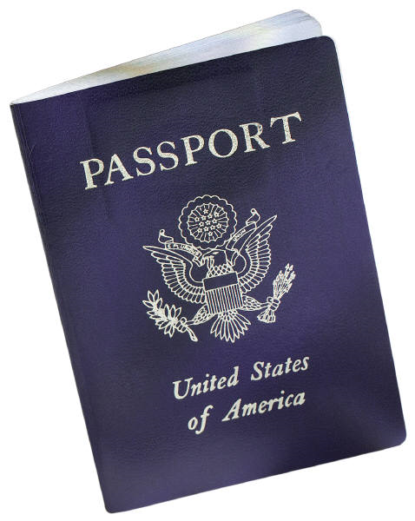
Actual Address vs. Substitute Address
Notes:
- Participant may protect their actual address by registering to vote as a confidential elector.
– rare; mostly just looking for a street address, not P.O. Box.
– Safe at Home must disclose an actual address if ordered by the court. Safe at Home will request that this record be sealed.
- Safe at Home may disclose an actual address to law enforcement for official purposes.

Slide 10
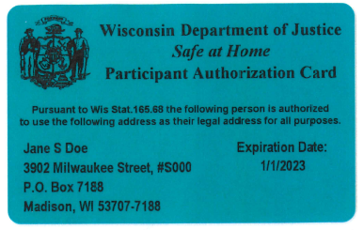
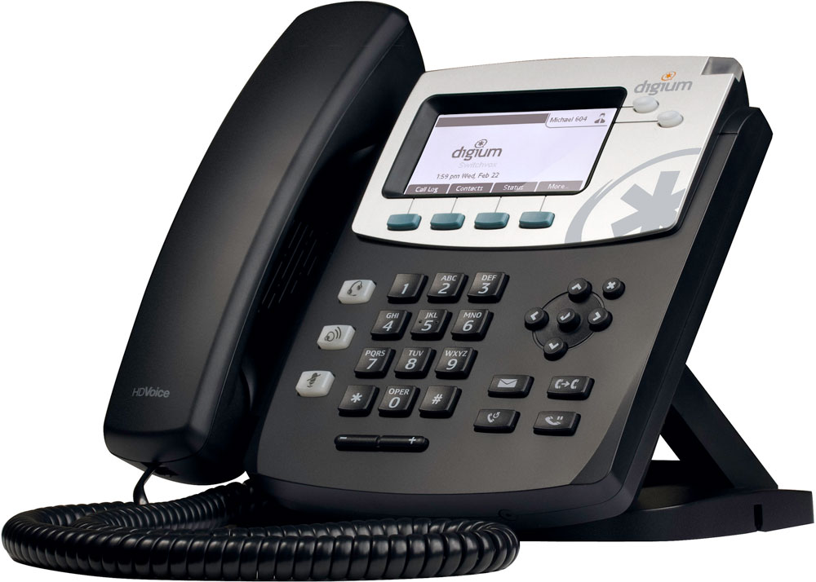
Frequently Asked Questions
Someone on our agency housing waitlist told me they’re in Safe at Home. How can I/our agency confirm that’s true?

Slide 11
Frequently Asked Questions
Someone on our agency housing waitlist told me they’re in Safe at Home. How can I/our agency verify that they live in our service area?
Participant(s) Names
Confirmation of residence within geographic boundaries
Safe at Home Contact Information

Slide 12
Frequently Asked Questions
A Safe at Home family is ready to be placed into housing. Now what do we do?
What information is absolutely necessary for us to have? Why?
What information is absolutely necessary for us to share? Statutory?
What are our internal practices for protecting/keeping confidential records?

Slide 13
Frequently Asked Questions
What about evictions?
Pre-filing
Filing
Court
Post-Judgement
*
*
*

Slide 14
Other Questions?
Us, too…

Slide 15
Safe at Home
Wisconsin Department of Justice
P.O. Box 7035
Madison, WI 53707
Ph. (608) 266-6613
Secure Fax (608) 261-8660
safeathome@doj.state.wi.us
www.SafeAtHomeWI.gov

