Slide 1
Stigma and Person First Language
Sarah Rodefer, MSW

Slide 2
What do you first think of when you hear…
Schizophrenia
Disabled
Bi-polar
Mentally ill
Alcoholic

Slide 3
Most often people think…
Sick
Disturbed
Helpless
Damaged
Weak
Scary
Lazy
Criminal
And many other negative adjectives

Slide 4
What is the Definition of Stigma?
Any mark of infamy or disgrace; sign of moral blemish; stain or reproach cause by dishonorable conduct; reproachful characterization.
http://www.webster-dictionary.net/definition/Stigma

Slide 5
What Are Stigma’s Roots
There are 4 main components to stigma:
Labeling someone with a condition
Stereotyping people with that condition
Creating a division such as a superior “healthy” group vs. a lesser “sick” group
Discriminating against someone on the basis of their label

Slide 6
The Effects of Stigma
“Stigma” is an umbrella term that is used when talking about the negative effects that come with being in the minority of a larger group.
When talking specifically about mental illness, stigma may refer to or cause:
Fear
Shame
Guilt
Avoidance
Embarrassment
Low Self-esteem
Isolation
Stereotyping

Slide 7
What Stigma Can Cause
An individual with mental illness to not get treatment because of fear
To hide the mental illness out of guilt or for fear they will be scorned by family members, friends or society in general.
Social isolation because of embarrassment or shame

Slide 8
Hardships Caused by Stigma
A belief that recovery cannot happen because of a stereotype that persons with mental illness are less competent, cannot work or should be institutionalized
A decreased access to adequate services (as compared to a physical illness)
The current lack of mental health parity
Some people with mental illness have been subject to physical and verbal abuse
Even though it is against the law, employers may discriminate on hiring an employee and promotions based on mental illness
Sometimes it is difficult to find landlords who will accept a tenant with severe and persistent mental illness

Slide 9
So, What Are Some Causes of Stigma?
The term “mental illness” itself implies a distinction from “physical illness”
“Mental” suggests not a legitimate medical condition, but rather something that results from one’s own doing or choices.
Media
Their accounts of crime. Statistics do not show a correlation between medicated mental illness and violence
Inaccurate portrayals on TV and movies about characters with mental illnesses
These negative portrayals fuel fear and mistrust and reinforce distorted perceptions, leading to even more stigma

Slide 10
How do we reduce stigma?
Know the facts. Educate yourself.
Be aware of your attitudes and behavior.
Choose your words carefully.
Educate others.
Focus on the positive.
Support people.
Include everyone.
https://www.mendthemind.ca/stigma/seven-important-things-we-can-do-reduce-stigma-and-discrimination/

Slide 11
Person First Language
What is person first language?
Puts the person before the disability (or category), and describes what a person has, not who a person is.
Language should be used to empower individuals, not place limitations on them
See the person, not the illness

Slide 12
What do you call a person with a disability?

Slide 13
…a person ☺

Slide 14
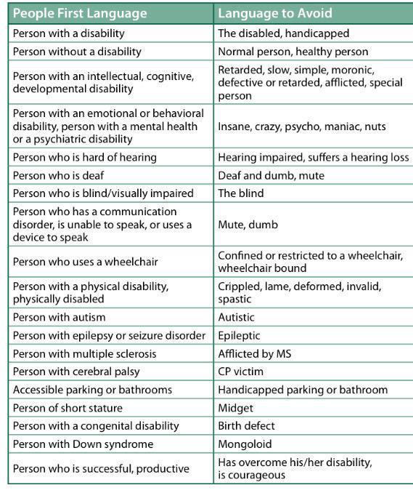

Slide 15
Other examples of person first language
Say:
People with disabilities.
He has a cognitive disability/diagnosis.
She has autism (or a diagnosis of...).
He has Down syndrome (or a diagnosis of...).
She has a learning disability (diagnosis).
He has a physical disability (diagnosis).
She’s of short stature/she’s a little person.
He has a mental health condition/diagnosis.
She uses a wheelchair/mobility chair.
He receives special ed services.
She has a developmental delay.
Children without disabilities.
Communicates with her eyes/device/etc.
Customer
Congenital disability
Brain injury
Accessible parking, hotel room, etc.
She needs... or she uses...
Instead of:
The handicapped or disabled.
He’s mentally retarded.
She’s autistic.
He’s Down’s; a mongoloid.
She’s learning disabled.
He’s a quadriplegic/is crippled.
She’s a dwarf/midget.
He’s emotionally disturbed/mentally ill.
She’s confined to/is wheelchair bound.
He’s in special ed.
She’s developmentally delayed.
Normal or healthy kids.
Is non-verbal.
Client, consumer, recipient, etc.
Birth defect
Brain damaged
Handicapped parking, hotel room, etc.
She has problems with...has special needs.
Copyright 2009 Kathie Snow. www.disabilityisnatural.com

Slide 16
“A homeless person;” “the homeless”
Instead say…
A person experiencing homelessness
Someone who is homeless
A youth experiencing homelessness
A family experiencing homelessness

Slide 17
Imagine There Was No Stigma to Mental Illness | Dr. Jeffrey Lieberman | TEDxCharlottesville
https://www.youtube.com/watch?v=WrbTbB9tTtA
Pay attention to how Dr. Lieberman describes his patients and how he advocates in his talk.
Write down any instances of person first language or strengths based language

Slide 18
Activity on person first language

Slide 19
Recovery is Possible
In fact, it’s not only possible, but for many, probable.
Recovery is a holistic process that includes both physical health and aspects beyond medication.
Hope for recovery should be reflected in all treatments, services and supports.
This process is different for each individual.
Some individuals use medication and therapy. Others use community and successful living. Some use a combination of both.
http://www2.nami.org/Content/NavigationMenu/Find_Support/Consumer_Support/Recovery.htm

Slide 20
More on Recovery
The most important principle is that recovery is a process, not an event.
The course of the illness varies greatly from person to person
Medications and hospital time are important in symptom management, but not strongly related to long-term outcome
People DO have control over their own levels of happiness
www2.nami.org/Content/NavigationMenu/Inform_Yourself/Upcoming_Events/Convention-2014/Recovery%26EBP_for_state--T.Zipple.ppt&rct=j&frm=1&q=&esrc=s&sa=U&ved=0CBQQFjAAahUKEwiqyPG3mfzGAhXEcT4KHewkADY&usg=AFQjCNH2wZT3uKRTBS23y_P1aWS44C_TBg

Slide 21
Recovery Wrap-up
People can, and most do, get better
We cannot predict who will get better so we need to do our best for everyone
People have significant control of their lives and recovery
The work that we do can support recovery

Slide 22
Recovery Happens to Everyone
Think of a time something bad has happened in your life
What took place
How did you feel the initial months after the event?
When did you first feel you were “getting over it” (recovering)?
What specific things helped you through this?
What specific things hurt?
Because you are here, you have survived and have, or are, recovering from that event

Slide 23
Recovery is…
Our own place in the world
Peace of mind
Friends and family
Opportunities to grow and to be who we are
Activities that provide genuine pleasure
Authentic happiness
A good life (though perhaps a different life)

Slide 24
Recovery is not…
A cure, but rather an ongoing process
An end to problems and symptoms
A guarantee there will be no relapses

Slide 25
Respect:
Treat a person with mental illness with the same respect you’d afford anyone else.
Listen:
Really hear what someone is telling you before forming your own opinions based on records or assumptions of what you think you know about mental illness.
Remember that people are people first:
The person you are working with is more than a diagnosis. What are their interests, hobbies, beliefs, strengths? Find a way to connect. Use person first language.

Slide 26
Remember that mental illness is a brain disorder
It is not something that a person brought on himself or herself. Also, they are not faking their mental illness for attention.
Empower
Treat people with dignity and respect by supporting, encouraging and facilitating their independence and control over their lives and recovery. Resist the urge to fix things, rather facilitate a healthy process of recovery.

Slide 27
Sarah Rodefer, MSW
Program Director
sarah@namiwaukesha.org
262-409-2745

