Slide 1
Wisconsin Works (W-2)

Slide 2
Debra Cronmiller
Policy and Automation Section Chief
Bureau of Working Families
Division of Family and Economic Security
Wisconsin Works (W-2)

Slide 3
Mission
The mission of the Department is to improve the economic and social well-being of Wisconsin’s children, youth and families. DCF is committed to protecting children and youth, strengthening families, and supporting communities. Its five overarching goals are:
Children are nurtured, safe and engaged;
Enhance prevention and early intervention efforts throughout Wisconsin;
Families will have access to quality early care and education;
Parents will secure and maintain meaningful jobs;
Fathers will be more engaged in the lives of their children.

Slide 4
Congressional Intent and Charge
WHAT IS TANF?
Created by the landmark welfare reform legislation in 1996, Temporary Assistance for Needy Families (TANF) is the federal program that replaced Aid to Families with Dependent Children (AFDC). In Wisconsin, TANF is administered by the Wisconsin Department of Children and Families (DCF).

Slide 5
Congressional Intent and Charge
WHAT IS TANF?
All TANF-funded programs must meet one of four purposes:
Provide assistance to needy families;
End the dependence of needy parents by promoting job preparation, work, and marriage;
Prevent and reduce out-of-wedlock pregnancies; and
Encourage the formation and maintenance of two-parent families.

Slide 6
Congressional Intent and Charge
WHAT IS W-2?
One of Wisconsin’s TANF program’s is Wisconsin Works (W-2), which provides temporary financial assistance and employment preparation services for low income families with children.

Slide 7
Background Information
Under W-2, there is no entitlement to assistance. The program is available to low-income parents with minor children who meet eligibility requirements and who are willing to work to their ability.
Each W-2 eligible participant meets with a Financial and Employment Planner (FEP), who helps the individual develop an employability plan.
There are 8 W-2 agencies in Wisconsin consisting of a mix of private for-profit and private non-profit organizations. All W-2 agencies are either co-located or electronically linked to Wisconsin Job Centers for access to career planning, job placement and advancement, and training at the local level.
The cumulative total number of months an individual may receive benefits under the W-2 program is 60 months (will change to 48 months).

Slide 8
Eligibility Criteria
To be eligible for W-2 services for any month, applicants must meet the following eligibility criteria:
Non-financial (W-2 Manual Section 2.2)
Be a custodial parent.
Be 18 years of age or older.
Be a U.S. citizen or qualified non-citizen.
Be a resident of Wisconsin.
Cooperate with requirements of the state/W-2 Agency.
Have no other W-2 Group member participating in a W-2 employment position.
Financial (W-2 Manual Section 3.1)
Have a total countable income of less than or equal to 115% of the Federal Poverty Level (FPL).
Have total countable assets equal to or less than $2,500 in combined Equity Value
^{dcf.wisconsin.gov}

Slide 9
Paid Placements
Community Service Jobs (CSJ)
W-2Transitions (W-2T)
At Risk Pregnancies (ARP)
Custodial Parent of an Infant (CMC)
^{dcf.wisconsin.gov}

Slide 10
Community Service Jobs (CSJ)
Developed for individuals who lack basic skills and work habits needed in a regular job environment.
CSJ positions offer real work training opportunities, but with additional supervision and support to help the participant succeed.
CSJ participants receive a monthly payment of up to $653.
For every hour that the participant misses work or education or training activities without good cause, the grant amount will be reduced by $5.
Participation is limited to 24 cumulative months with possible extension when there are barriers to employment.
Examples of barriers to employment include: lacking education or job experience, medical problems, mental health issues
^{dcf.wisconsin.gov}

Slide 11
W-2Transitions (W-2T)
Developed for individuals who have been determined not ready for unsubsidized employment and unable to successfully participate in one of the other W-2 employment positions.
Individual’s incapacitation or the need to remain in the home to care for another W-2 group member who is incapacitated or disabled.
W-2T positions include assignments to work activities such as a community rehabilitation program, a job similar to a community service job, or a volunteer activity, and may include an educational component.
W-2T participants receive a monthly payment of up to $608
For every hour that the individual fails to participate without good cause, the grant will be reduced by $5.
Participation is limited to 24 cumulative months with possible extension when there are barriers to employment.
^{dcf.wisconsin.gov}

Slide 12
Custodial Parent/Caretaker of an Infant (CMC)
A placement for low-income parents with newborns to provide care for their children during the first months of the children’s lives.
In addition to meeting the W-2 eligibility criteria, an individual is qualified for this placement if he/she meets the W-2 eligibility requirements and has an infant 8 weeks old or less.
CMC participants receive a monthly payment of $673. This payment is never reduced, but is pro-rated for a partial month.
CMC placements generally count against the total 60-month time limit for W-2 assistance except for certain exceptions (for more info see W-2 Manual Section 2.10.8 CMC Time limits)
^{dcf.wisconsin.gov}

Slide 13
At Risk Pregnancies (ARP)
Provides financial support and services to unmarried women in the third trimester of pregnancy who have a medically verified at risk pregnancy (and are unable to work because of it)
ARP participants receive a monthly payment of $673.
^{dcf.wisconsin.gov}

Slide 14
Unpaid Placements
Case Management Follow-up : Individuals who obtain employment while in the program. For individual that are making WPR, a $50 per month supplemental payment will be issued as of October 2018.
Case Management Pregnant Women: Pregnant women without custody of any born children
Case Management Denied: Has used the 60 months or more of their time limits and isn’t eligible for an extension
Case Management Noncustodial Parent: Non-custodial parent of a child whose custodial parent is on W-2 or receiving Wisconsin Shares
Case Management Underemployed: Individuals who are employed at application but still meet financial and non-financial eligibility criteria
Case Management Minor Parent: A custodial parent who is under age 18
Case Management Job Ready: An individual who has been determined to be ready for immediate employment
^{dcf.wisconsin.gov}

Slide 15
Employability Plan (EP)
The EP is a single written document outlining how an individual will achieve a specific employment goal or, if appropriate, a goal to obtain SSI or SSDI benefits.
The EP details what the individual will do through his/her participation in the program to achieve that goal and how the W-2 agency will assist.
For more information see W-2 Manual Section 06
CSJ and W-2T participants must participate in all assigned work training activities or education and training activities outlined in the EP. Payments for CSJ and W-2T participants who fail to participate in assigned activities are reduced by $5.00 per hour for hours missed without good cause.
A FEP must close a case when a participant fails to cooperate with specific W-2 program requirements without good cause.
^{dcf.wisconsin.gov}

Slide 16
What’s New for W-2 EPs
Incentives for W-2 Agencies to provide more intensive upfront assessment – career assessments and vocational assessments.
Incentives to assign work activities to long term W-2 participants
Incentive for W-2 participants engaged in Vocational Education
^{dcf.wisconsin.gov}

Slide 17
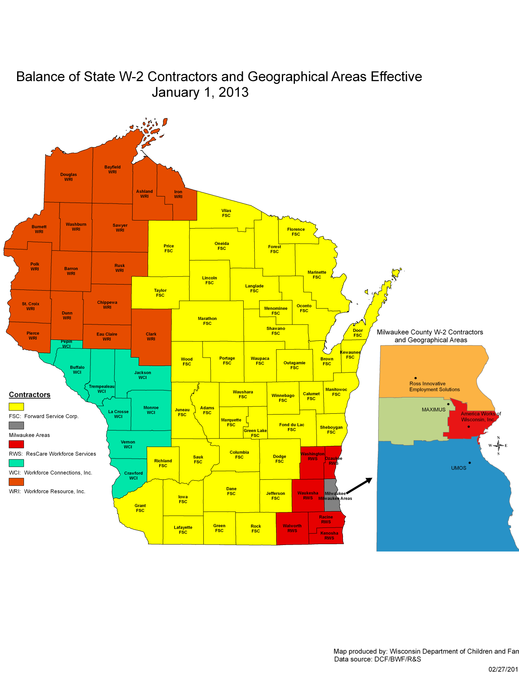
W-2 Contractors
^{dcf.wisconsin.gov}

Slide 18
SUBSIDIZED EMPLOYMENT PROGRAMS
^{dcf.wisconsin.gov}

Slide 19
Subsidized Employment
The Wisconsin Department of Children and Families (DCF) is dedicated to helping everyone who wants to work find meaningful employment. To assist parents who have traditionally faced significant obstacles to finding jobs, DCF has designed several subsidized employment programs to help in the transition to unsubsidized, family-supporting careers.
^{dcf.wisconsin.gov}

Slide 20
Subsidized Employment
TRIAL EMPLOYMENT MATCH PROGRAM (TEMP)
TEMP is a Wisconsin Works (W-2) employment position that provides vocational training and up to six months of subsidized work to custodial parents (CP) statewide and noncustodial parents (NCP) in Dane, Kenosha, Marathon and Milwaukee Counties. In addition to meeting W-2 financial and nonfinancial eligibility, unemployed individuals must:
Be a CP who has received W-2 in the last 12 months and has been in the Community Service Job (CSJ) or W-2Transition (W-2T) placement for the most recent six months; or
Be an NCP who is subject to a child support order and in compliance with the drug screening requirements of DCF 105.
^{dcf.wisconsin.gov}

Slide 21
Subsidized Employment
TRANSFORM MILWAUKEE JOBS (TMJ)
TMJ is available to low-income residents of Milwaukee County who are not eligible for unemployment insurance benefits and who are not receiving W-2 services or benefits. TMJ provides vocational education and up to six months of subsidized work to the following target populations:
General Population: Unemployed offenders, unemployed parents with child support orders, and unemployed parents of children in the child welfare system who reside within the following boundaries of Milwaukee County:
North – West Silver Spring Drive
South – West Mitchell Street
West – North Sherman Boulevard
East – Highway 43
(Program will be available Countywide starting January 2019)
Foster Population: Unemployed youth to age 24 who were in the foster care system at age 16 or older and who reside in Milwaukee County.
^{dcf.wisconsin.gov}

Slide 22
Subsidized Employment
TRANSITIONAL JOBS (TJ)
TJ is the companion program to the Milwaukee TMJ program and is operated in the City of Beloit and Ashland, Bayfield, Florence, Forest, Iron, Langlade, Menominee, Racine, Rusk and Sawyer Counties. Starting in July 2018, Adams, Clark, Jackson and Juneau Counties will also be served in the Balance of the State.
TJ is available to low-income residents in rural and urbans areas of Wisconsin who are not eligible for unemployment insurance benefits and who are not receiving W-2 services or benefits. TJ provides vocational training and up to six months of subsidized work to:
Unemployed offenders,
Unemployed parents with child support orders,
Unemployed parents of children in the child welfare system, and
Unemployed youth aging out of foster care.
^{dcf.wisconsin.gov}

Slide 23
Subsidized Employment
^{dcf.wisconsin.gov}

Slide 24
Job Access Loans and Emergency Assistance
^{dcf.wisconsin.gov}

Slide 25
Job Access Loans
Job Access Loans are short-term interest-free loans that are intended to meet immediate and discrete expenses that are related to obtaining or maintaining employment. W-2 agencies must not use JALs in place of W-2 services or other appropriate financial resources.
W-2 Wisconsin Works agency can approve a JAL from $25 up to $1,600. In any 12-month period the maximum outstanding loan balance for any individual is $1,600; however, individuals may have more than one open loan.
There is no entitlement to a JAL.
^{dcf.wisconsin.gov}

Slide 26
Job Access Loans
In order to obtain eligibility for a JAL, the applicant must meet W-2 financial and non-financial eligibility. The applicant must need the loan to address an immediate and discrete financial crisis that is not the result of the individual’s failure to accept a bona fide offer of employment or the individual’s termination of a job without good cause.
A JAL recipient must be either:
Employed and need the loan to continue employment; or
Have a bona fide job offer and need the loan to obtain employment;
There is no entitlement to a JAL.
^{dcf.wisconsin.gov}

Slide 27
Emergency Assistance
Emergency Assistance (EA) provides funding to families with a child(ren) who meet all eligibility criteria. Among other requirements, to be eligible for EA, the applicant must be experiencing a current emergency due to fire, flood or natural disaster, impending homelessness, homelessness, or energy crisis. EA is one of many housing and emergency resource programs.
^{dcf.wisconsin.gov}

Slide 28
Emergency Assistance
Maximum payment amount:
The maximum payment amount for an EA Group experiencing an energy crisis is $500 regardless of group size.
For all other emergency types the following maximum payment amounts apply:
$516 for an EA Group with 2-4 members;
$645 for an EA Group with 5 members;
$110 per group member for an EA Group with 6 or more members.
^{dcf.wisconsin.gov}

Slide 29
TANF METRICS AND PEFORMANCE
^{dcf.wisconsin.gov}

Slide 30
TANF FUNDING
Program Area | 2016-2017 JFC Approved
Total | $ 649,676,600.00
W-2 Agency Contracts and Benefits | $ 141,336,500.00
Benefits | $ 83,000,000.00
Contracts | $ 58,336,500.00
Other TANF Employment Programs | $ 7,000,000.00
TMJ/TJ | $ 7,000,000.00
Child Care | $ 329,397,900.00
Other Benefits | $ 61,173,200.00
Kinship Care | $ 21,435,000.00
CTS | $ 31,338,200.00
EA | $ 8,400,000.00
Administrative Support | $ 15,901,300.00
Other Support (Children First) | $ 1,140,000.00
Grant Programs | $ 2,591,900.00
Boys and Girls Clubs | $ 1,175,000.00
Wisconsin Community Services | $ 400,000.00
Fostering Futures – Connections Count | $ 360,300.00
GED Testing | $ 115,000.00
Adult Literacy | $ 41,600.00
Legal Services | $ 500,000.00
Other Programs | $ 91,135,800.00
EITC | $ 69,700,000.00
SSBG | $ 14,653,500.00
Child Welfare Safety Services | $ 5,392,700.00
Child Welfare Prevention Services | $ 1,389,600.00
^{dcf.wisconsin.gov}

Slide 31
Federal Performance Measures
Work Participation Rate (WPR) Background
The WPR is the required minimum percentage of families in a state’s caseload that the state must have engaged in work or work-like activities.
The WPR only applies to families on cash assistance in the Wisconsin Works (W-2) program. It does not apply to families receiving benefits or services in other TANF funded programs, nor does it apply to families in the W-2 program who are in placements that do not pay cash assistance.
Most importantly, the WPR does not recognize actual job attainment which is the cornerstone of Wisconsin’s W-2TANF program.
^{dcf.wisconsin.gov}

Slide 32
Federal Performance Measures
The TANF regulations define work activities that count toward the WPR. These work activities include:
Working Full-Time or Part-Time in Unsubsidized Employment (so long as the participant is still on cash assistance);
Work Experience;
Paid Work Experience not Funded by TANF;
Job Skills Training by itself or combined with Vocational Adult Basic Education, Vocational English-as-a-Second-Language, or Vocational Literacy;
Technical College and Technical College Study Time; and
Job Search and Job Readiness.
^{dcf.wisconsin.gov}

Slide 33
Federal Performance Measures
Two-Parent Households
For federal reporting, a two-parent household is defined as two adults with a child in common with neither parent being disabled or caring for a disabled family member.
Two-parent households that are receiving federally funded child care must participate in at least 55 hours of activity.
Two-parent households that are not receiving federally funded child care must participate in at least 35 hours of activity.
^{dcf.wisconsin.gov}

Slide 34
Federal Performance Measures
Teen Parents
Teen parents ages 18 and 19, who do not have a high school diploma, may meet their work participation requirement either through the combination of Core and Non-Core activities described above, or through participation in activities that fall under the federal definition of Satisfactory School Attendance. These activities include:
General Educational Development – GED
High School Equivalency Diploma – HSE
Regular School – K through 12
^{dcf.wisconsin.gov}

Slide 35
Federal Performance Measures
Disregarded Participants
The following participants are disregarded from the TANF WPR:
CSJ and W-2T participants who are caring for a disabled family member
CMC, CSJ and W-2T participants who are a single custodial parent with a child under 12 months of age. There is a 12-month lifetime limit on disregarding a family for this reason.
^{dcf.wisconsin.gov}

Slide 36
Important Links
Wisconsin Works (W-2) Overview: http://dcf.wisconsin.gov/w2/wisworks.htm
Wisconsin Works (W-2) Partner Resources: http://dcf.wisconsin.gov/w2/partner.htm
W-2 Manual: http://dcf.wisconsin.gov/w2/manual/default.htm
Wisconsin Works (W-2) Agency Directories (Includes Interactive Agency Locator): http://dcf.wisconsin.gov/w2/directories.htm
Acronyms and Definitions (from the 2013 W-2 Contracts) http://dcf.wisconsin.gov/w2/rfp/2013/attachments/exhibit4.pdf
^{dcf.wisconsin.gov}

