Slide 1
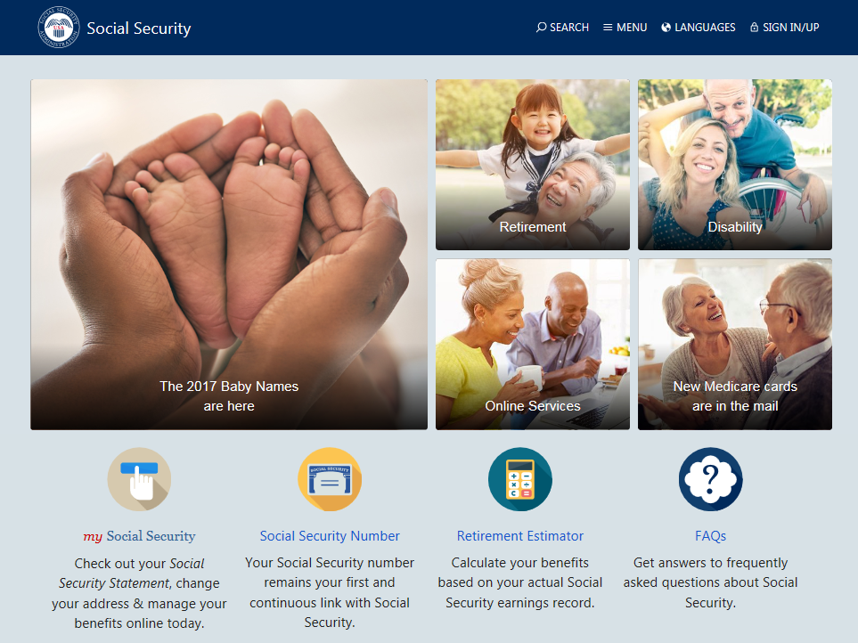
Wisconsin Balance of State Continuum of Care
Quarterly Meeting
May 17 2018
Social Security: Exploring the Benefits
Connie DaValt
Area Work Incentives Coordinator
November 2016
Connie DaValt – Area Work Incentives Coordinator
(866) 807-5995 ext 26030
connie.davalt@ssa.gov

Slide 2

Today’s Topics
Social Security Disability Insurance (SSDI)
Supplemental Security Income (SSI)
The Disability Process
Medical Reviews
Work Incentives

Slide 3
Social Security’s
Benefit Programs
RSDI/SSDI
Retirement,
Survivors, Disability Insurance
Medicare*
SSI- Supplemental Security Income
Medicaid*
Concurrent

Slide 4

Social Security Disability Insurance (SSDI)
Benefits paid to disabled workers and their families.
Qualified individuals will…
Have a disability according to SSA rules.
Have a ‘current connection’ to the work force – meet established work requirements
Paid from the Social Security trust funds (FICA contributions)

Slide 5

How much is a SSDI benefit?
Different for each wage earner
Based on the individual’s average lifetime covered* earnings
* Earnings on which FICA taxes were paid

Slide 6

When does the SSDI benefit begin?
A State agency applies SSA rules and determines when the disabling condition began (Date of Onset).
5 month waiting period during which no benefits are payable.
SSDI benefits can be paid retroactively (up to 12 months prior to the date of filing)
Benefits are paid the month after they are due. (i.e. April check paid in May)

Slide 7

Work Credits
When you work and pay Social Security taxes, you earn up to a maximum of 4 work credits each year
Work credits are based on the total amount of your wages or self-employment income during the year
The amount of earnings needed to earn a work credit changes each year
2018 – one work credit is $1320

Slide 8
Work Requirements for Disability
Before age 24
1-1/2 years of work in a 3 year
period before becoming disabled
Age 24-31
  work during half the time between age
  21 and the time the disability began
  Age 31 or older
  work during 5 out of the 10 years before the disability began

Slide 9

Social Security Benefits for your Family
Additional benefits may be payable to:
Unmarried children, under age 18
Unmarried children, age 18-19 and still in high school.
Unmarried children, any age with a disability which began prior to age 22.
Spouse, age 62 or older
Spouse, any age if caring for a child under age 16 (or a child of any age who has a disability)
Note: Benefits paid to family members are limited to a ‘family maximum’ and will not lower the benefits paid to the wage earner.

Slide 10



Supplemental Security Income (SSI)
People with limited income and resources can be eligible for SSI if they meet the following criteria:
  Blind at any age or
  Disabled at any age or
  Age 65 or older
Paid from general tax revenues
Medicaid

Slide 11

SSI Financial Eligibility
2018 Rates
Have low income and resources
  “Countable” income:
    Less than $750.00 per month
  “Countable” assets:
    $2,000.00 for single person
    $3,000.00 for couple

Slide 12

SSI
Eligibility can begin the month after Social Security is contacted (but we still need to wait for a medical decision)
Checks come on the 1st of the month for that month
Medicaid (MA) begins with the first month of eligibility (sometimes earlier)

Slide 13

What Affects SSI Eligibility and
Payment Amounts?
Unearned income ($20 general disregard)
Earnings from work ($20/$65 earned income disregard then $1 for every $2 excluded)
Deemed income
Assets and resources

Slide 14
Example
Bob receives SSDI of $320.00 mo
Income:
$320 SSDI
- 20 general income exclusion
$300 countable income
SSI benefit:
$750.00 SSI Federal Benefit Rate (FBR)
- 300.00 countable unearned income
$450.00 SSI payment amount
Bob receives a total of $770.00 mo

Slide 15


Deemed Income
SSA considers a portion of the income of a “living with” spouse (or parents) available to the SSI recipient
SSA ‘deems’ income from:
  Ineligible parent(s) to child recipients under age 18, living at home
  Ineligible spouse to recipient spouse, living together

Slide 16

SSI Resources
Resource limits
  — $2,000 for individual
  — $3,000 for couple
  We count the following resources:
  Liquid assets: cash, bank accounts (CDs, IRAs), stocks and bonds, 401Ks
  Second vehicle/Property other than where you live
  We don’t count the following resources
  Home in which you live
  One vehicle
  Life insurance (face value under $1500)
Some resources set aside for burial
Household goods and personal effects

Slide 17




The Disability Process

Slide 18

Disability - Adult
Must have a condition or impairment which is expected to last more than a year or end in death which does not allow you to earn over the Substantial Gainful Activity (SGA) threshold
SGA limit for 2018 $1180 mo

Slide 19

Disability - Child
Must have a physical or mental condition that very seriously limits his or her activities which is expected to last at least 1 year or result in death.

Slide 20

Disability Determination
A determination of disability is made by the State Disability Determination Bureau (DDB). DDB collects medical records from doctors, hospitals, schools and others who know about the disability.
A disability determination may take 4-6 months

Slide 21

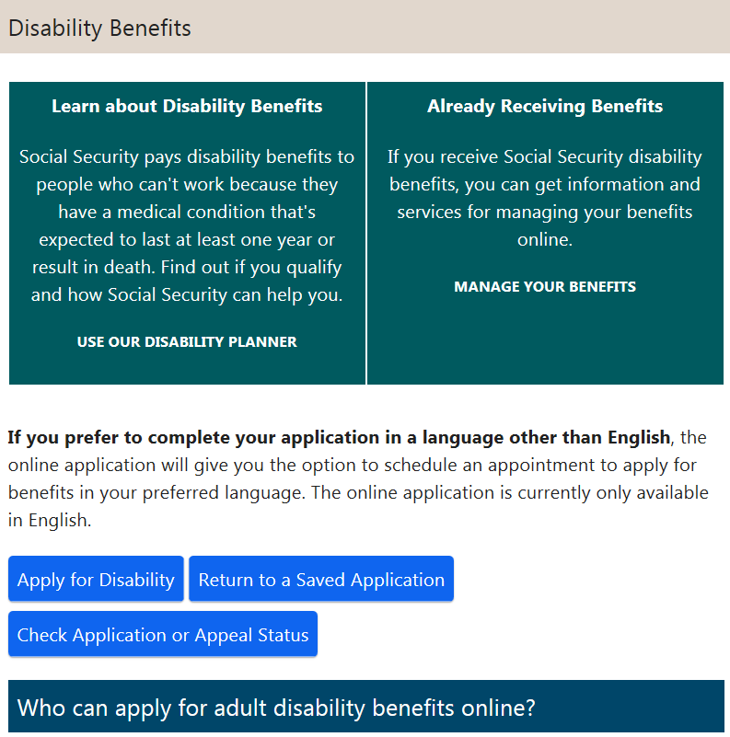
How to Contact SSA for a Disability Application
Begin Online
SSDI and Medical portion
(SSA will contact you for SSI application. If you don’t hear from SSA within 1 week, call to set up the SSI appointment)
Phone 1-800-772-1213
7am – 7pm
In office interview (with appointment)

Slide 22
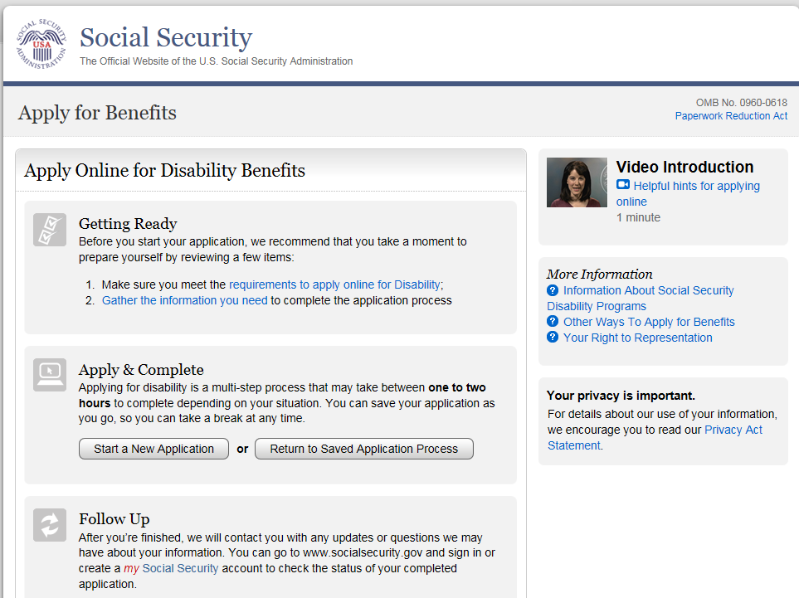
How to file a Disability Application: http://www.socialsecurity.gov/pgm/disability.htm

Slide 23
What Happens After You Complete the Application
Social Security will forward your application to the State Disability Determination Bureau (DDB)
DDB will contact your medical providers to obtain your medical records
DDB may ask you to provide additional information about how your condition affects your daily activities

Slide 24

And Then What?
If adequate information is available
in existing records, along with your statements, the DDB will make
a decision
DDB may ask you to have a
special examination at our expense
if more information is needed about your disabling condition

Slide 25

If Your Claim Is Allowed
We will send you an award notice that explains:
When your benefits start
Your monthly benefit amount
Information you need to report to us
    Work Activity
    Medical Improvement
What to do if you have questions
When your case will be reviewed

Slide 26

If Your Claim Is Denied
You will get a letter explaining our decision
You may appeal the decision within 60 days after you receive our notice
    Reconsideration
    Hearing
    Appeals Council
You will need to update information that
has changed

Slide 27
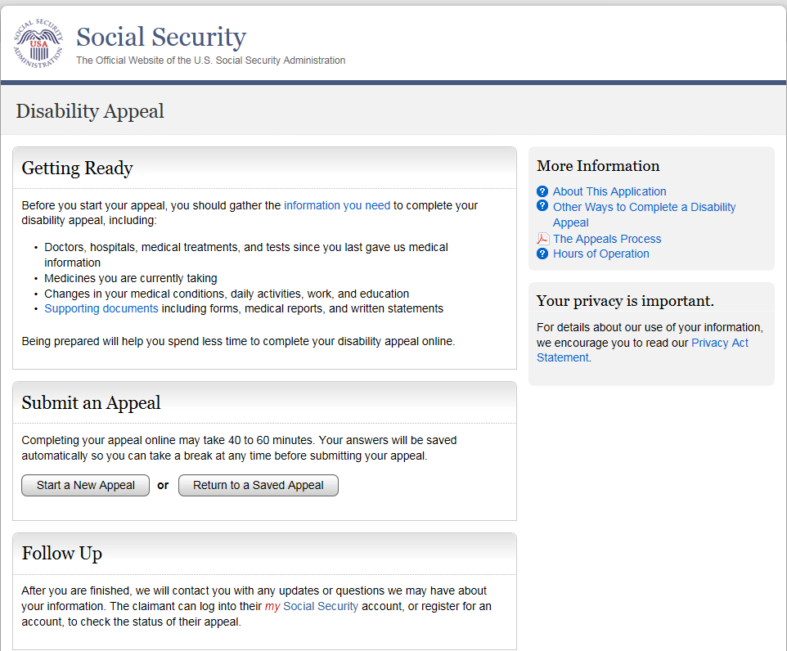
Appeal On-Line

Slide 28

Medical Continuing Disability Review
Legislation requires that SSA review the medical condition of all disability beneficiaries (every 1-7 years)
During the disability review, we will obtain information about…
Medical Sources
Medical tests/procedures
Medications
Work Activity

Slide 29

Transitioning from Benefits to Work
How work affects SSDI and SSI benefits
Work Incentives and Employment Supports
Benefits Planning

Slide 30
What are Work Incentives and Employment Supports?
Agency initiatives designed to provide long term assistance to beneficiaries that want to work.
Apply to both SSDI and SSI
Incentives that test the ability to work.
Ongoing support as work continues, with the goal of self-sufficiency.
Incentives that offer the ability to keep benefits and Medicare/Medical Assistance while working.

Slide 31
What scares SSI and SSDI recipients who want to work?
New Job ?!? New Vocational program ?!? Change scares people!
Reduced Benefit Check ?!? No Benefit Check ?!?
Discontinued Medicare/Medicaid ?!? No Healthcare Coverage ?!?
OVERPAYMENT ?!?
Sure these things are scary, but a lot less scary when you know some basic program rules and PLAN!

Slide 32

Let’s look at some SSDI Work Incentives:
9 month Trial Work Period
SGA - Impairment Related Expenses, Subsidy, Unsuccessful Work Attempts
36-Month Extended Period of Eligibility
Extended Medicare

Slide 33
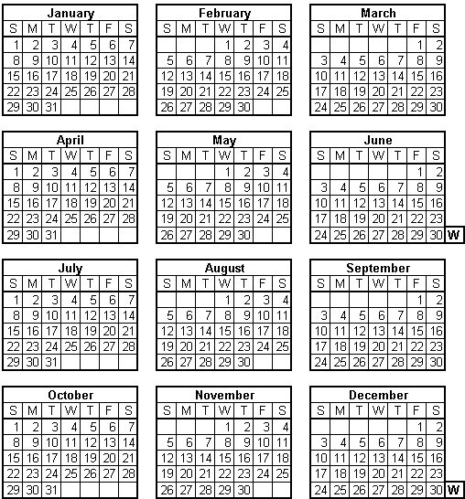
Trial Work Period
  Time to test ability to work
  Current Trial Work Period (TWP) guidelines = $850 in monthly gross earnings
  9 Months, not necessarily consecutive
  Full benefit continues regardless of earnings

Slide 34

Trial Work Period Example – Joe
Joe becomes disabled in January 2013. In March 2014 he decides to return to work earning $1200 month.
Joe’s Trial Work Period:
Joe will receive his entire SSDI check during his TWP!
2014 | JAN | FEB | MAR | APR | MAY | JUN | JUL | AUG | SEP | OCT | NOV | DEC
 |  |  | TWP1 | TWP 2 | TWP 3 | TWP4 | TWP5 | TWP6 | TWP7 | TWP8 | TWP9

Slide 35
Substantial Gainful Activity
The performance of significant & productive work for pay.
Current Substantial Gainful Activity (SGA) Earnings Guidelines
  $1180/month
  $1970/month for Blind Individuals
The first month of SGA after the end of the TWP is called the Cessation Month
Benefits are paid for the Cessation Month and two grace months

Slide 36

Cessation Example - Joe
Joe continues to work, earning $1200/mo
  12/14 Cessation Month
  01/15 Grace Month
  02/15 Grace Month
2014 | JAN | FEB | MAR | APR | MAY | JUN | JUL | AUG | SEP | OCT | NOV | DEC
 |  |  | TWP 1 | TWP 2 | TWP 3 | TWP 4 | TWP 5 | TWP 6 | TWP 7 | TWP 8 | TWP 9 | C
2015 | JAN | FEB | MAR | APR | MAY | JUN | JUL | AUG | SEP | OCT | NOV | DEC
 | G | G
Joe receives his full SSDI benefit
From 03/14 – 02/15 while working

Slide 37
How SSA evaluates an employee’s work and earnings and decides if they are at the SGA-level
Start with Gross Earnings
Deduct
  Impairment-Related Work Expenses (IRWE)
  (Medications/Transportation/etc : related to the Disability, necessary for work, paid for out of beneficiary’s pocket)
  Subsidy and Special Conditions
  (Consider the value of the work)

Slide 38


Extended Period of Eligibility (EPE)
  Consecutive 36 months following the end of the TWP
  Benefits paid for months where earnings are < SGA ($1180)
  Benefits suspended for months where earnings are > SGA ($1180)

Slide 39
EPE Example - Joe
2014 | JAN | FEB | MAR | APR | MAY | JUN | JUL | AUG | SEP | OCT | NOV | DEC
 |  |  | TWP 1 | TWP 2 | TWP 3 | TWP 4 | TWP 5 | TWP 6 | TWP 7 | TWP 8 | TWP 9 | EPE C
2015 | JAN | FEB | MAR | APR | MAY | JUN | JUL | AUG | SEP | OCT | NOV | DEC
 | EPEG | EPE G | EPE 4 | EPE 5 | EPE 6 | EPE 7 | EPE 8 | EPE 9 | EPE 10 | EPE 11 | EPE 12 | EPE 13
2016 | JAN | FEB | MAR | APR | MAY | JUN | JUL | AUG | SEP | OCT | NOV | DEC
 | EPE 14 | EPE 15 | EPE 16 | EPE 17 | EPE 18 | EPE 19 | EPE 20 | EPE 21 | EPE22 | EPE23 | EPE24 | EPE 25
2017 | JAN | FEB | MAR | APR | MAY | JUN | JUL | AUG | SEP | OCT | NOV | DEC
 | EPE 26 | EPE 27 | EPE 28 | EPE 29 | EPE 30 | EPE 31 | EPE 32 | EPE 33 | EPE 34 | EPE 35 | EPE 36
Joe’s EPE: 12/01/2014 - 11/30/2017
We can resume Joe’s benefits if his earnings fall below SGA during
this period

Slide 40
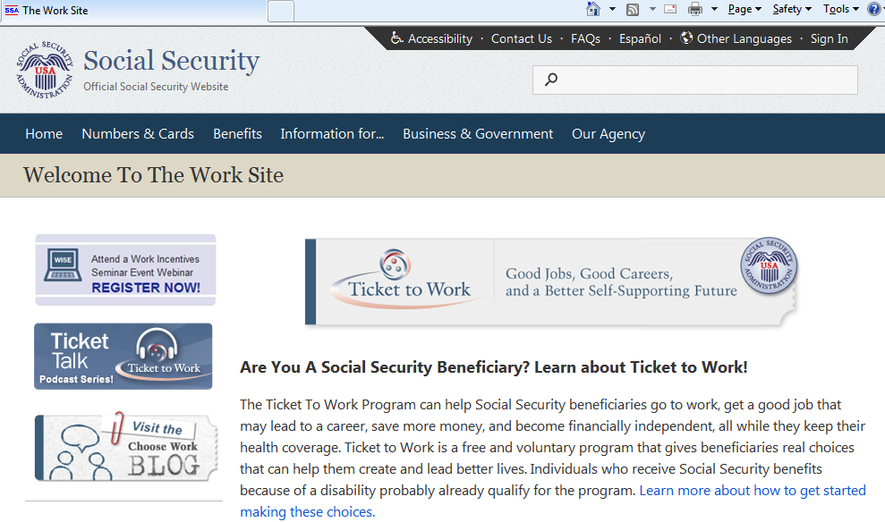
Ticket to Work
Ticket to work can be used to obtain free employment support services from an Employment Network or State Vocational Rehabilitation Agency

Slide 41

Ticket to Work
All SSDI/SSI beneficiaries (ages 18-64) are assigned a Ticket to Work
The ticket may be assigned to an employment network (EN) to receive employment services
Voluntary program
An EN can be a state, local or private organization
Beneficiaries “making progress” using their ticket will not be scheduled for a Continuing Disability Medical Review
www.yourtickettowork.com

Slide 42

Employment Networks (EN)
EN’s can provide:
counseling and guidance
job placement services
job coaching
other support services to help client enter and retain employment

Slide 43
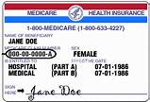
Continuation of Medicare
  Individuals with disabilities who work will continue to receive at least 93 consecutive months of Medicare after the nine month trial work period
  Claimant can choose to purchase coverage

Slide 44

SSI Work Incentives

Slide 45

Let’s look at some
SSI Work Incentives
Earned Income Exclusion
Student Earned Income Exclusion
Continued Medical Assistance under 1619(b)

Slide 46
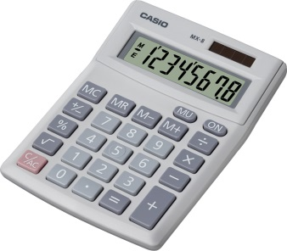
SSA Doesn’t Count All of Your Income...
General Income Exclusion of $20
Deducted first from unearned income
Earned Income Exclusion
$65 per month - plus 1/2 of the rest
It Pays to Work!
2018 SSI Federal Benefit Rate $750

Slide 47

SSI Earned Income Example
Dorothy receives SSI benefits of $750 mo, she starts working and earns $1285 mo
$1285 – 85 = 1200/2 = $600 countable income
SSI rate $750 - $600 = $150 SSI payment
Dorothy’s income :
$1285 (wages) +$150 (SSI) = $1435

Slide 48

SSI – Student Exclusion
Under age 22
“regularly attending school”
  Could be high school or college
  Could be home study or work study
2018 maximum exclusion of $7350 per year or $1820 per month

Slide 49

Student Status
“Regularly attending School” means the person takes one or more courses of study and attends classes:
    In a college or university for eight (8) hours a week,
OR
    In grades 7-12 for twelve hours a week;
OR
    In a training course to prepare for employment for 12 hours a week (15 hours per week if the course involves shop practice)’
OR
    For less time indicated above for reasons beyond control, such as illness.

Slide 50

Continued Medical Assistance
Section 1619 (b)
When work earnings reduce SSI payments to zero, MA will continue if yearly wages are below the “threshold”
2017 Wisconsin = $33,173
Individual Thresholds can be higher based on an individual’s actual MA use

Slide 51

Social Security and Representative Payee
Does the beneficiary need help managing their money?
Evidence of capability:
Legal
Lay
Medical
Payee preference:
Legal guardian
Parent
Relative
Friend
Agency

Slide 52

Social Security On-Line Services
If you are not receiving benefits:
Apply for benefits
Get your Social Security Statement to review:
  estimates of your benefits
  your earnings record
  Social Security and Medicare taxes you’ve paid
Request a replacement Social Security Card

Slide 53

Social Security On-Line Services
If you are receiving benefits:
Get your benefit verification letter
Change your address and phone # (SSDI)
Start or change your direct deposit
Get a replacement SSA 1099
Get a replacement Medicare card
Report your wages (SSDI)

Slide 54
Who else can help?
Work Incentives Planning and Assistance (WIPA)
Community based organizations that work to enable beneficiaries to make informed choices about work and to support working beneficiaries to make a successful transition to financial independence
WI WIPA – Employment Resources Inc. (877) 242-1357
Disability Benefit Specialists
DBSs are in every county in WI. They are available to help answer questions, file applications and solve problems related to Social Security, Medicare, health insurance and other benefits for people with disabilities between the ages of 18-59
www.dhs.wisconsin.gov/disabilities/benspecs/program.htm

Slide 55


