Slide 1
Youth Homeless Demonstration Project (YHDP) Coordinated Community Plan and Next Steps
Leigh Polodna, Grant Specialist, WI BOS CoC
Carrie Poser, CoC Director, WI BOS CoC
December 2021

Slide 2
Agenda
Introduction
What makes YHDP work different from other HUD funding
Requirements of the CCP
Next Steps for the WI BOS
HUD Exchange Tour
Questions

Slide 3
What Makes YHDP Different from other HUD funding?
A focus on authentic engagement from youth with lived expertise of homelessness
As planners, decision makers, and leaders
Focus on specific values & principles
Equity, family engagement, housing first, positive youth development & trauma informed care, unsheltered homelessness, youth choice, individualized & client driven supports, Social and community integration, coordinated entry, and focus on special populations of youth
The Coordinated Community Plan (CCP) requirement
Intentional time is set aside for local planning on how we will prevent and end homelessness
Plan must be approved by HUD before access to project funding is made available
YHDP comes with robust and intensive Technical Assistance as support and capacity building

Slide 4
Required Components of the Coordinated Community Plan (CCP)
What they are; What we have; What we need

Slide 5
YHDP and the CCP
You can find this information in Appendix B of the Notice Of Funding Opportunity:
https://www.hudexchange.info/programs/yhdp/
The purpose of the YHDP funds is to demonstrate how a coordinated community approach to serving homeless youth, age 24 and younger, can dramatically reduce homelessness.
This Coordinated Community Plan is going to lay out how we will do that as well as the community’s vision, how decisions will be made, what the current need is, what the community’s goals are and ideas on how we will achieve those goals. It is more than just a plan about how we will spend the funding.
We will be looking at this from two different lenses. First, you will need to be meeting with local partners in your community and essentially filling out the CCP for your coalition/region. Then we will be coming together to consolidate all the coalitions/regions for one BOS Community CCP.
The CCP will be a hybrid approach

Slide 6
In order to apply for the $7.5 million…
You must:
The CCP needs to have active participation from stakeholders and youth. If a coalition does not participate in the development of the CCP, the coalition will not be eligible to apply for project funds.
For a community to be eligible for project funding there must be a Youth Action Board, whether local or regional.
Must produce an MOU from PCWA.
Must produce a letter of support from an elected official.
Must produce a letter of support from a RHY provider if eligible.
Must have your own local CCP.
Include the YHDP Principles and Values in everything that you do, including a potential project.

Slide 7
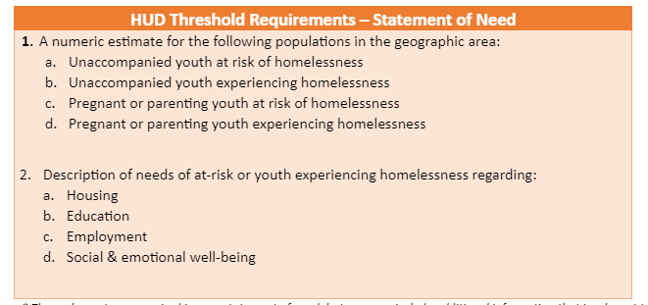
Statement of Need (Information from Appendix B and CCP Template Document which was shared from TA Providers)
A statement of need concerning at risk, homeless and unsheltered unaccompanied and pregnant or parenting youth in the geographic area. This statement describes the experiences of youth homelessness in your community and establishes the reasons why the community must work to prevent and end youth homelessness. It identifies gaps and problems within the community through data, including anecdotes.
For WI BOS we will need to have a statement of need locally and then a CoC statement that incorporates the local statements of need.

Slide 8
Statement of Need
Questions to Consider:
How can you create an inclusive data collection and review process?
Develop a plan for collecting qualitative and quantitative data (e.g., HMIS, focus groups, census data)
What is missing from the data that you have, and what might be sources to learn more?
What data can partner systems (child welfare, education/school districts, juvenile justice, health) provide related to homelessness and housing instability for youth?
In what ways might you disaggregate data to understand racial and other disparities?
How will you determine if the data matches the experience of young people who have been through or are currently accessing the homeless response system?
How can you directly incorporate the experiences of young people into your statement of need?
Read Key Component #1 - YHDP Foundations & Beyond: Coordinated Community Plan

Slide 9
Statement of Need
What we have so far from application
Multiple contributing factors to youth homelessness
A rough idea of the current capacity
Examples of regional work being done
Some data sources:
Outcomes from TRA agencies
WI DCF and HMIS data match from 2005-2013
Racial Disparity Assessment
HMIS data for 2020
PIT data (January 2020)

Slide 10
Statement of Need
What we still need
*Updated Current capacity
*Answers to the Questions to consider, specifically process.
*Are there other initiatives that have started since getting funded for YHDP?
*Updated data
*Updated HMIS data
*Updated PIT information-July 2021 will not be fully vetted, but could use as a baseline
*Request an updated DCF/HMIS foster care data match
*Regional data

Slide 11
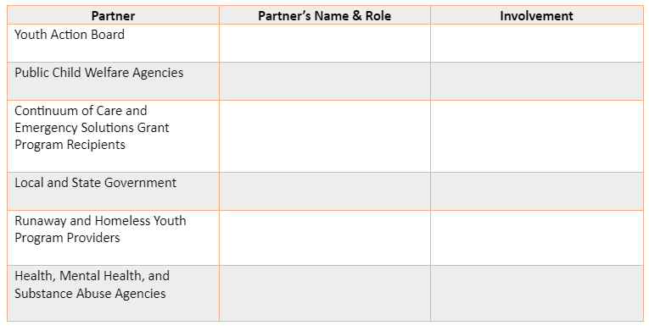
Stakeholders
A list of partners, and a description of their involvement that includes representation from a number of stakeholder groups. Effectively addressing youth homelessness will require coordination, collaboration and innovation from a wide range of cross-system stakeholders:
Youth with lived experience (YAB members)
Public Child Welfare Agencies *We will need these stakeholders both locally and CoC level
School districts
Institutions of higher education
workforce development organizations
Juvenile and Adult Corrections and Probation
Organizations that represent cultural and racial diversity of youth in your community
CoC and ESG Program Recipients
Early childhood Development and child care providers
Local and State Government
RHY Providers
Health, Mental Health and Substance Abuse Agencies
Local and State Law enforcement and Judges
Public Housing Authorities
Affordable Housing Providers
Non-Profit Youth Organizations
Landlords
Privately Funded Homeless Organizations
Community Development Corporations
Local Advocacy, Research and Philanthropic Organizations

Slide 12
Stakeholders
What we have
Public Child Welfare Agencies signed letters from most coalitions
Signed letter from Department of Children and Families to cover the rest
Department of Public Instruction signed letter of support
CoC and ESG Recipients
Non-Profit Youth Organizations
RHY Providers
Organizations that serve culturally specific communities

Slide 13
Stakeholders
What we need:
*Local and State Government
*Health, Mental Health and Substance Abuse Agencies
*Juvenile and Adult Corrections and Probation
*Local and State Law Enforcement and Judges
*Public Housing Authorities
*Affordable Housing Providers
*Early Childhood Development and Child Care Providers
*Institutions of higher education
*Landlords
*Privately funded homeless Organizations
*Local Advocacy, Research and Philanthropic Organizations
*Community Development Corporations

Slide 14
Mission and Vision
We need a shared mission, vision, list of goals, objectives and action steps, including which partners are responsible for each action step. Having a mission and vision gives the group a common goal to vision and blueprint of where we are going and lets everyone know what they should be doing.

Slide 15
Mission and Vision
Questions to consider:
Why are we here?
What are we trying to do?
What is the world we are trying to create?
What are our collective core values in ending youth homelessness?

Slide 16
Governance
We need to have a governance structure, including an organizational chart and decision making process. Having a documented YHDP governance structure will help the community address system-level challenges in moving forward the work to end youth homelessness. Documenting the decision-making process, including who is involved in decision making and how disagreements will be managed, increases transparency and accountability to community partnerships.
Your YHDP governance structure may rely on an existing structure (e.g., an existing CoC youth committee) or create a new one to account for the breadth of stakeholders involved in the YHDP process. Regardless, it is helpful for your YHDP governance structure to be connected in some way with your CoC governance structure to ensure smooth approval of your CCP and selected YHDP projects, and to support YHDP projects after their two-year demonstration period when they are renewed as regular CoC projects. You might also utilize a similar structure to the one used when you were planning to submit your YHDP application.

Slide 17
Governance
Questions to consider:
Who is involved in decision making and what role do they play?
How are homeless coalitions represented?
What power does the Youth Action Board hold?

Slide 18
Governance
What we have
Youth Service Provider Committee/CCP Workgroup
YAB structure outline (Regional/BOS)
Coordinated Entry Committee
Diversity, Equity and Inclusion Committee
Discharge Planning Committee
WI BOS Board of Directors

Slide 19
Governance
What we need
*YAB structure functioning (local and CoC)
*A more established decision-making structure
*Governance Chart

Slide 20
List of Projects
We need a list of new projects to be funded by HUD and other sources that will support the implementation of the CCP. Using data from your statement of need, the community should go through an intentional process to identify gaps in the youth homeless response system and overall coordinated community response to youth homelessness. If the community does not already do a youth gaps analysis, our assigned TA provider can facilitate system modeling sessions to determine need.
At this part of the planning phase, the community is documenting which overall project types will meet the needs of gaps in the youth homeless response system. It is not expected that you will be able to include the specific projects that agencies will operate after you complete the procurement process (e.g., Rapid Rehousing has been identified as a project type, but who will administer the RRH project(s) has not yet been determined).
Please see Appendix A for more details about what the requirements are for a project.

Slide 21
List of Projects
Things to consider:
Determine existing strengths and gaps in your youth homeless response system.
Use a system modeling process to identify what & how much of each housing & service project are needed (your TA providers can help you with this!)
Use a participatory design process to include all stakeholders, especially youth leaders, in developing project descriptions.
Be detailed in how the projects should be designed so that funded projects are implemented in alignment with decisions made during the planning process.
Carry this work into the RFP process to identify project recipients/subrecipients.

Slide 22
Signature Page
The CCP is designed to be a full-scale plan for preventing and ending youth homelessness and because it will take more than homeless service system to accomplish the end state, cross-system partners are critical to the work. A signature page that includes the signatures of official representatives of at least the following systems:

Slide 23
Signature Page
Things to consider:
Acknowledge and engage required partners early in the planning process. Help them envision their role in the YHDP work.
Inform required partners about the YHDP award as soon as the CoC receives notification & explain the planned community-wide approach to developing the CCP.
Determine who will sign on behalf of each required entity.
Coordinate with the YAB to determine if all members will provide a signature or if a set of representatives will sign in support.
Invite required partners to your planning tables & go to their planning tables with the goal of building partnerships that benefit all involved partners and the young people they serve.
Pro-tip: Do not wait until your CCP is final to ask for partner review & signature!

Slide 24
YHDP Values and Principles Click here for more information about any of these principles
Equity
Special Populations
Positive Youth Development & Trauma-Informed Care
Family Engagement
Housing First
Unsheltered Homelessness
Youth Choice
Individualized and client-driven supports
Social and Community Integration
Coordinated Entry

Slide 25
Next Steps
We will be starting to meet biweekly through the Youth Service Provider committee.
Poll questions to schedule meetings.
January-March we will need to be hitting the ground running and starting the work of gathering the pieces we need to write the plan.
Active local/regional meetings to start filling out the CCP for your local community
Active local Youth Action Boards meeting regularly

Slide 26
HUD Exchange Tour
YHDP Home Page: https://www.hudexchange.info/programs/yhdp/
Community Resources Page: https://www.hudexchange.info/programs/yhdp/community-resources/#resources
Other Communities’ CCPs: https://www.hudexchange.info/programs/yhdp/community-resources/#yhdp-coordinated-community-plans

Slide 27
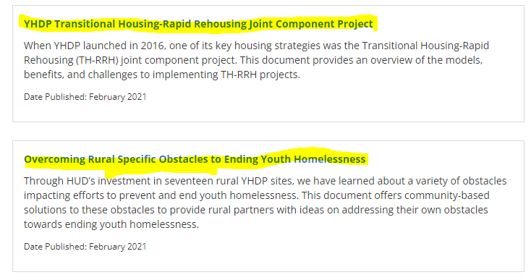
HUD Exchange Tour
Key Things to Watch/Read

Slide 28
What you need to do next:
Read Appendix B of the YHDP NOFO*
Read Appendix A of the NOFO
Watch the Youth Collaboration 102 and 201 Roadmaps
Read Youth Action Board Pathways to Leadership
Take a look at Montana and Nebraska’s Plans
Take a look at NCHE’s Incorporating Education in CCP
Read YHDP TH-RRH Joint Component Project document
Anything else that looks interesting on the YHDP Community Resources Page
Send the google survey to youth interested in participating in the YAB

Slide 29
Questions??

Slide 30
Contact Information
Carrie Poser Leigh Polodna
CoC Director Grant Specialist
Carrie.Poser@wibos.org Leigh.Polodna@wibos.org
715-598-3301 608-406-9757

